Slide 1
Building Airtight? Ventilate Right The Importance of MVHR
Craig Brooke
ADM Systems
Relax!
ADM have all your heat recovery ventilation needs covered!

Slide 2
Who are ADM Systems?
One of the pioneers in heat recovery ventilation - core competence since the early 1990s
Completely independent not limited to any one manufacturers product range
Select from a range of SAP Appendix Q products including Passive House certified
Services include full CAD design, supply, installation, technical support commissioning and balancing and maintenance
Network of UK based NICEIC accredited ventilation installers

Slide 3
Key components when considering the thermal strategy for your build
Fabric First, Insulation, Air Tightness 10 v 0.6
Heating
Ventilation

Slide 4
Why is ventilation a key consideration in the thermal strategy of a house?
Pre-Covid in an airtight house, up to 30% to 40% of total heat loss can be contributed by uncontrolled ventilation
It’s a requirement of Part F and Part L of the Building Regulations for England & Wales, or Scottish Domestic Technical Handbook Section 3.14
Indoor air quality, condensation control (we spend around 90% of our time indoors)
Normally required in a Passive House due to the level of airtightness being achieved

Slide 5
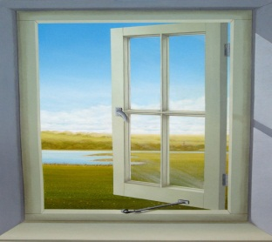
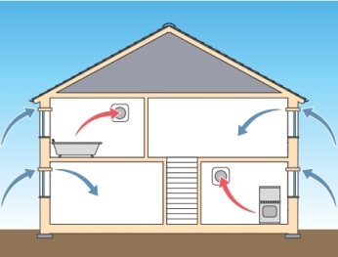
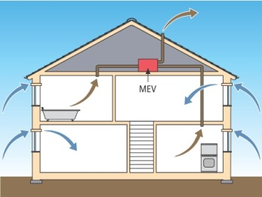
Non MVHR Extract Only Options 2022 Regulations
Opening windows
Does not satisfy Building Regulations (Summer Purge only)
Intermittent Extract fans and trickle ventilators. Only suitable for less airtight properties
Continuous Extract (MEV or dMEV) and trickle ventilators

Slide 6
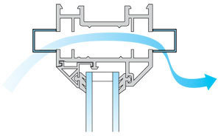
Extract Only Options
Extract fans and continuous extra approaches all require trickle vents in windows (or airbricks)
Cold draughts make us feel less comfortable (wind chill)
Tendency is to turn up heating to compensate

Slide 7
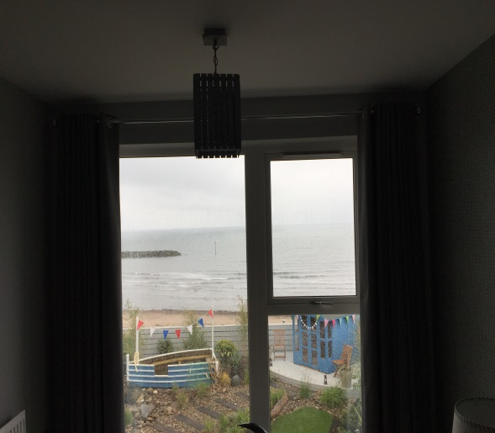
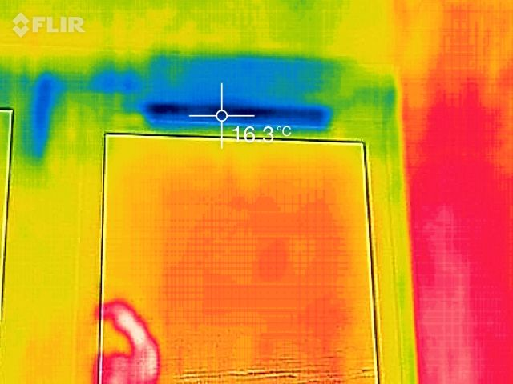
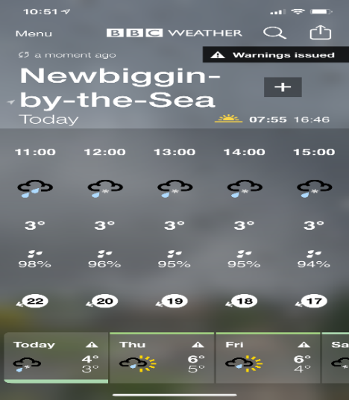
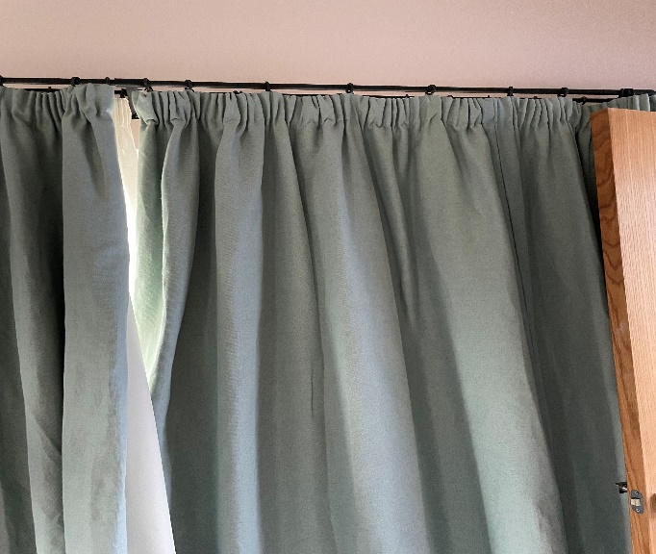
Impact and Flaws of Trickle Vents
3ºc 95% humidity

Slide 8
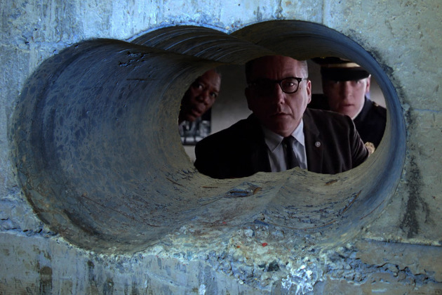
Ahhh! So THAT’s where all our heat is disappearing to??!

Slide 9
Mechanical Ventilation with Heat Recovery (MVHR)
How does it work and what
are the benefits?

Slide 10
What is MVHR?
NOT a heating system, but compliments heating system by considerably reducing heat losses.
NOT an air conditioning system! Some cooling products are available to offer tempering of air.
It is a balanced and controlled whole house forced air ventilation system
Supplies a constant supply of filtered fresh air and extracts the stale air within your property
Recovers most of the heat you generate within your home which lowers energy costs
No Requirement for Trickle Ventilators

Slide 11
How does MVHR Work?
Uses heat from “warm areas” of the building, and transfers this to other areas. Warm areas can be “wet rooms”, but also South facing rooms, double height areas, wood burning stove
In the summer months a bypass system allows fresh, filtered air to be introduced without being heated by the heat exchanger.

Slide 12
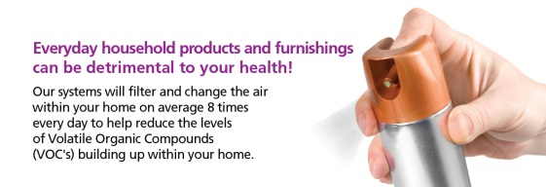
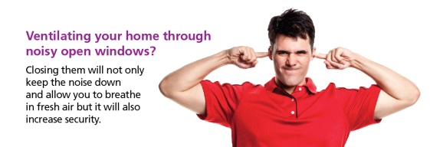
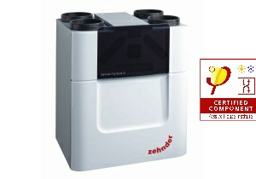
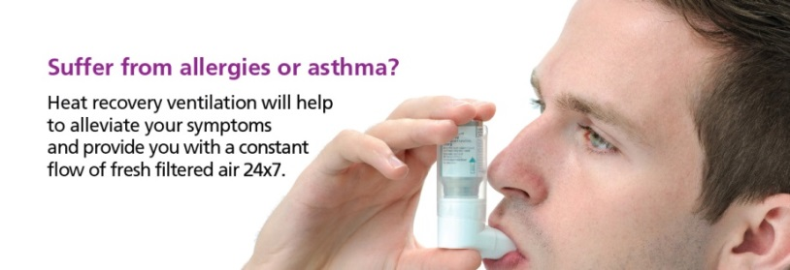
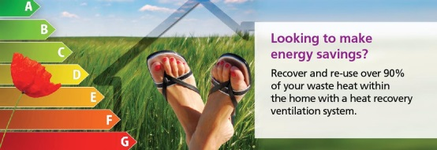
MVHR – Comfort and Good Air Quality

Slide 13
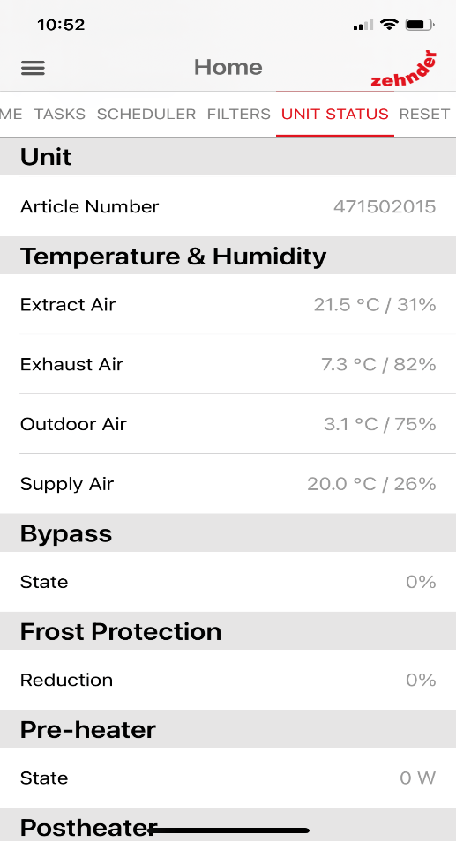
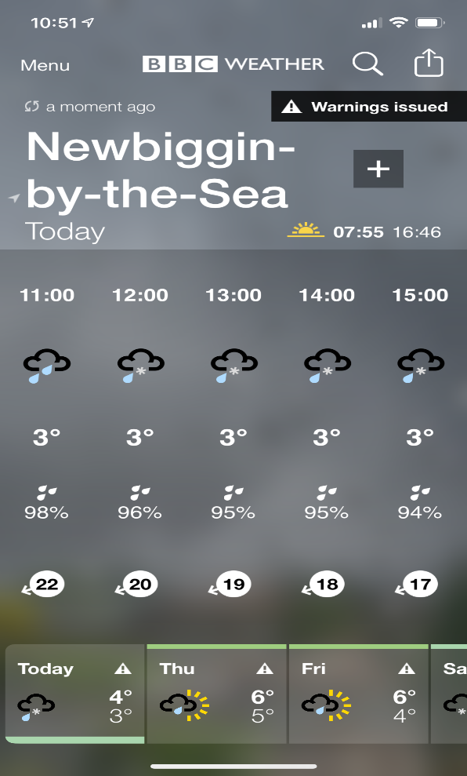
MVHR effect v Extract Only effect
Non MVHR House Northumberland
MVHR House in
Northumberland

Slide 14
Mechanical Ventilation with Heat Recovery (MVHR)
The Ventilation Design Process
(What’s involved)

Slide 15
MVHR: Design Considerations
Summary of Design INPUTS
Geographic location i.e. Building Regulations that are to apply
Floor area and building volume
Air permeability (air tightness of building – normally on SAP calculation)
Construction type (traditional block/brick, SIPS, ICF, timber frame etc.)
Building layout (vaulted areas, joist type, glazing/solar gain)
Unit location (maintenance/access)
Control strategy (integral humidity sensors, remote/wired manual controls)
System integration (app control, Building Management Systems, wood burning stoves, cooker hood type, internal door undercut)
External terminal considerations i.e. north-facing air intake, planning restrictions etc
Summary of Design OUTPUTS
Unit(s) specification
Ducting routes and types including any sound attenuation requirements
Building air changes per hour
Individual room airflow rates highlighting air changes per hour
Power consumption (dictates running costs)
Filter replacement cost and future maintenance costs

Slide 16
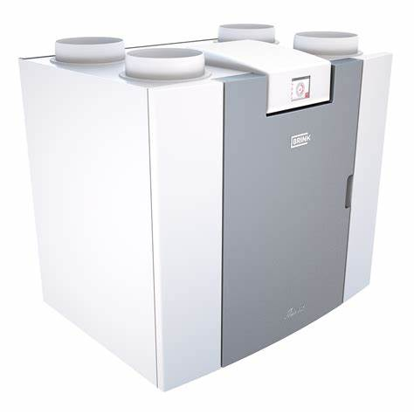
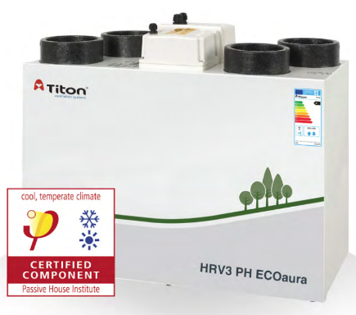
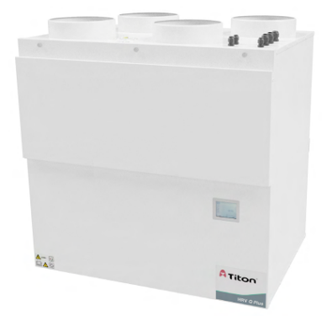
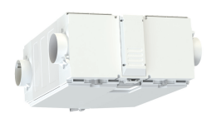
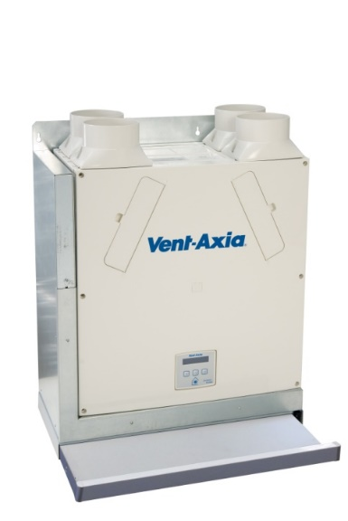
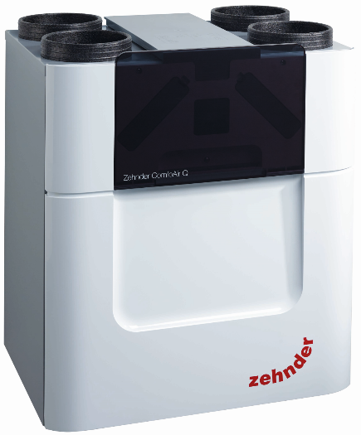
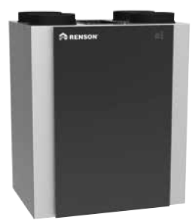
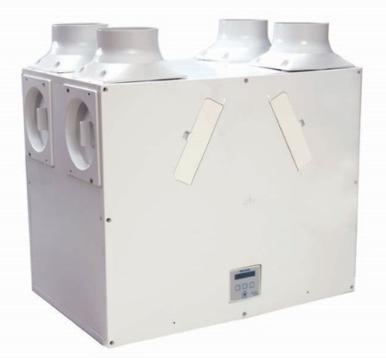
MVHR: Selecting the unit(s)
Units – suitability, air flow performance, cost, thermal efficiency, power consumption, control options, user friendliness, durability, consumables
Notes:
16

Slide 17
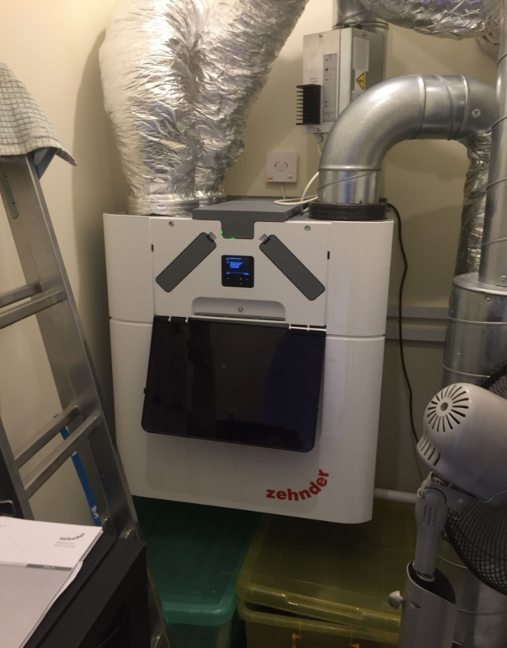
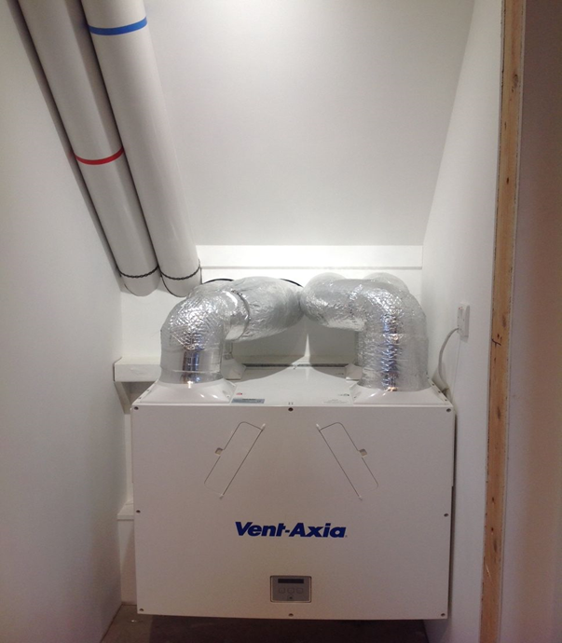
Location of MVHR units

Slide 18
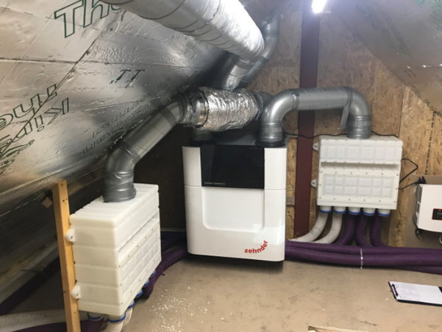
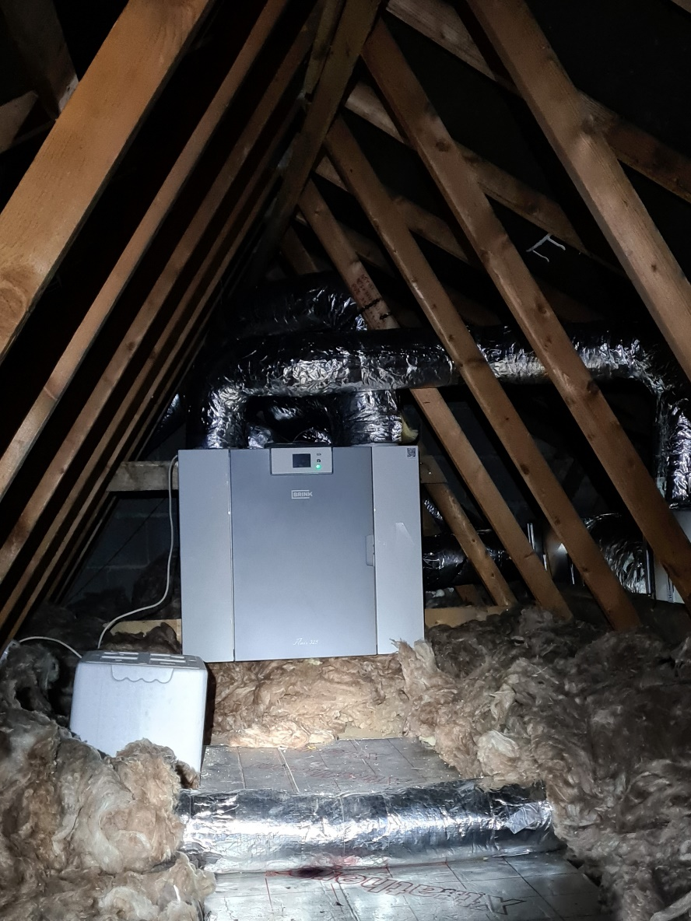
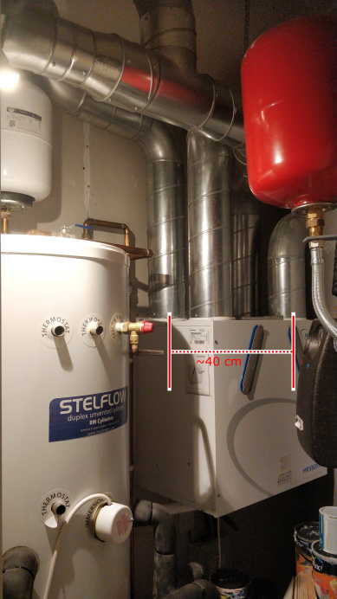
Location of MVHR units (continued)

Slide 19
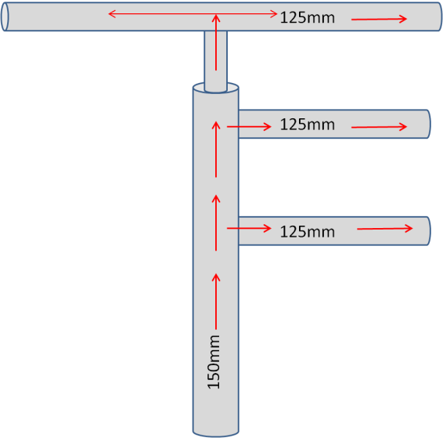
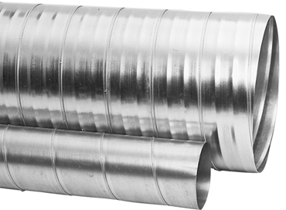
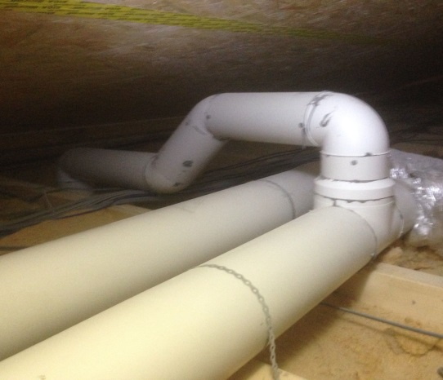
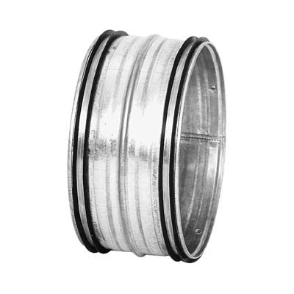
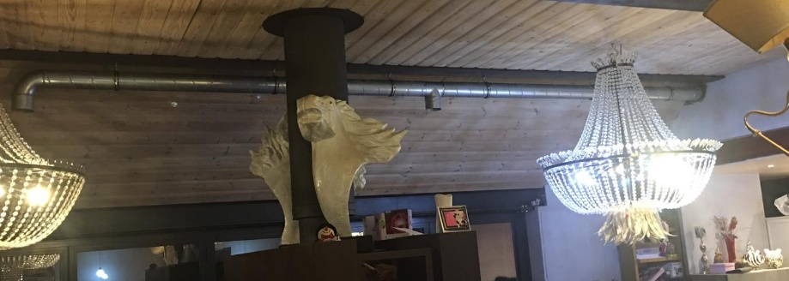
MVHR: Selecting the ducting Branched system arrangement
Smooth-bore improves air flows, most have push-fit connections, available in 200mm, 180mm, 150mm, and 125mm diameter, also in rectangular 220mm x 90mm or 204mm x 60mm (for limited void spaces).
Notes:
19

Slide 20
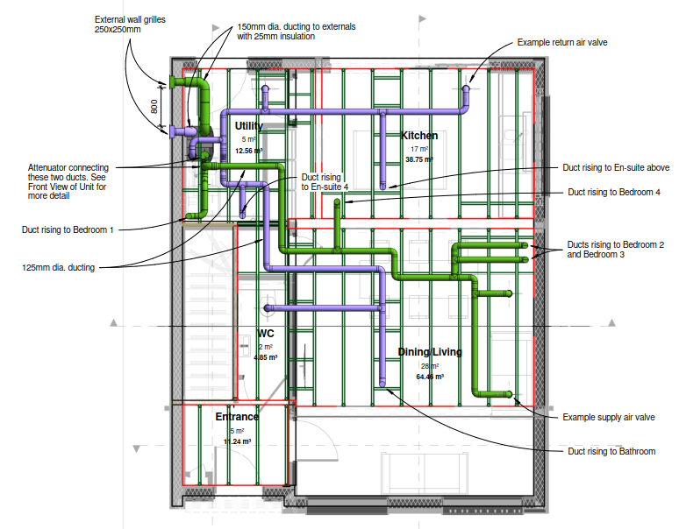
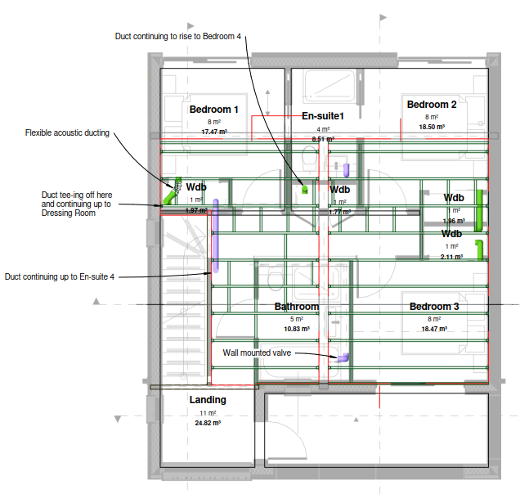
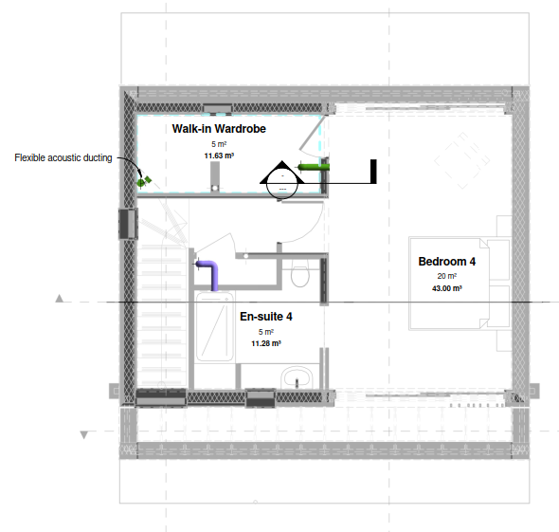
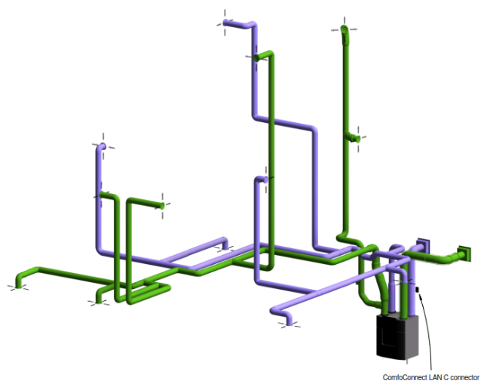
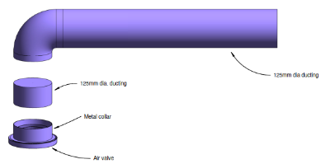
MVHR: Design layout branch ducting
Notes:
20

Slide 21
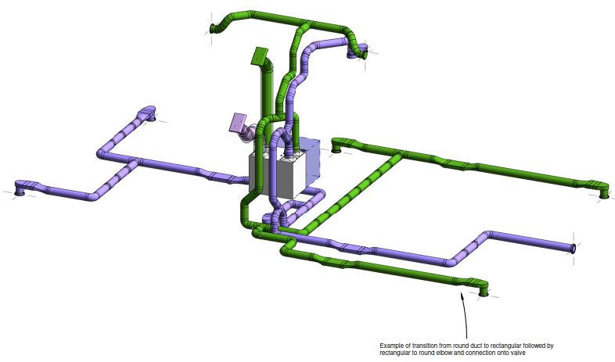
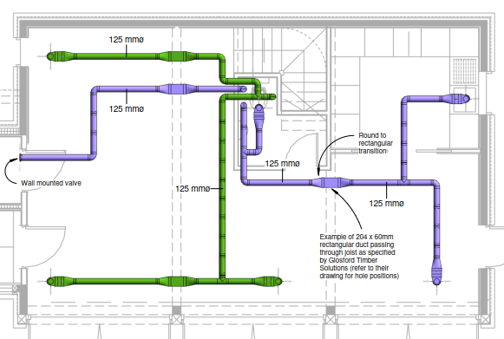
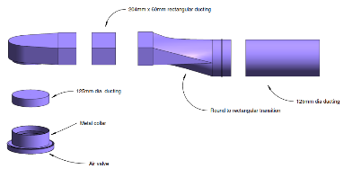
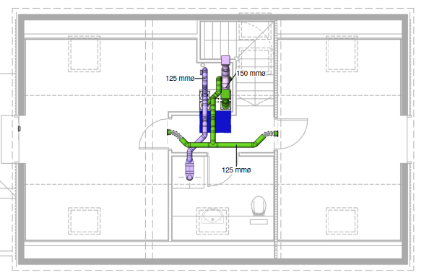
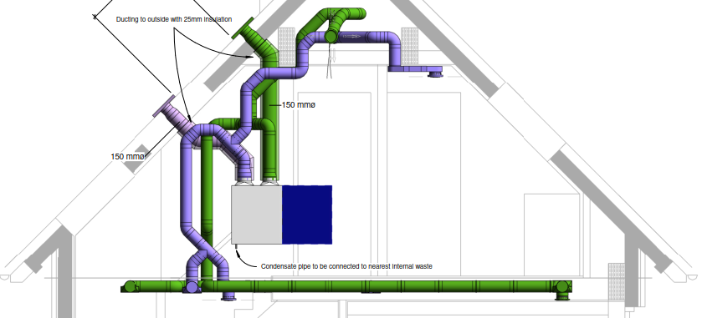
MVHR: Design layout branch ducting
Notes:
21

Slide 22
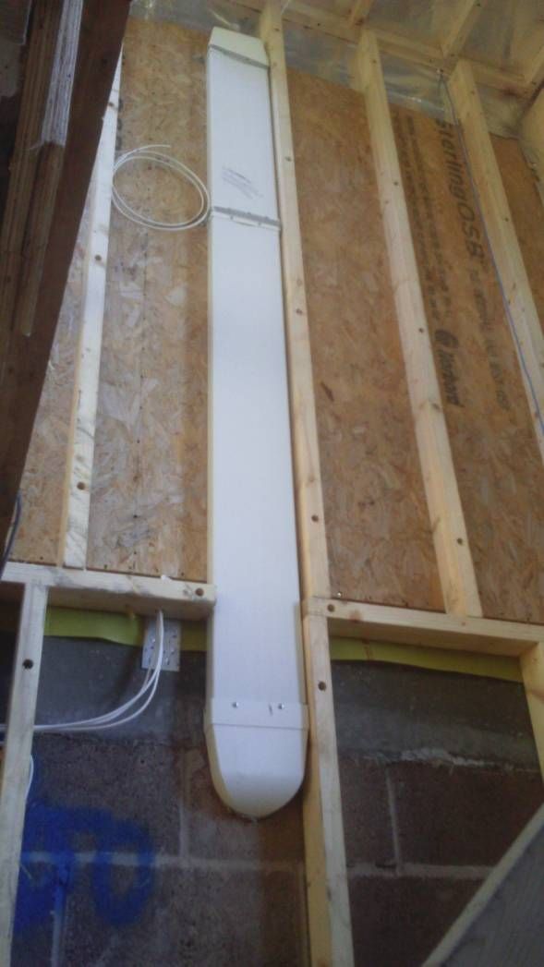
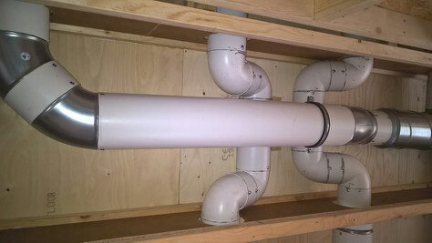
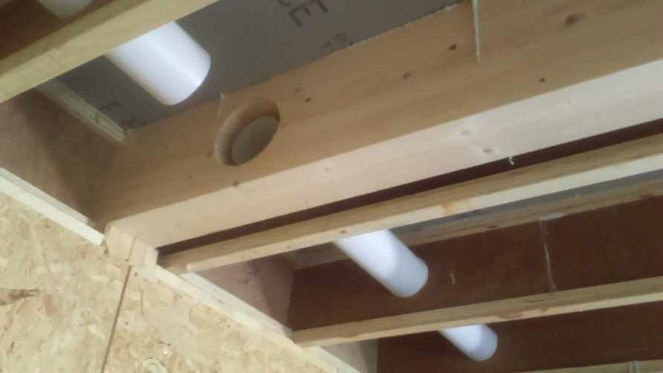
MVHR: Examples of ducting - uninsulated
Notes:
22

Slide 23
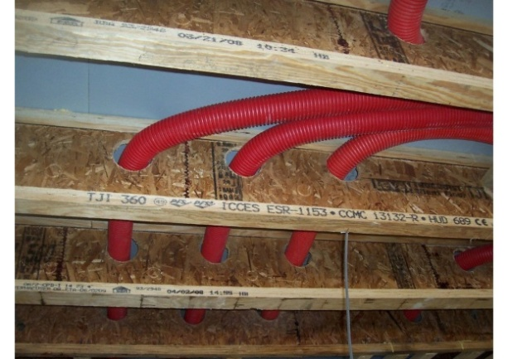
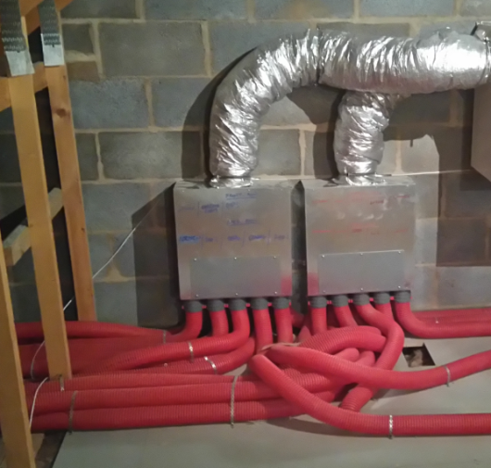
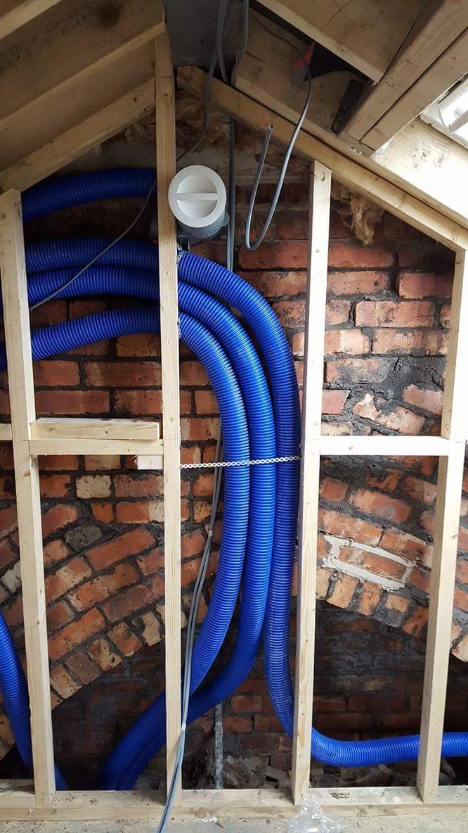
MVHR: Radial Semi-Rigid Ducting (75mm and 90mm diameter)
Smooth-bore improves air flow, anti-static lining, ideal for Pozi Joists, Eco-Joists and engineered timber, perfect for limited void spaces and renovation projects. Can be quicker to install than branch with multiple people, reduces “cross-talk” between rooms, rubber seal on joints ensures airtightness. Use in conjunction with multiple port distribution manifolds for air distribution – can use two manifolds to increase number of ports.
Notes:
23

Slide 24
MVHR: Design layout branch ducting
Notes:
24

Slide 25
MVHR: Design layout radial ducting
Notes:
25

Slide 26
MVHR: Further examples of radial ducting installed

Slide 27
MVHR: Hybrid system, uses both branched and radial ducting

Slide 28
MVHR: Ducting to be avoided!
We strongly advise against flexible ducting of ALL types because of its high air resistance (especially when kinked or restricted). Not only is it easily punctured or crushed but it will also lower the efficiency of any heat recovery unit. Very short sections may be unavoidable, guidance must always be followed. Flexible acoustic attenuation may be utilised where appropriate.

Slide 29
MVHR: Selecting the correct components Thermal ducting options
Any ductwork running in ‘cold unheated areas’ must be insulated.
Supply air ducting should also be insulated to take maximum advantage of summer bypass mode or postheaters when appropriate
Applies to both branch and radial systems
Pay attention to external ducts

Slide 30
MVHR: Selecting the correct components Thermal ducting options
Fully insulated radial duct system with manifolds remaining to be lagged so that all duct connections can be inspected to ensure all clips and seals fitted

Slide 31
MVHR: Selecting the correct components
Sound attenuation – User comfort
Notes:
31

Slide 32
MVHR: Ancillary Options
Internal diffusers
Suitability, aesthetics, system performance
Notes:
32

Slide 33
MVHR: Ancillary Options
External terminals
Suitability, aesthetics, system performance
Notes:
33

Slide 34
MVHR: Pre/Post Heating
Tempers the fresh air going into the MVHR machine in winter to prevent frost protection system shut down
Also available as an integral preheater option
Standard specification in Passive House projects
Air entering MVHR system should not be below 0 °C to ensure condensate discharge and heat exchanger will not freeze up
Minimum desirable domestic supply air temperature 16.5 °C
Notes:
34

Slide 35
MVHR: Pre/Post Heating (in-duct) - examples
Electric
Water

Slide 36
MVHR: Cooling/air tempering (not air conditioning)

Slide 37
MVHR: System Integration
App control, Building Management Systems, cooker hood specification, wood burners, valve positions (for cleaning and avoiding smoke alarms etc), condensate requirements
Notes:
37

Slide 38
MVHR: Fire stopping

Slide 39
SUMMARY: Key MVHR considerations prior to starting your project
Think about a system as early as possible
Consider the unit location
Know the rules and be compliant!
Strive for airtightness and energy efficiency
Choose your component and system supplier carefully by considering the following:
Are they experienced in MVHR?
Do they offer NICIEC/BPEC accredited installation?
Are they biased?
Can they offer you full support?
Do they work closely with your appointed consultants and trades?

Slide 40
New Build Project in Perthshire

Slide 41
Project in Perthshire
Construction Type – SIPS
Floor Area – 120m³
Airtightness – 0.7 m³/(h.m2)@50pa
All electric
Thermodynamic Solar Powered Heat Pump
Solar Panels
Back up Immersion Heater for boosting of hot water
Wood Burner for supplementary heat when required
MVHR
Average monthly consumption 302kwh ca. £82 per month based on av. Feb 24 electricity prices. Home working so occupied permanently.
Battery to be installed which will reduce consumption

Slide 42
Renovation – Extension Project York

Slide 43
Project in York Completed in 2018
Construction Type – Existing Terrace Brick & block Renovated to Enerphit standard.
2 New Timber Frame Extensions with Sedum Roof
Triple Glazing to existing and new extensions
Floor Area 113m²
Airtightness – 3m³/(h.m2)@50pa
All electric PHPP projected 3.5kw
Solar PV feeding Powerwall Battery
Towel Rails in Wet Rooms, small area of U/F in Kitchen/Dining
MVHR with post heater
Shower waste-water heat recovery
Typical total Annual Energy costs after feed in tarrif payments £700. Home working so occupied permanently.

Slide 44
MVHR: Servicing

Slide 45
Thank you for listening
Craig Brooke
ADM Systems * 1st Floor East Suite * The Waterfront * Salt Mills Road *
Shipley * BD17 7TD
Call: 01756 701051
General enquiries
info@admsystems.co.uk
Proposals
plans@admsystems.co.uk
www.admsystems.co.uk

