Slide 1
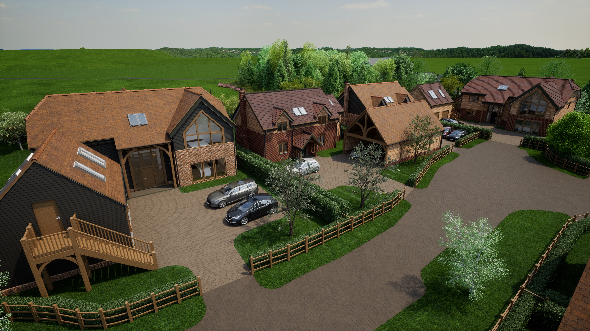
Structural Considerations
by David Gallagher

Slide 2
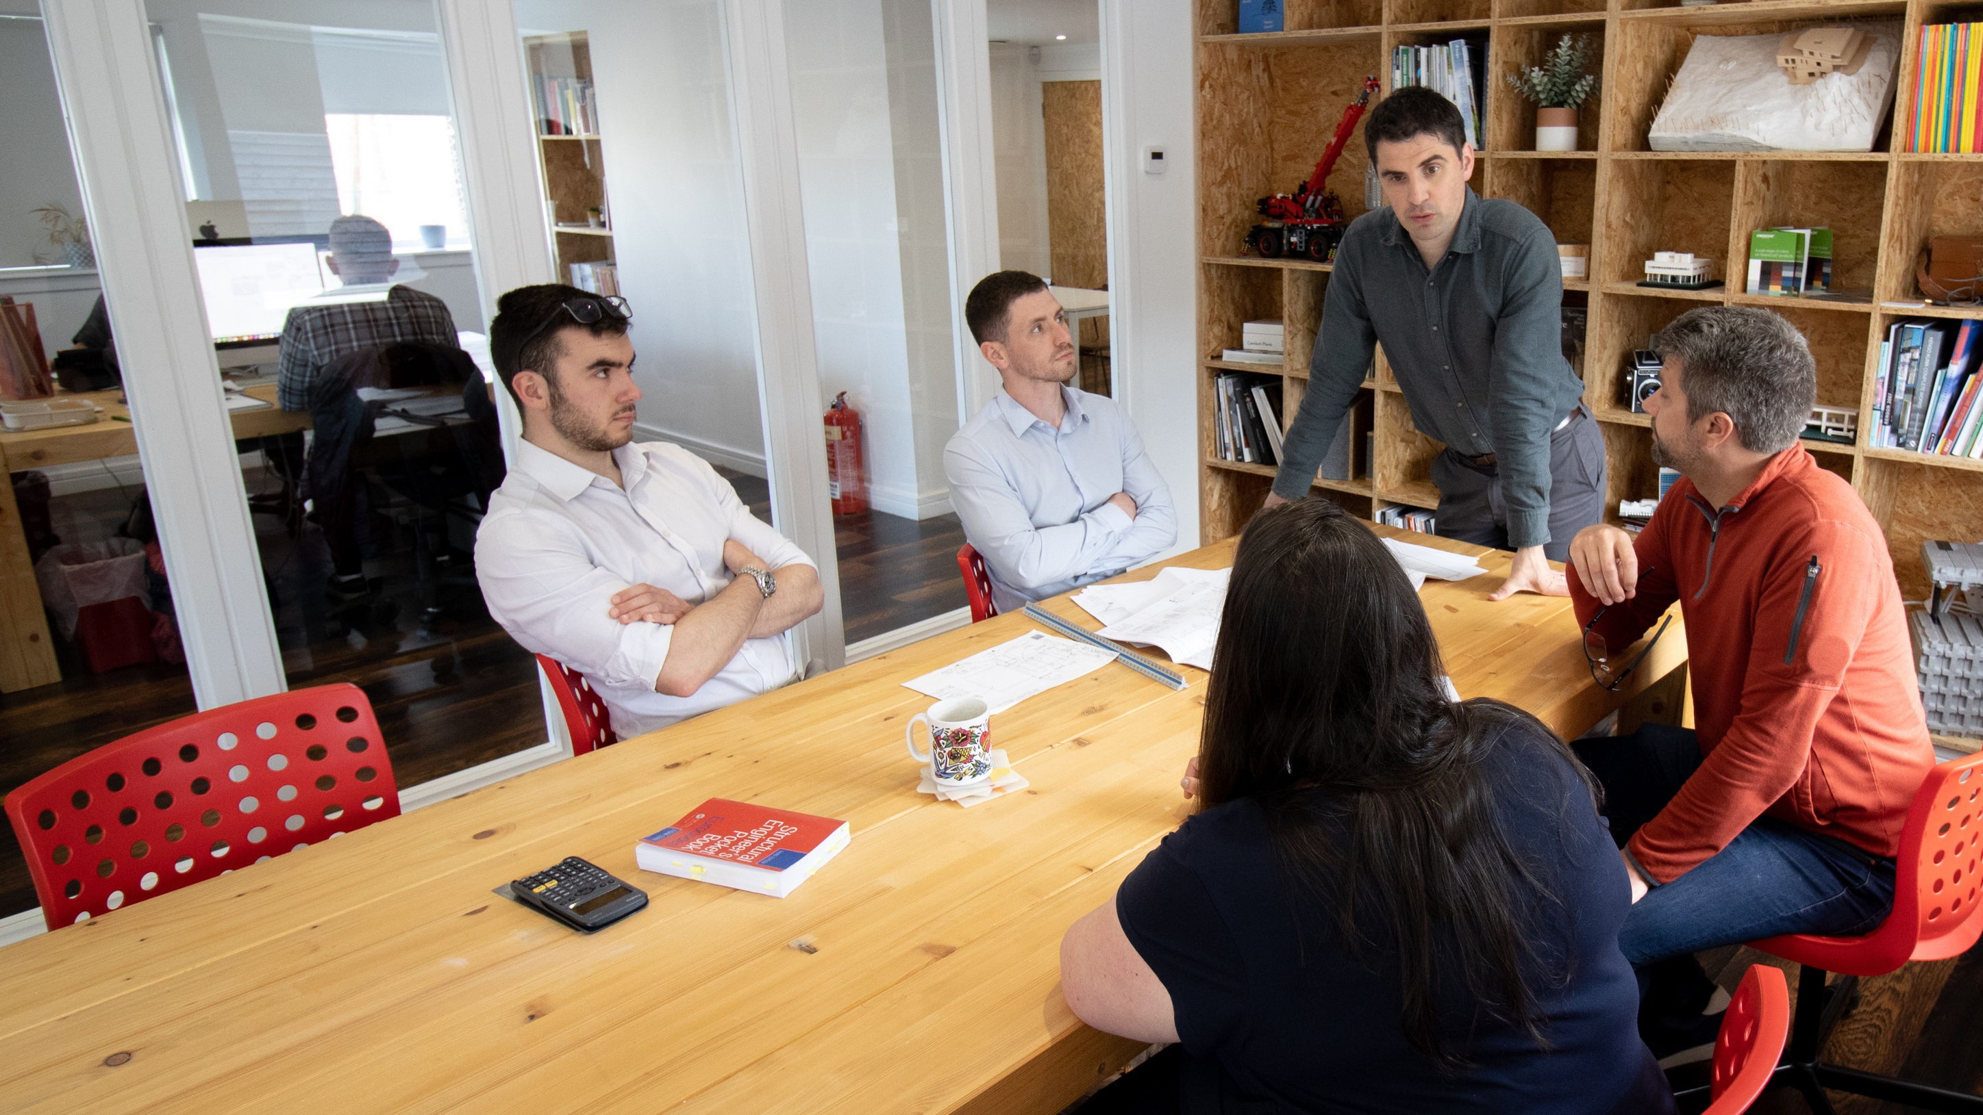
BACKGROUND TO ACS
ACS were established in 2021 as a Sister Company to AC Architects to provide a full design service for custom build clients
ACS specialise in Modern Methods of Construction (MMC) and provide specialist design services to Timber Frame, SIPs and ICF manufacturers and Suppliers
ACS utilise BIM software to aid co-ordination and integration with Architectural drawings
ACS are able to offer a full project design service from site evaluation through to construction inspections to suit Client requirements
ACS also offer specialist design services for steel connections, steel stairs, balustrades and feature glazing.
ACS are SER Certifiers (Scotland)

Slide 3
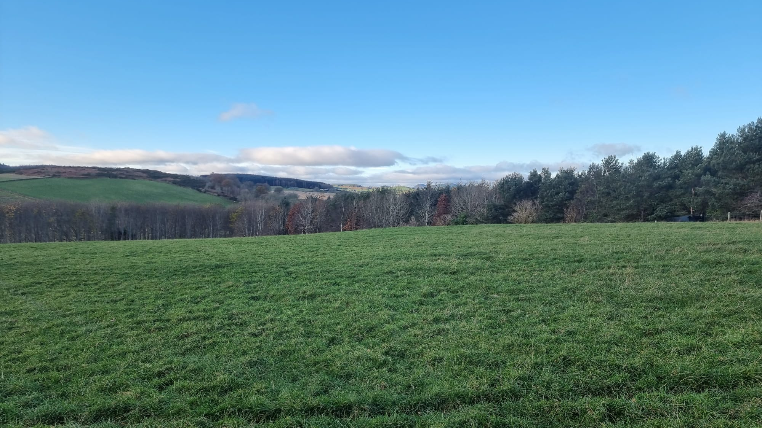
PROJECT STAGES
Initial Design
Planning Application
Building Regulations or Warrant
Production Drawings
On Site
CDM
ROLE OF STRUCTURAL ENGINEER
Preliminary Desk Top Evaluation of Site, Specification and Review of Site Investigation Scope and Findings
Early Review with Architect and Client to Determine Preferred Method of Construction and Structural Design Principles
Structural Design and Drawings for Building Warrant/Regs. Specification of Specialist Contractor Design Elements
Design and/or Review of Third-Party Elements
Structural Support and Additional Visits Can be Provided on Request
To Identify Any Site Specific Hazards That Would Not Reasonably Be Anticipated by a Competent Contractor Under CDM 2015
ACS INCREASED STRUCTURAL ENGEERING SCOPE
TRADITIONAL STRUCTURAL ENGEERING SCOPE

Slide 4
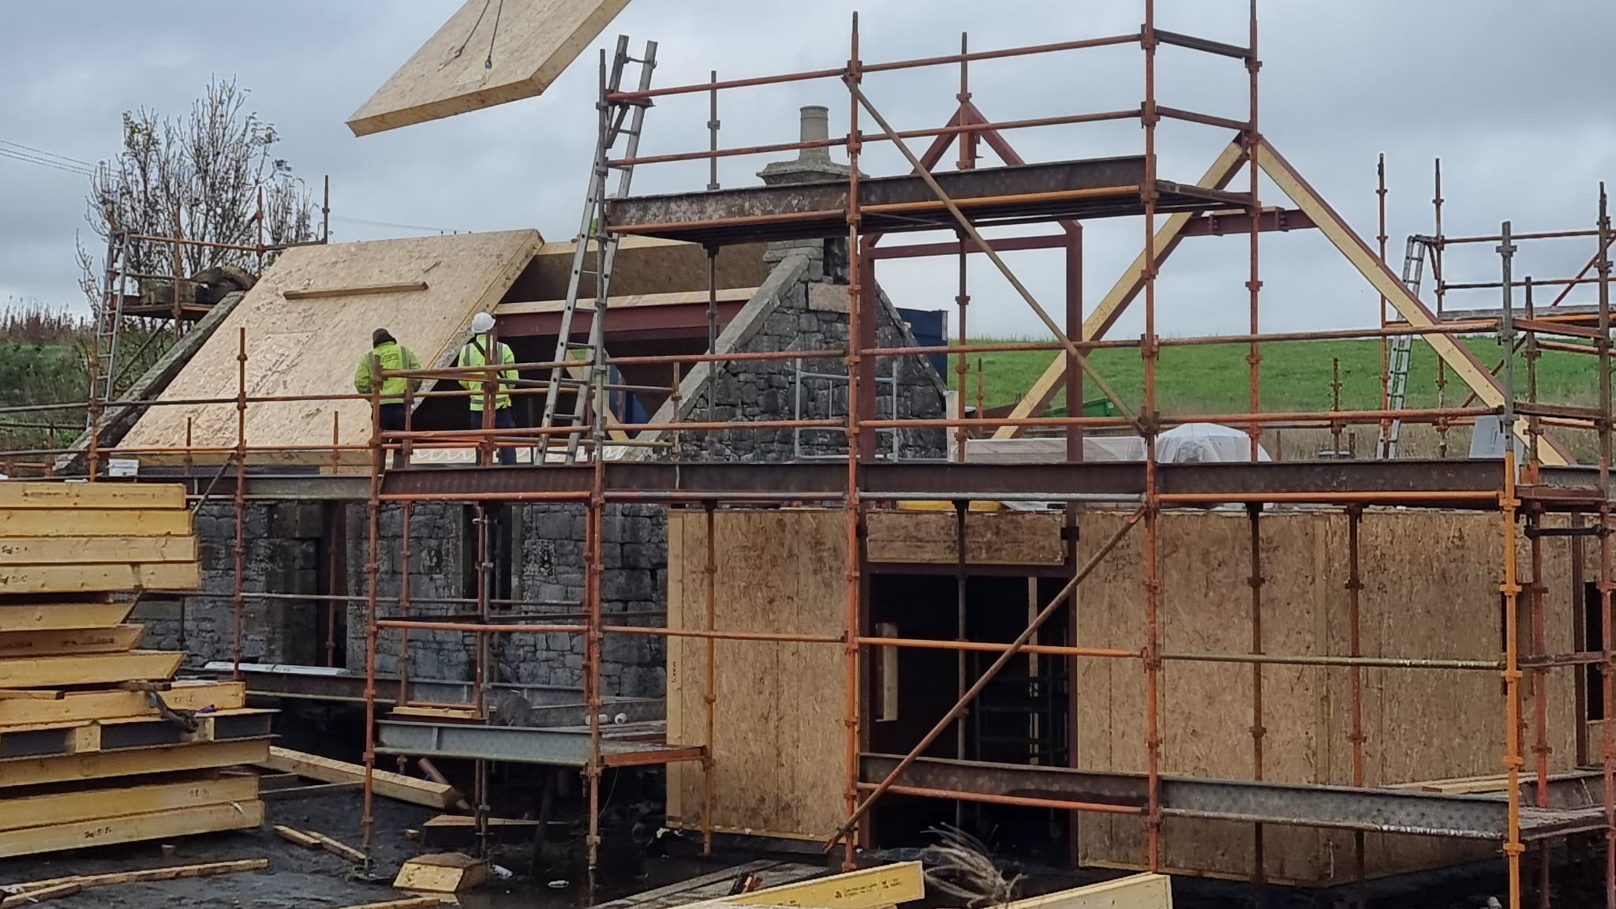
IMPORTANT CONSIDERATIONS WHEN SELECTING YOUR STRUCTURAL ENGINEER
Is the scope of service comparable between your tender returns?
Does the level of input offered by the Structural Engineer meet your and the site's requirements?
On-site support is also highly recommended. Has this been included or cost per visit identified.
Is your preferred Structural Engineer experienced in the methods of construction you are considering?
Does your preferred Structural Engineer have proven experience working with your Architect and specialist manufacturer?
Does your Structural Engineer have awareness of cold bridge detailing requirements
Value for money. Beware of false economy. Any difference in fee can be quickly dwarfed by over conservative design and/or slow information release.

Slide 5
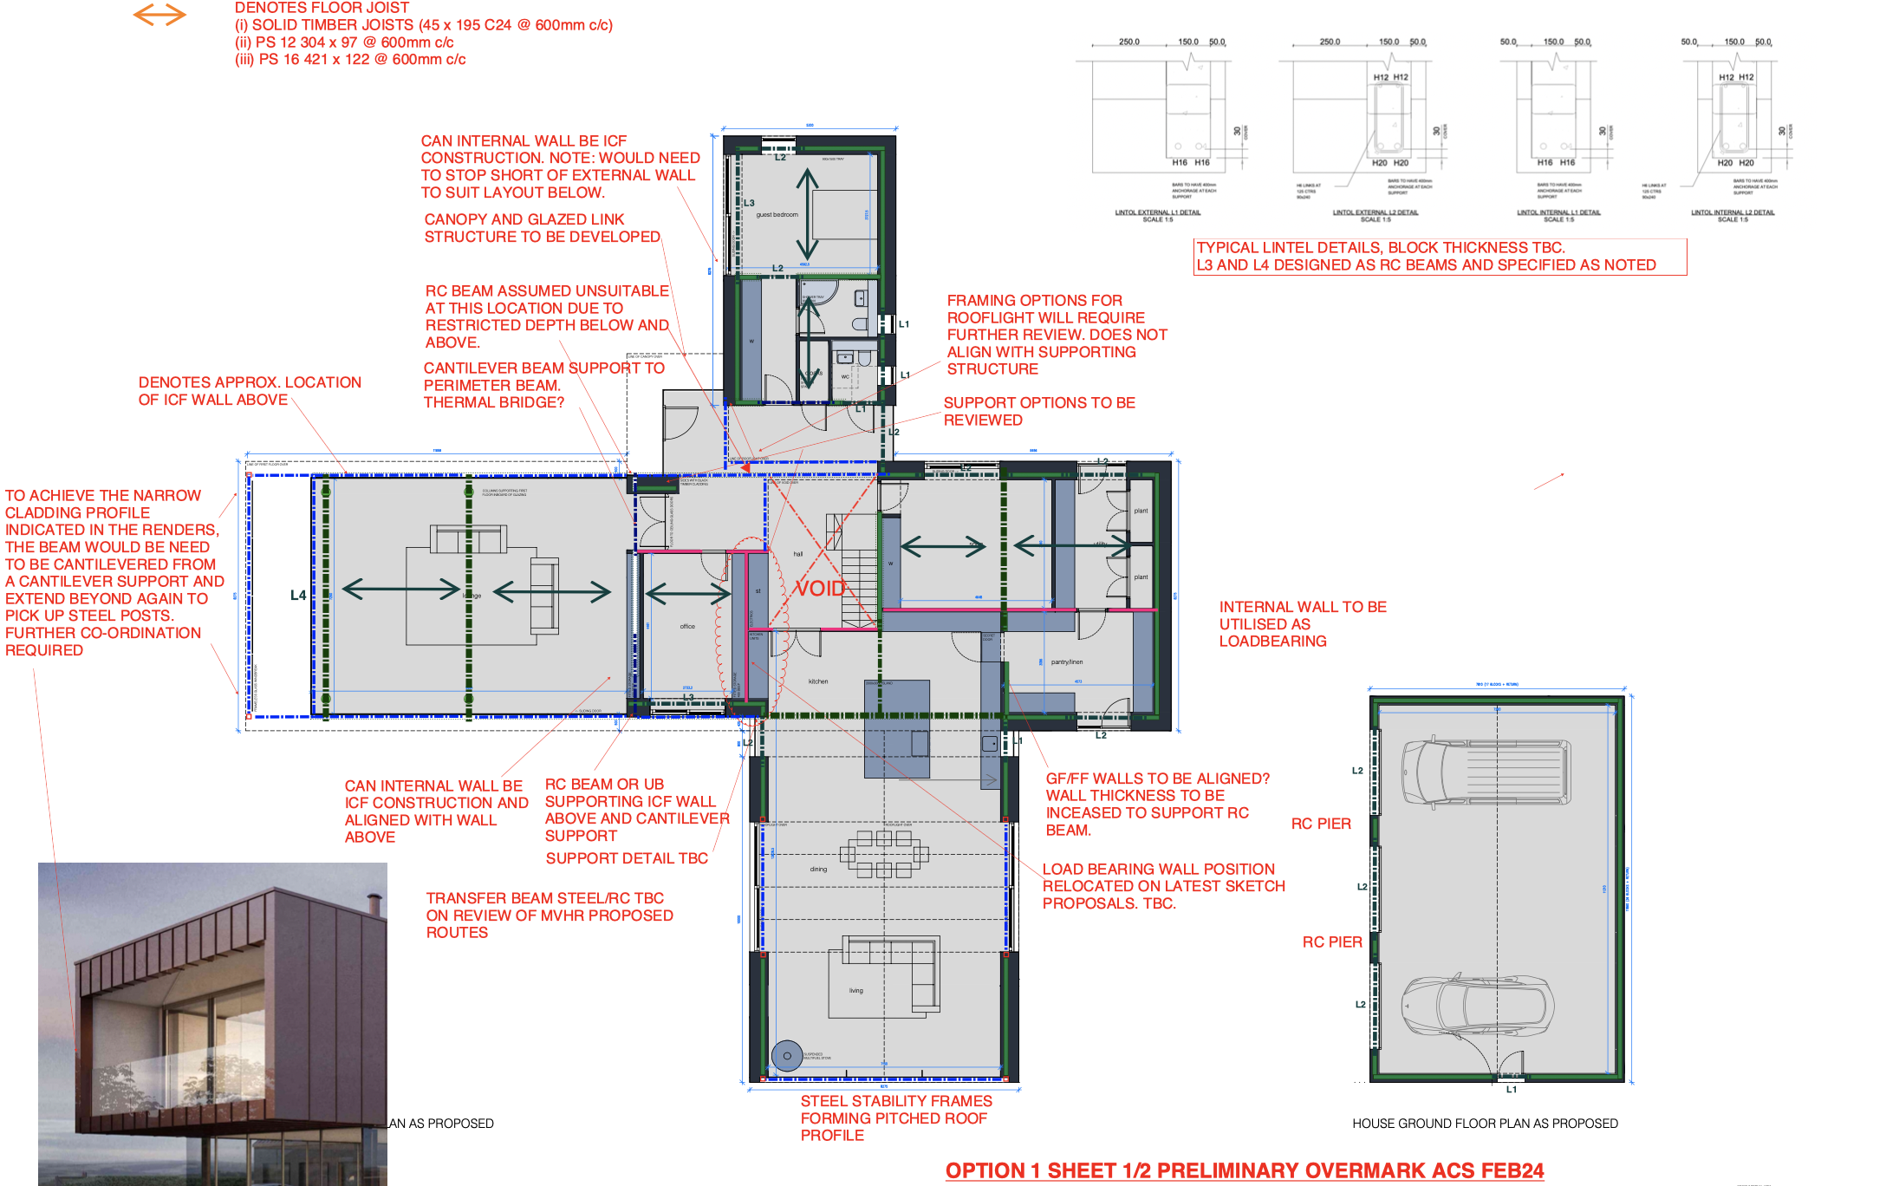
THE ADVANTAGE OF EARLY STRUCTURAL ENGINEER DESIGN REVIEW
Different perspective
Structural Zones identified
Transfer Structure and Column Locations
Early identification of value engineering opportunities

Slide 6
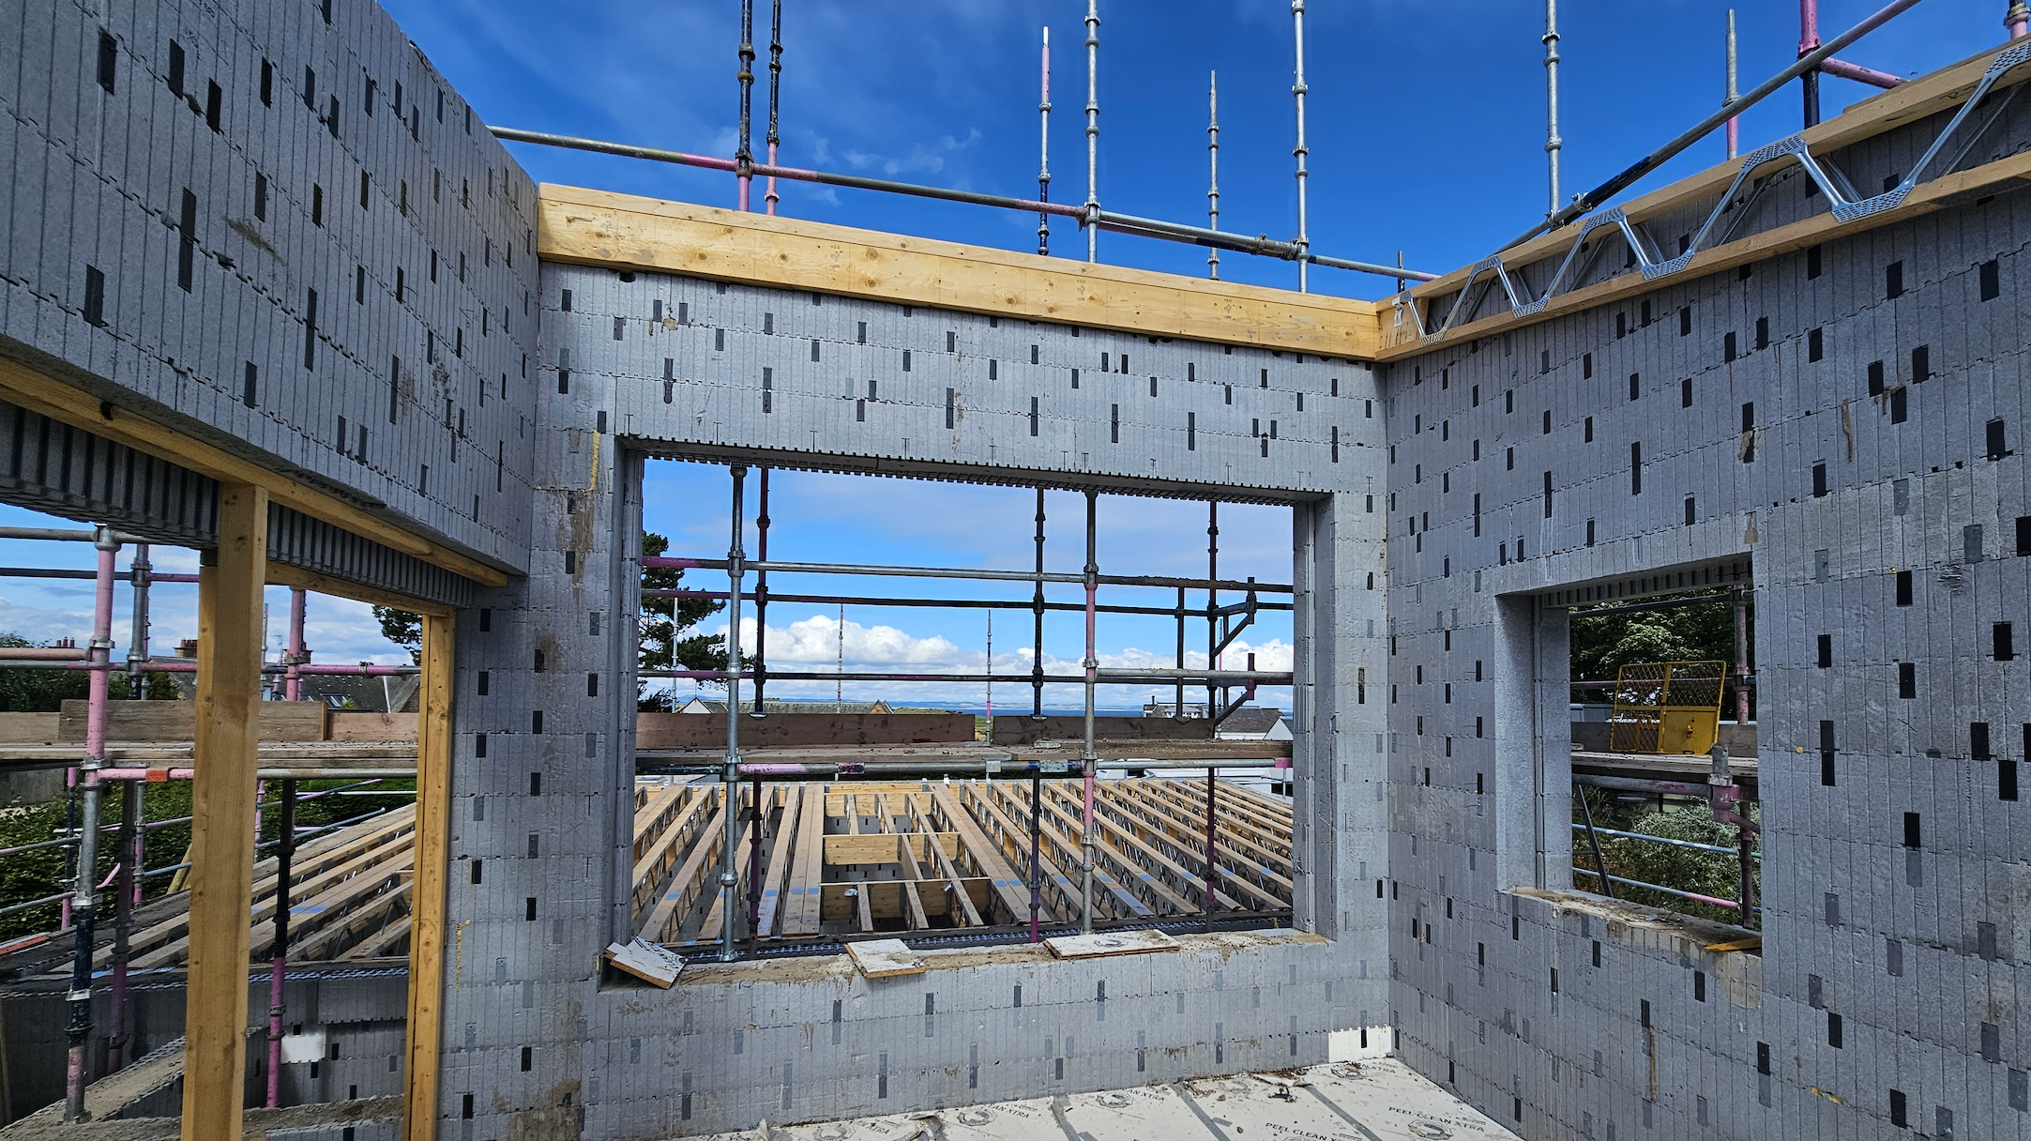
BENEFITS OF THE PROJECT ENGINEER BEING APPOINTED AS SPECIALIST ENGINEER BY YOUR ICF/SIPS/TIMBER FRAME CONTRACTOR
Allows the superstructure engineer to be involved in your project from an earlier stage.
Design assumptions made prior to appointment of your specialist manufacturer are more likely to reflect the final design requirements.
Helps inform preliminary costing and anticipated line loading for foundation design.
Th
Preferred detailing and specifications can begin to be incorporated into the early design prior to formal appointment.
Critical structural design considerations such as the stability strategy can be identified and coordinated.
Having one engineer responsible for your project (under two separate appointments) streamlines the design process.

Slide 7
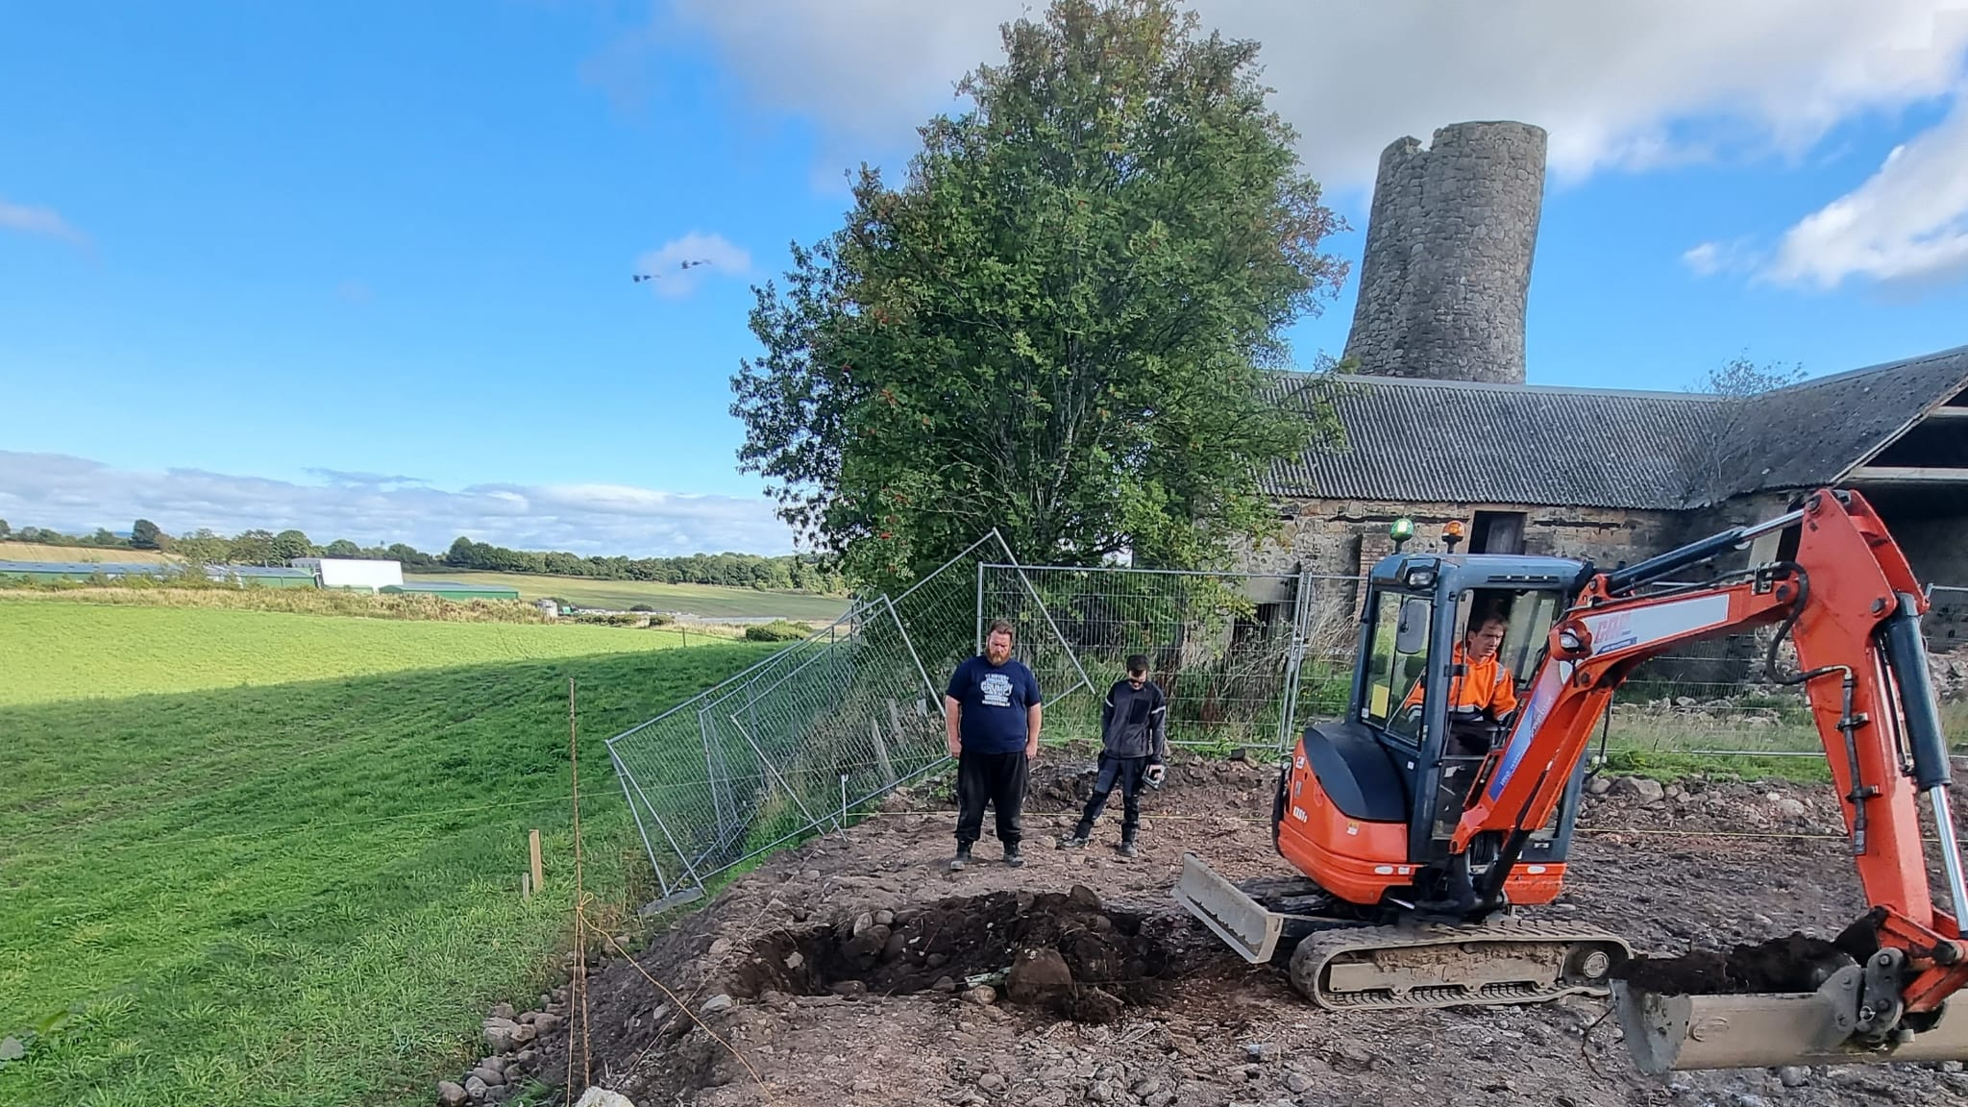
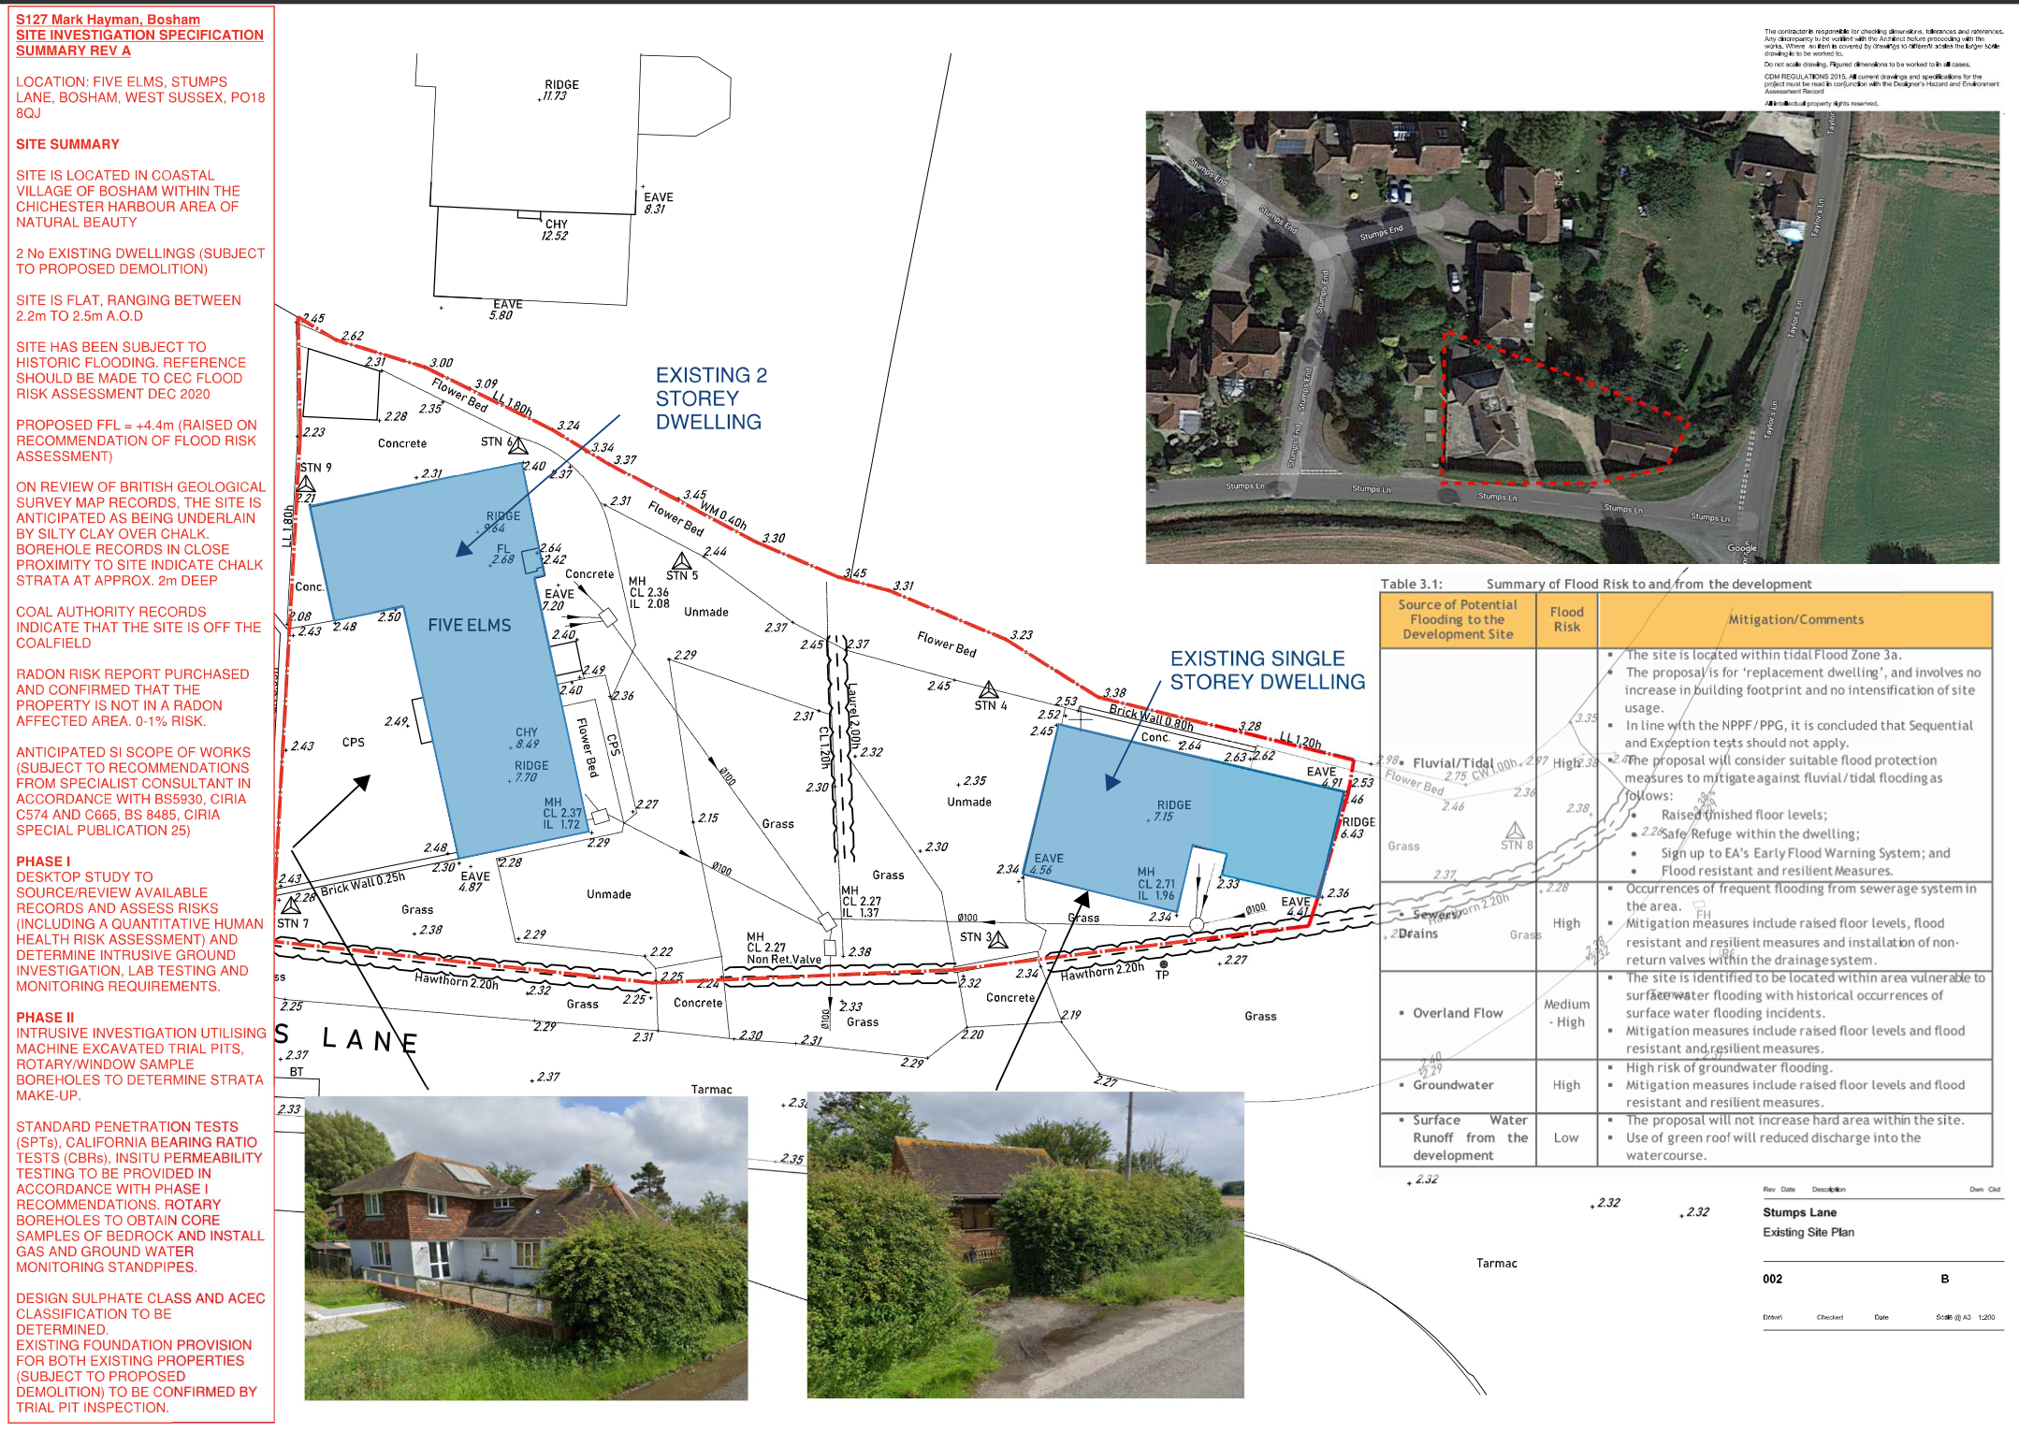
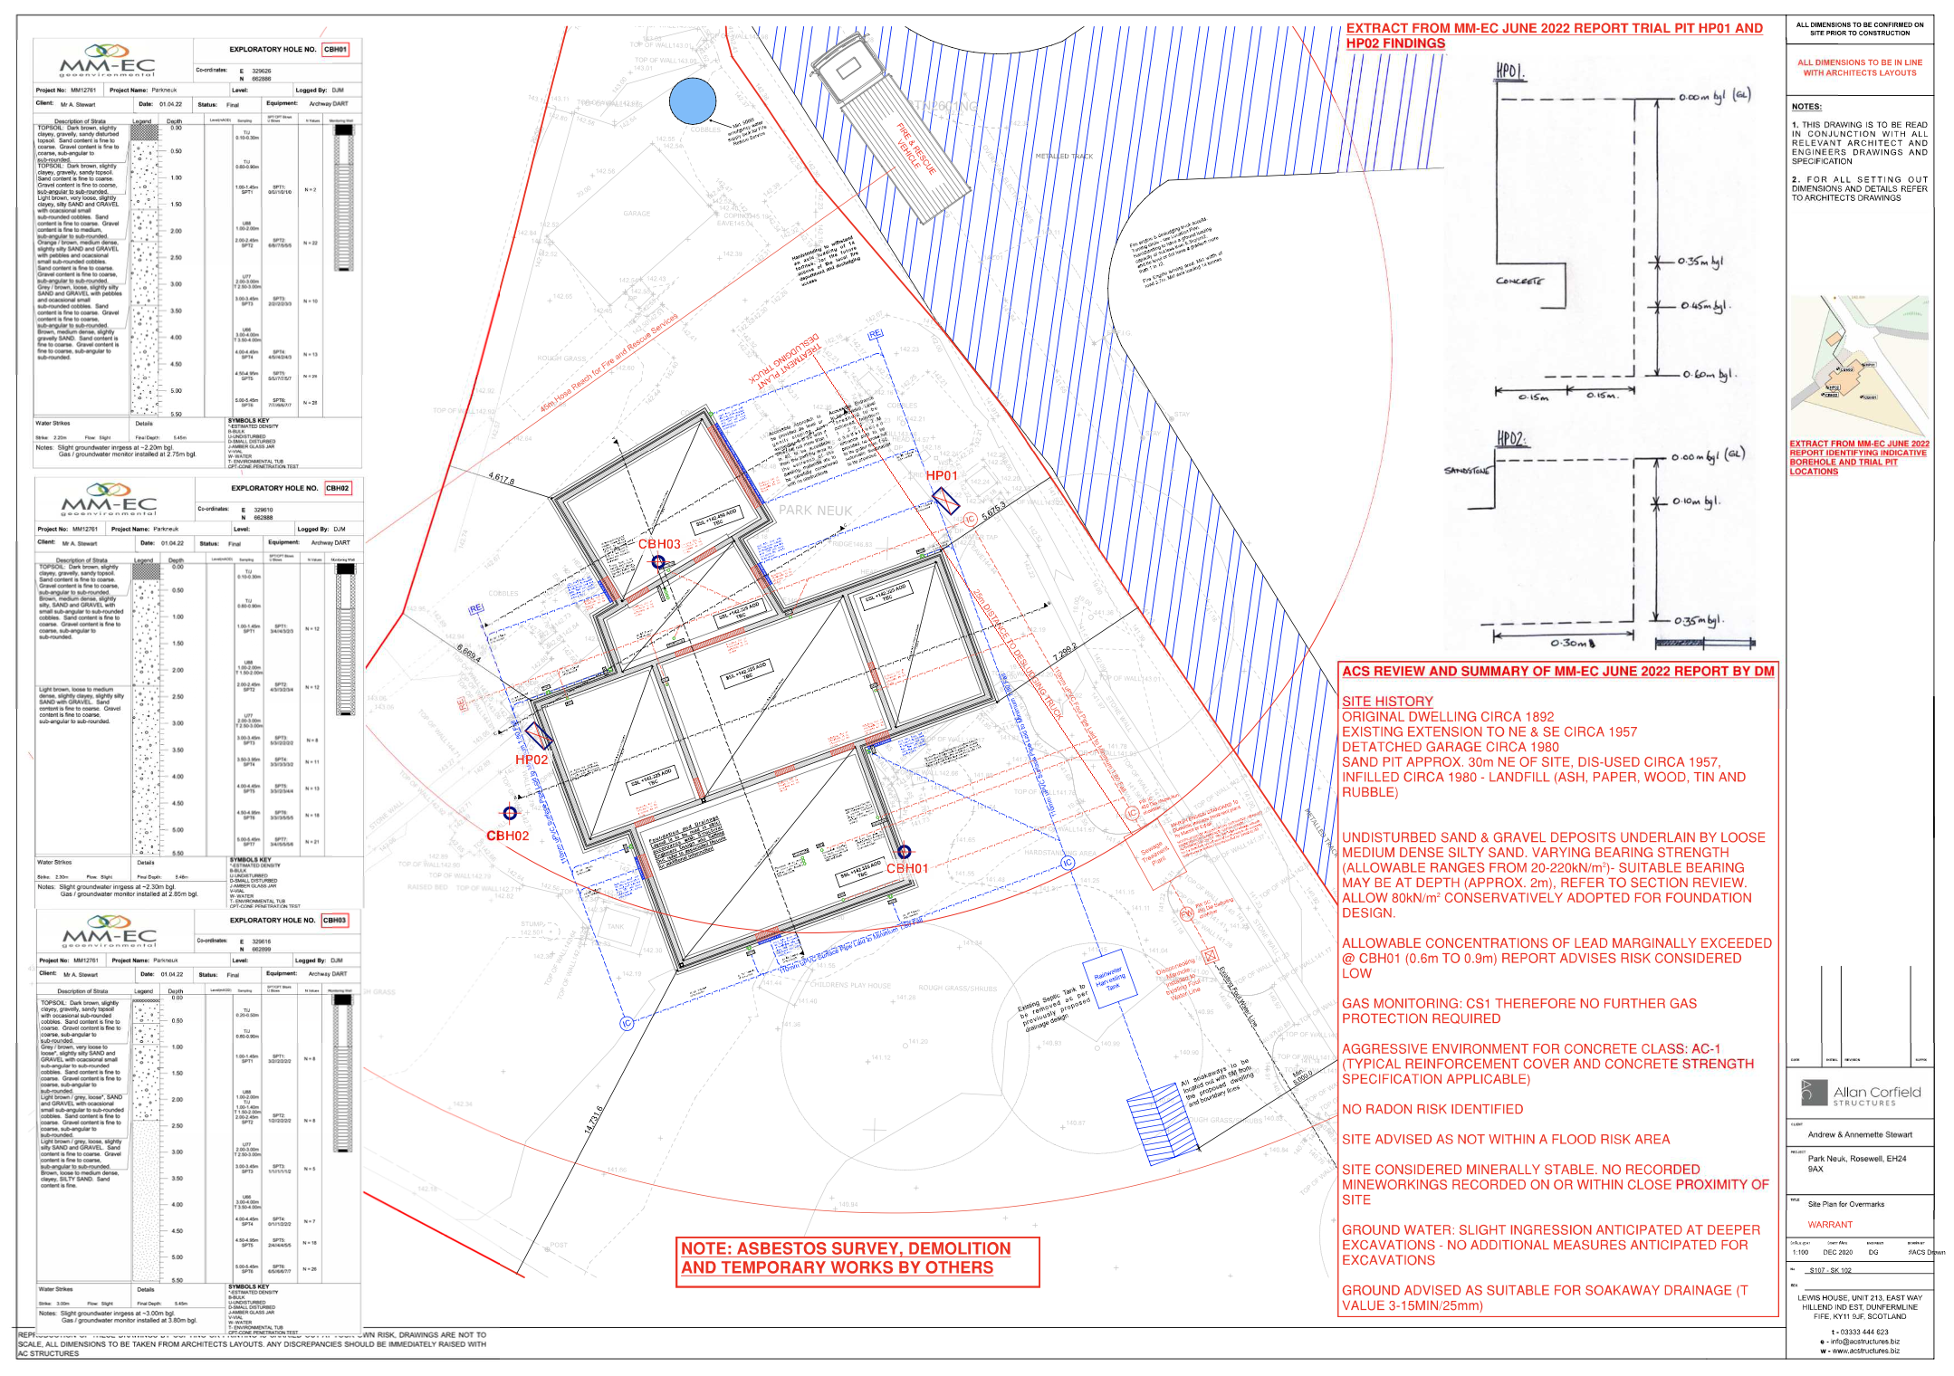
STAGE 1: INITIAL DESIGN
Preliminary Desk Top Evaluation of Site
Specification for Site Investigation Tender
Review of Site Investigation Tender Returns
Review of Site Investigation Findings
Outline Foundation Design

Slide 8
THE IMPORTANCE OF A SITE INVESTIGATION
The biggest unknown for any project is the ground conditions
The scope of the site investigation needs to be appropriate for the scale of the project and the anticipated ground conditions and foundation requirements
The site investigation is split into 2 phases. Phase I is a desktop evaluation of the site. This phase investigates the history of the site, potential risks and establishes the recommended scope of the Phase II - intrusive investigation.
The scope of stage 2 can vary but typically includes Boreholes, trial pits, lab testing, percolation test, gas and water monitoring.
If piling is anticipated the depth and number of boreholes required are likely to be more to ensure sufficient information is obtained for the specialist piling design

Slide 9
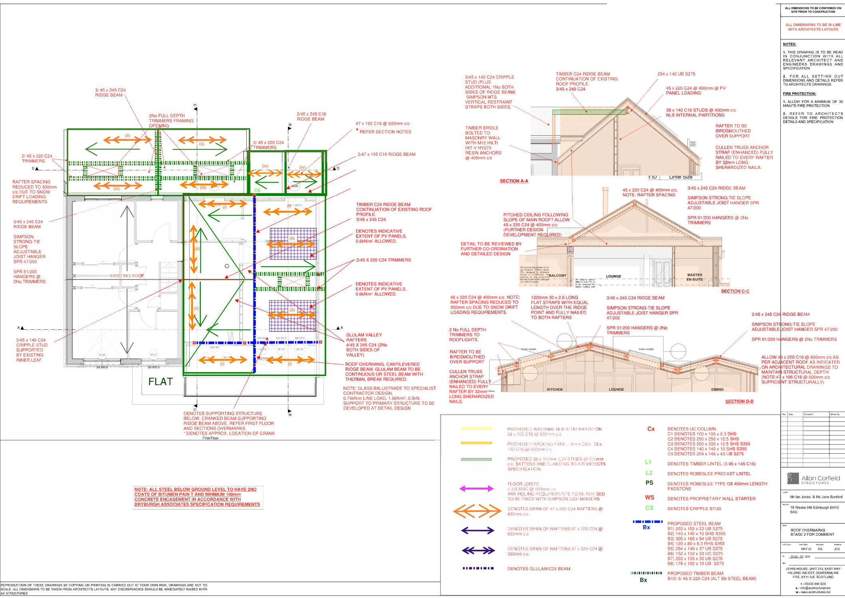
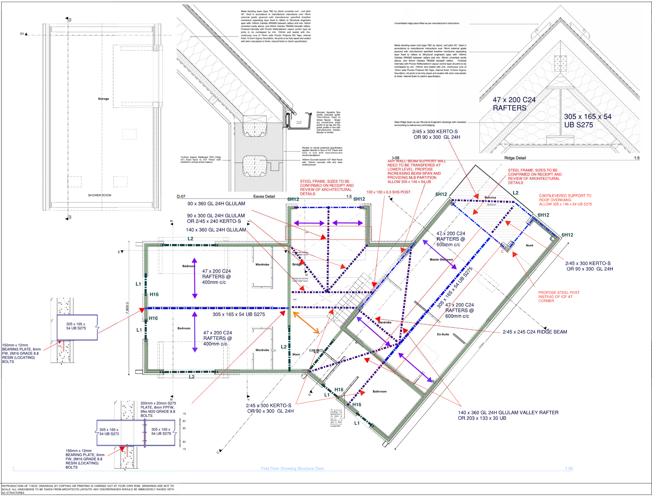
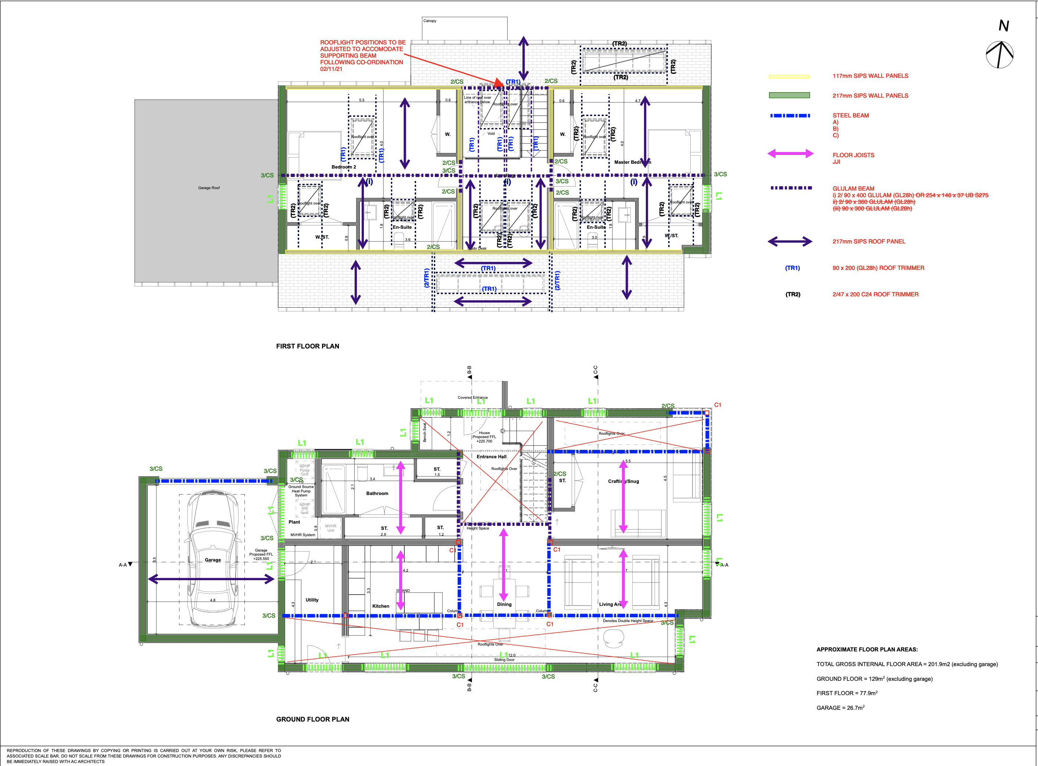
STAGE 2: EARLY DESIGN REVIEW
Design Review with Client and Architect
Review of Value Engineering Opportunities
Review Method of Construction Options
Preliminary Structural Sketch Overmarks
Early Design Co-ordination Review

Slide 10
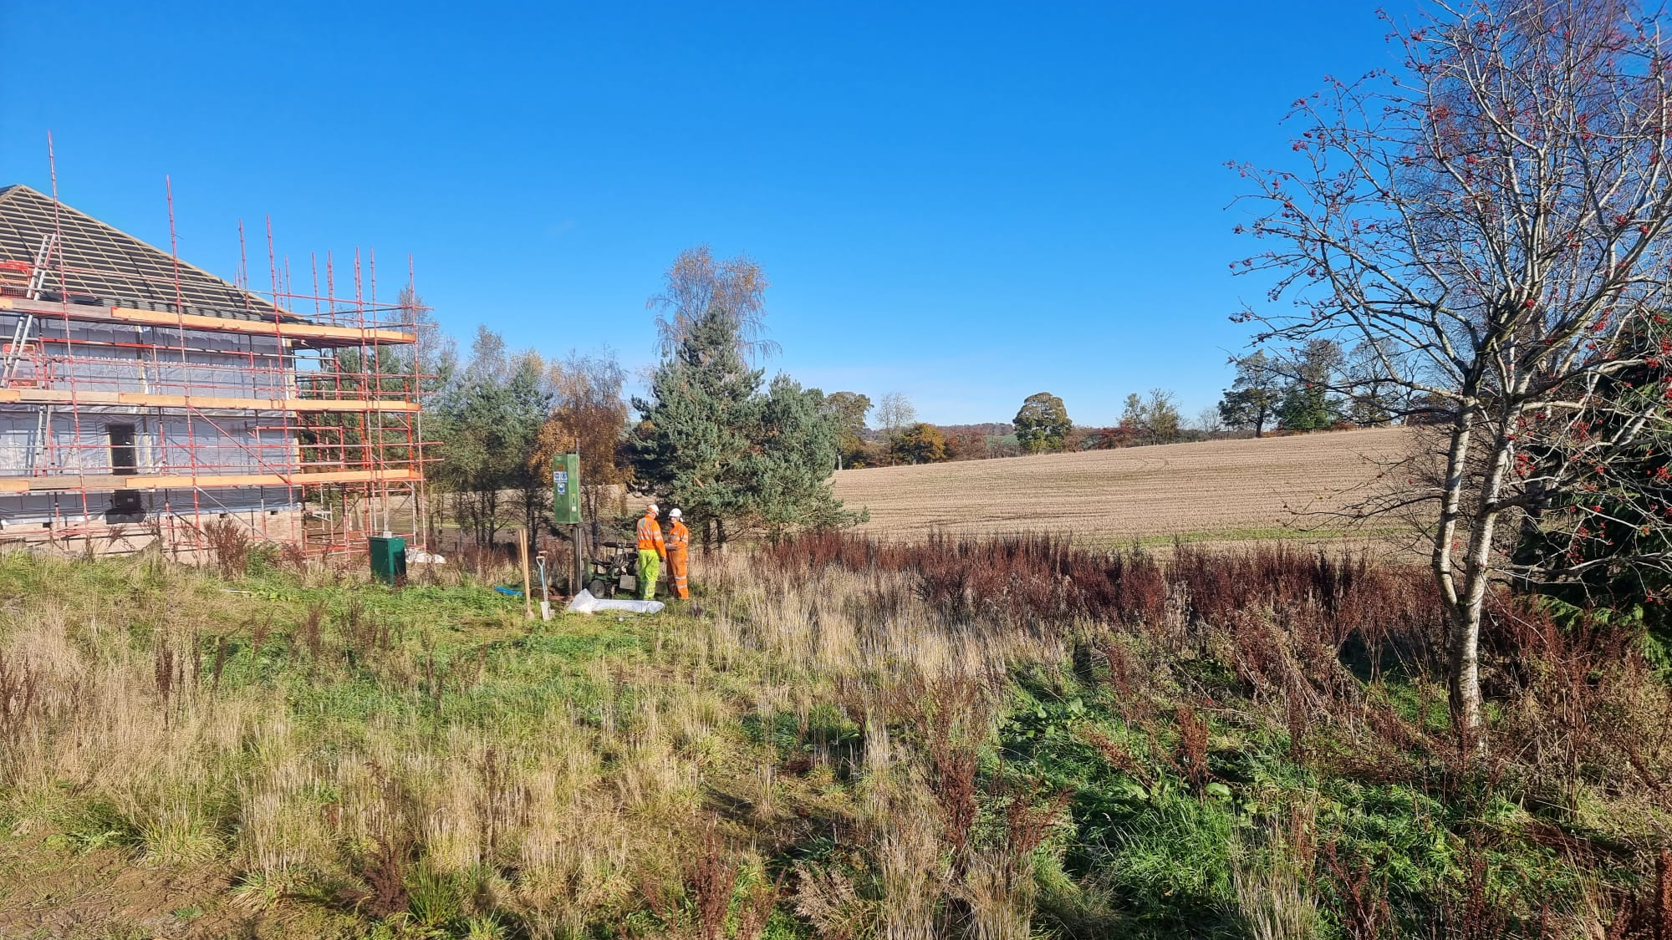
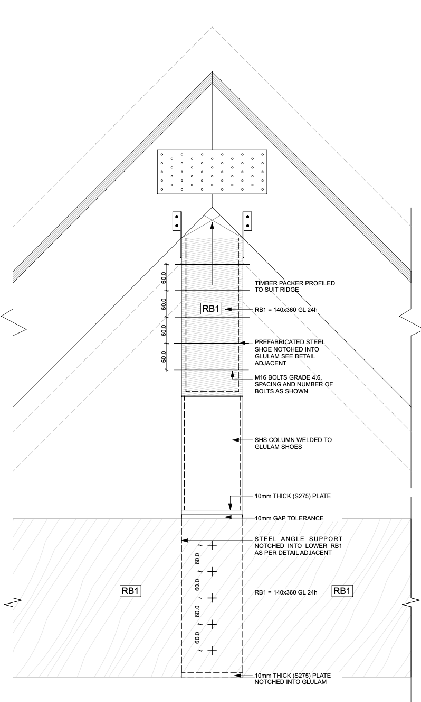
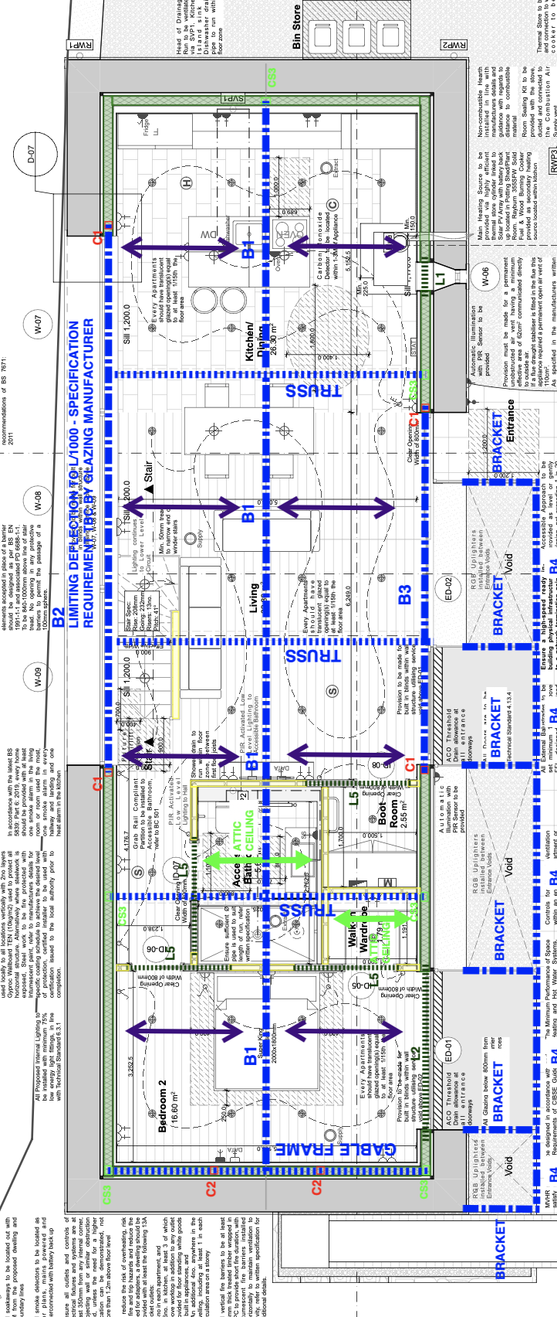
VALUE ENGINEERING FROM THE BEGINNING
WORK WITH YOUR SITE CONSTRAINTS
Try to limit volume of excavation by working with site levels
Avoid retaining walls where possible
Site access to be considered
TRANSFERRING GRAVITY LOADING FROM ROOF TO FOUNDATIONS
Aligning walls between floors to limit transfer structure
CONSIDER THE STABILITY OF THE STRUCTURE
Tall narrow structures and those with limited internal walls (and/or walls that do not align between floors) are more complicated and therefore more costly to stabilize
AVOID LARGE STRUCTURAL SPANS ABOVE CRITICAL ELEMENTS
Transfer beams above glazed bifold doors need to be designed to strict performance specification increasing the structural depth and/or weight = increased cost
MAXIMISE AVAILABLE STRUCTURAL ZONE
The deeper the zone available, the more efficient the structure becomes (minimum 310mm for airtight structures requiring MVHR)
SIMPLIFY THE ROOF STRUCTURE WHERE POSSIBLE
Vaulted ceilings with varying ridge heights introduce difficult detailing if there is an opening plan floor layout below
SIMPLIFY DETAILING AND AVOID THE REQUIREMENT TO DETAIL AGAINST COLD BRIDGING

Slide 11
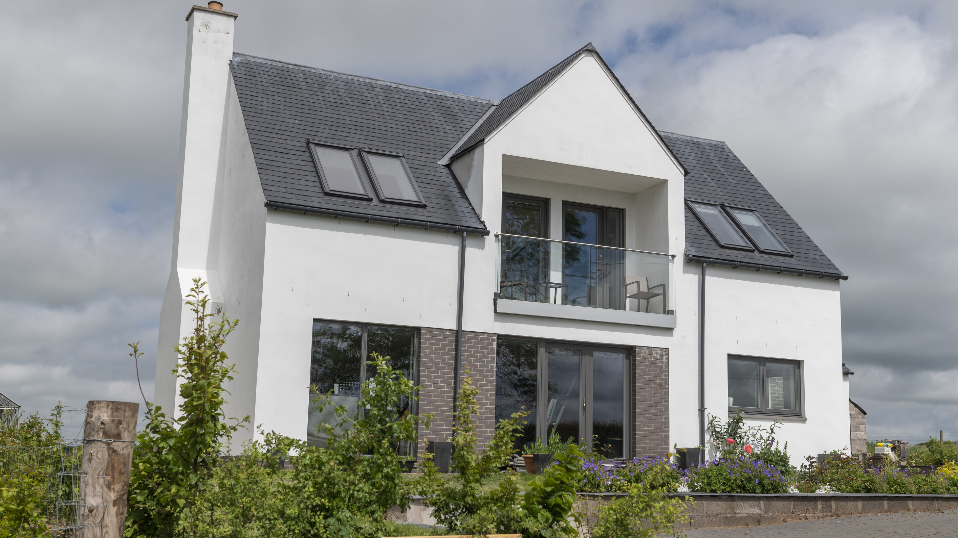
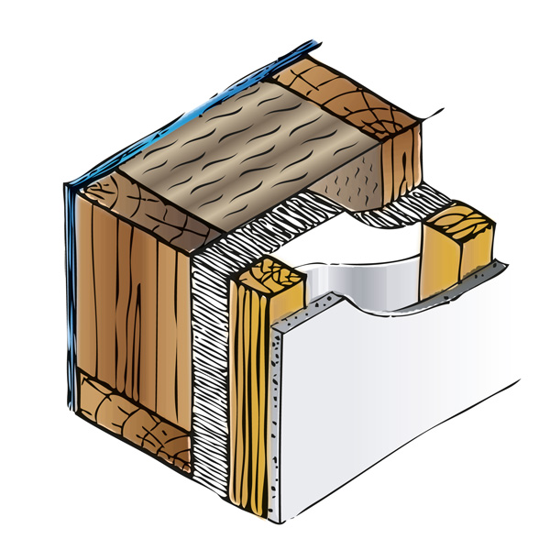
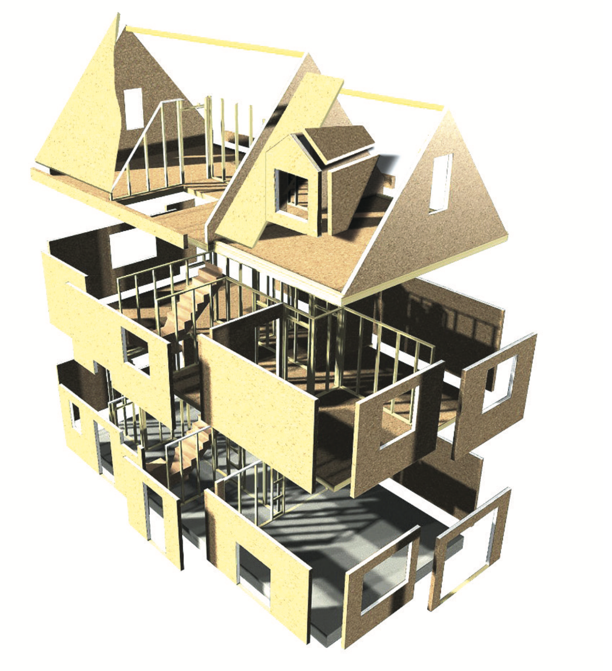
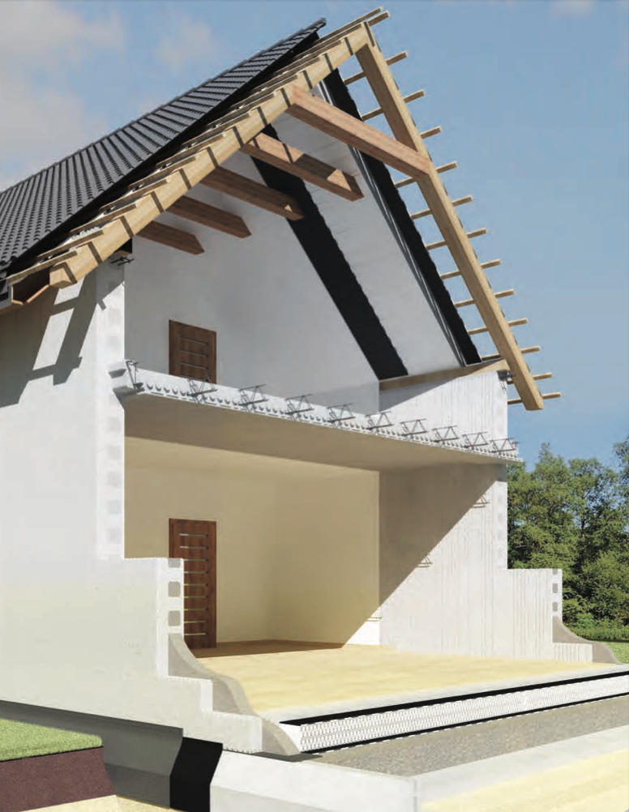
COMPARING METHODS OF CONSTRUCTION
TIMBER FRAME CONSTRUCTION
SIPS CONSTRUCTION
ICF CONSTRUCTION
PROS
Speed of construction – Reduced site time – quicker to wind and watertight
Greater cost certainty
Prefabricated panels reduces site wastage
Sustainable – Sourced from well maintained sustainable forests
Lightweight frame helps buildability and reduces foundation costs
Low embodied carbon compared to other construction options
PROS
Speed of construction – 5-7 days typical
High performance pre-insulated sip panel structure
Prefabricated panels reduces site wastage
Lightweight frame helps buildability and reduces foundation costs
Low embodied carbon compared to other construction options
High levels of air tightness 2-4 acph
PROS
Excellent air tightness
Great for projects where retaining walls are required
High insulation and acoustic performance
Can be constructed in a wide range of weather conditions
Integrated with raft foundations (where ground conditions permit)

Slide 12
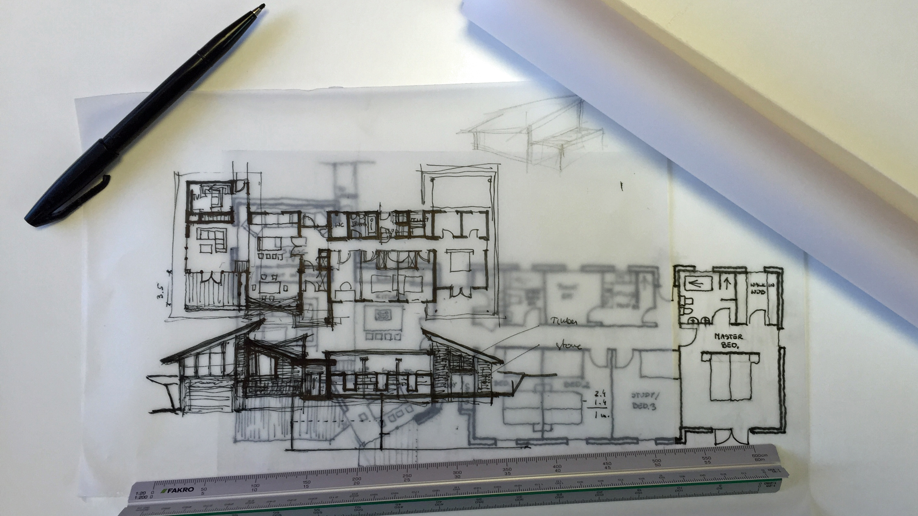
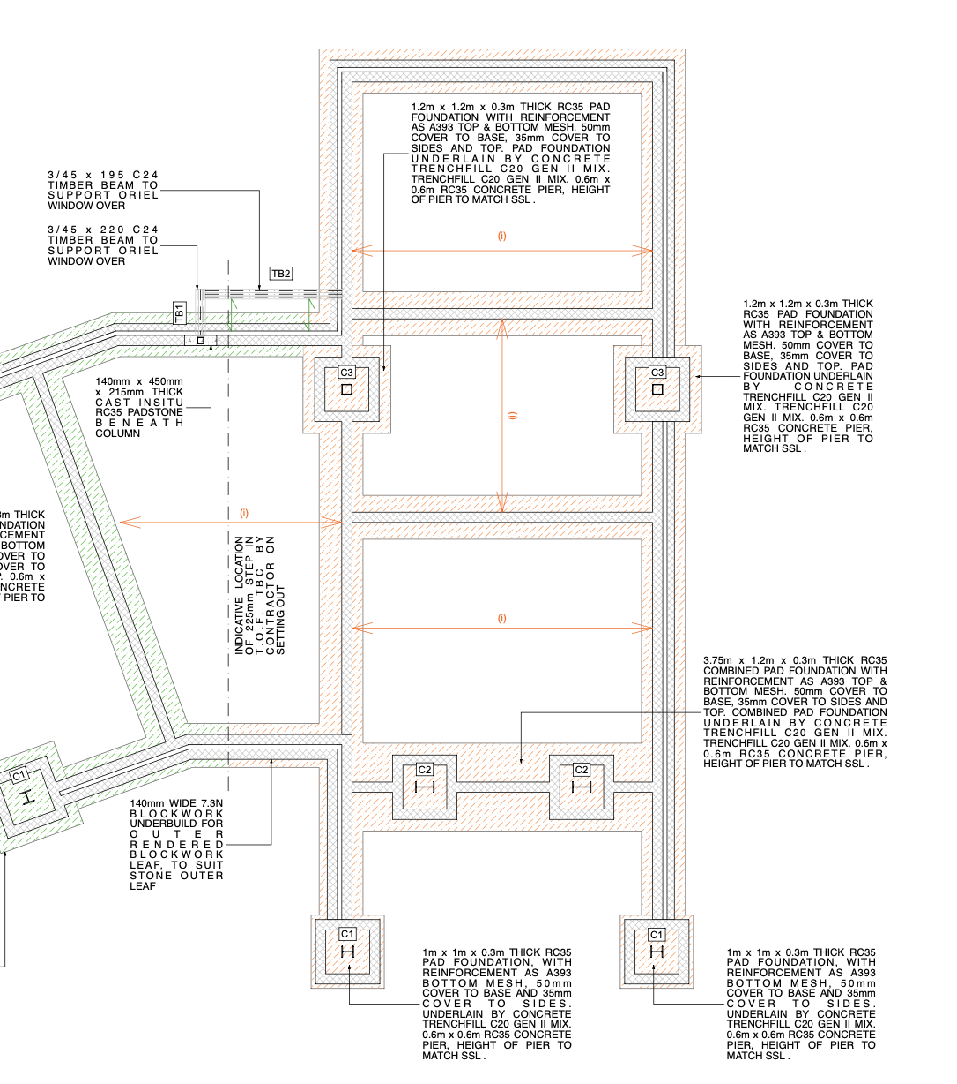
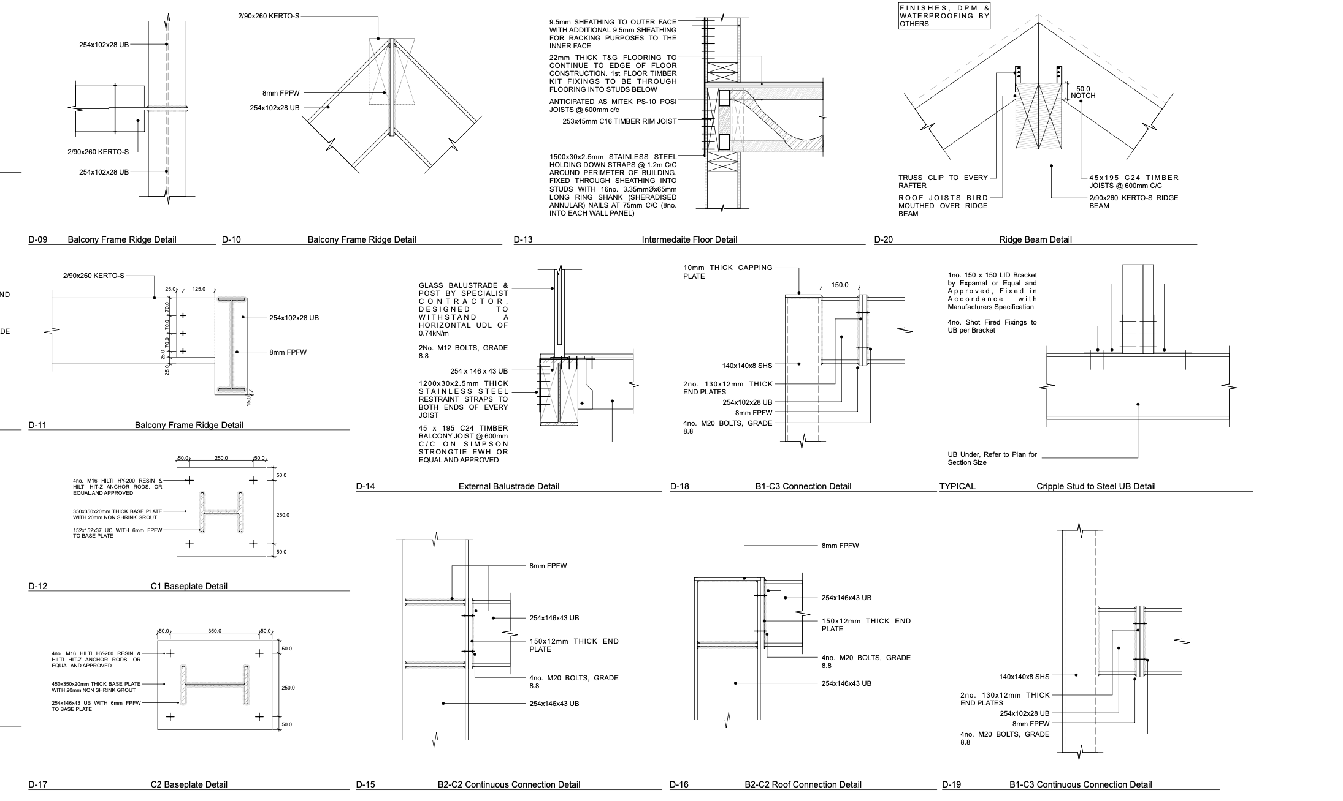
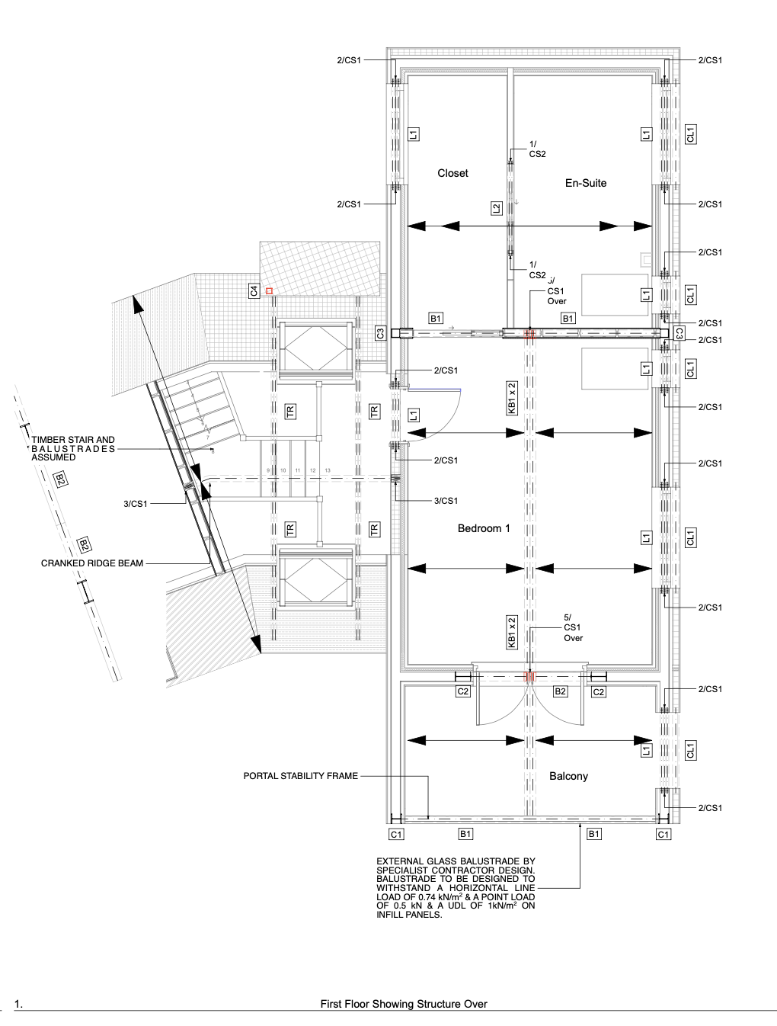
STAGE 3: STUCTURAL DESIGN AND DRAWINGS FOR WARRANT BUILDING REGULATIONS
Development of Stage 2 Proposals for Frozen Layout
Includes: Loading, Stability, Super Structure & Foundations
Timber Frame Detailed Design
Specification & Review of Specialist Contractor Design
Submission for Building Warrant (& in Scotland SER Certification)

Slide 13
SER CERTIFICATION CONSIDERATIONS
SPECIALIST CONTRACTOR DESIGN ITEMS – INCLUDED IN SCHEDULE 1/FORM Q
Feature glazing (>2m2 or acting as barrier (with 800mm of finished floor level)
Piling Design (if required)
Balustrades
Timber truss design
SUPPORTING CALCULATIONS REQUIRED PRIOR TO FABRICATION
SPECIALIST CONTRACTOR DESIGN ITEMS – EXCLUDED FROM SCHEDULE 1/FORM Q
Steel stairs or bespoke timber stairs beyond the scope of BS 585-1
If not available at warrant submission a staged warrant/SER may be required

