Slide 1
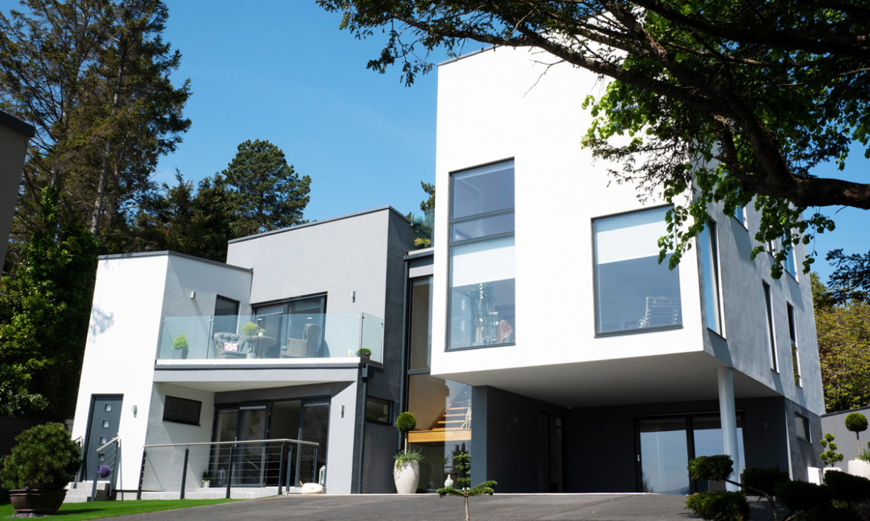

FUTURE HOME STANDARDS & CONSTRUCTION SYSTEMS - WITH jenny chandela

Slide 2
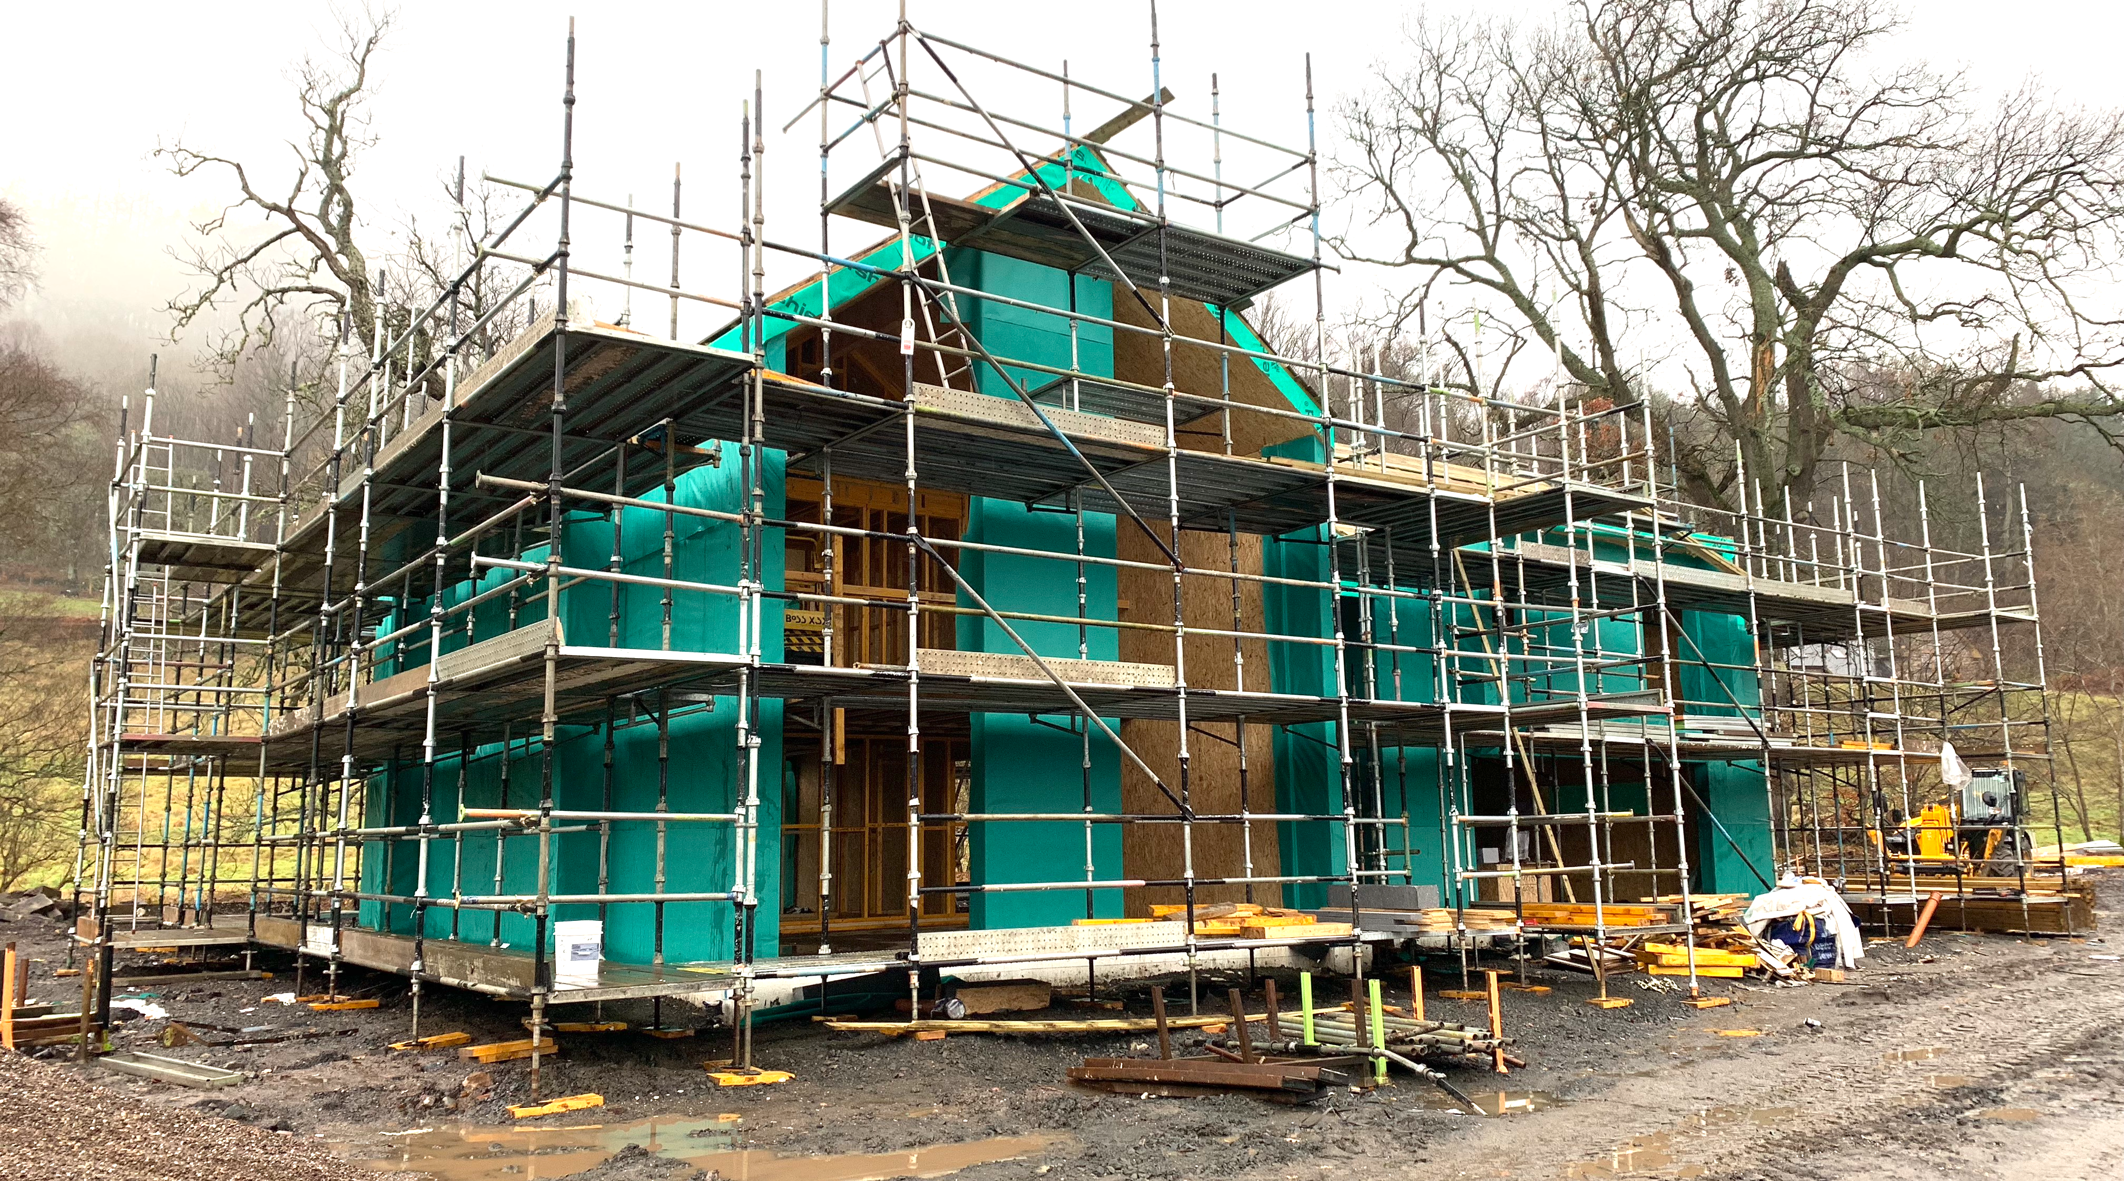
The current problem
The Future Homes Standard
The Fabric First Approach
Construction systems
Passive House
The design process
Summary

Slide 3
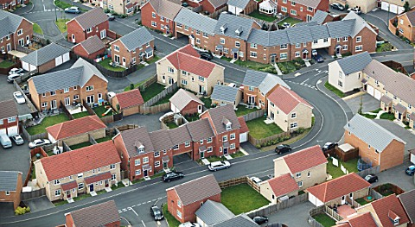
The Current Problem

Slide 4
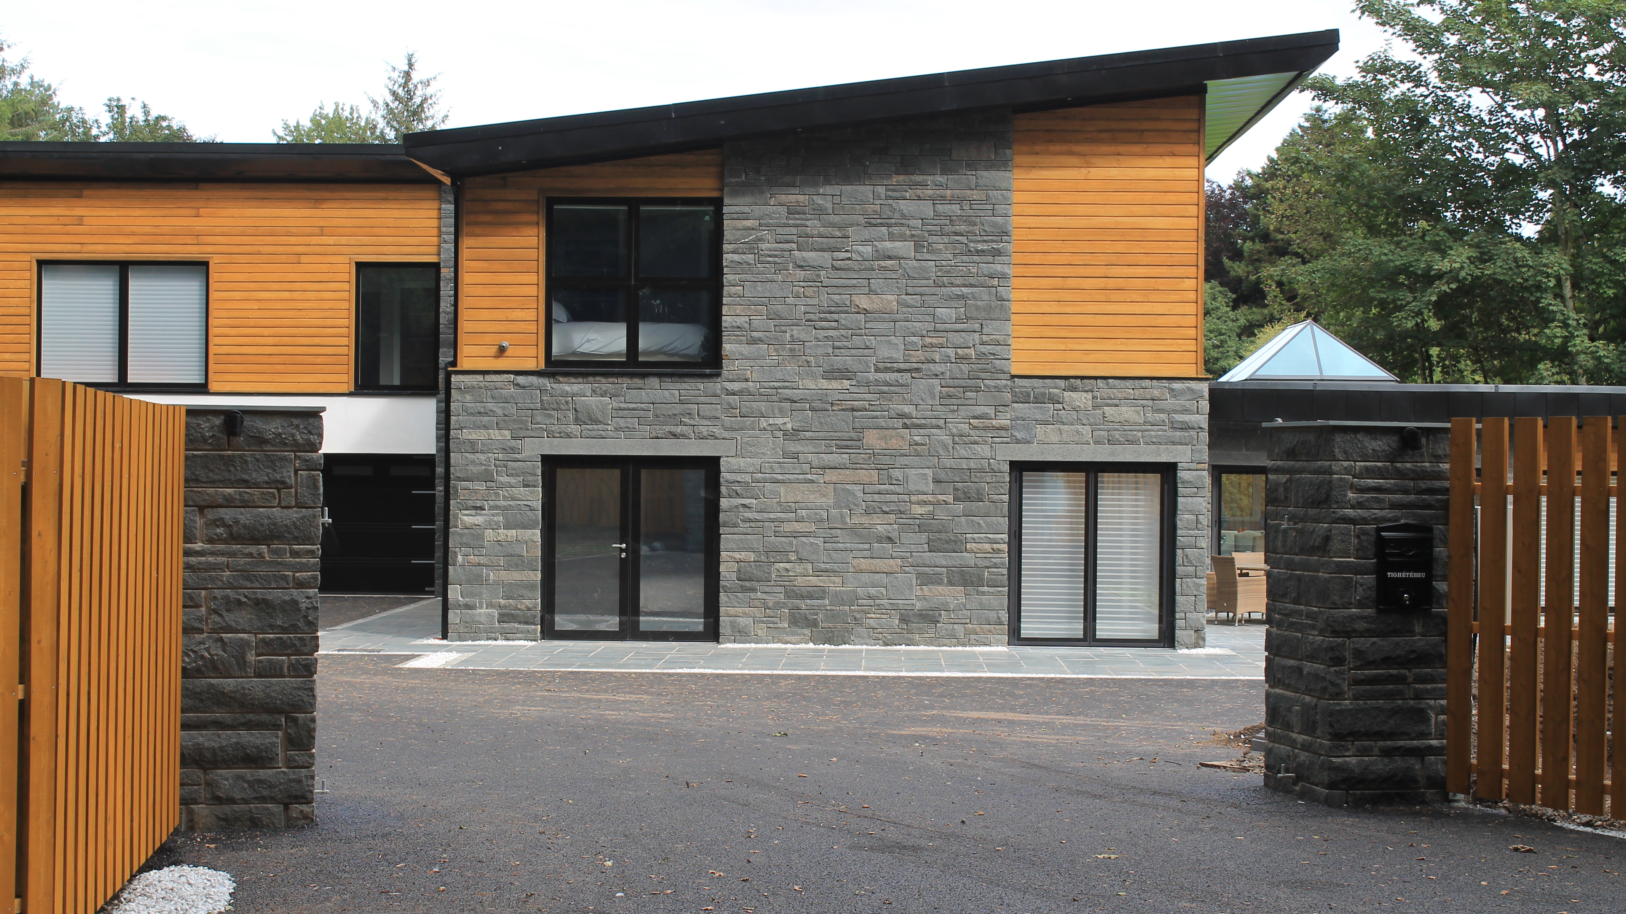
The Current Problem -
We have a massive shortage of housing in the UK and the current housing stock is sub-standard in design and energy performance
The major house builders who control the delivery of new homes are focused on volume rather than quality (EPC less than C)
Heating and powering homes accounts for over 20% of all greenhouse gas emissions in the UK
The construction industry accounts for over 10% of all greenhouse gas emissions in the UK

Slide 5
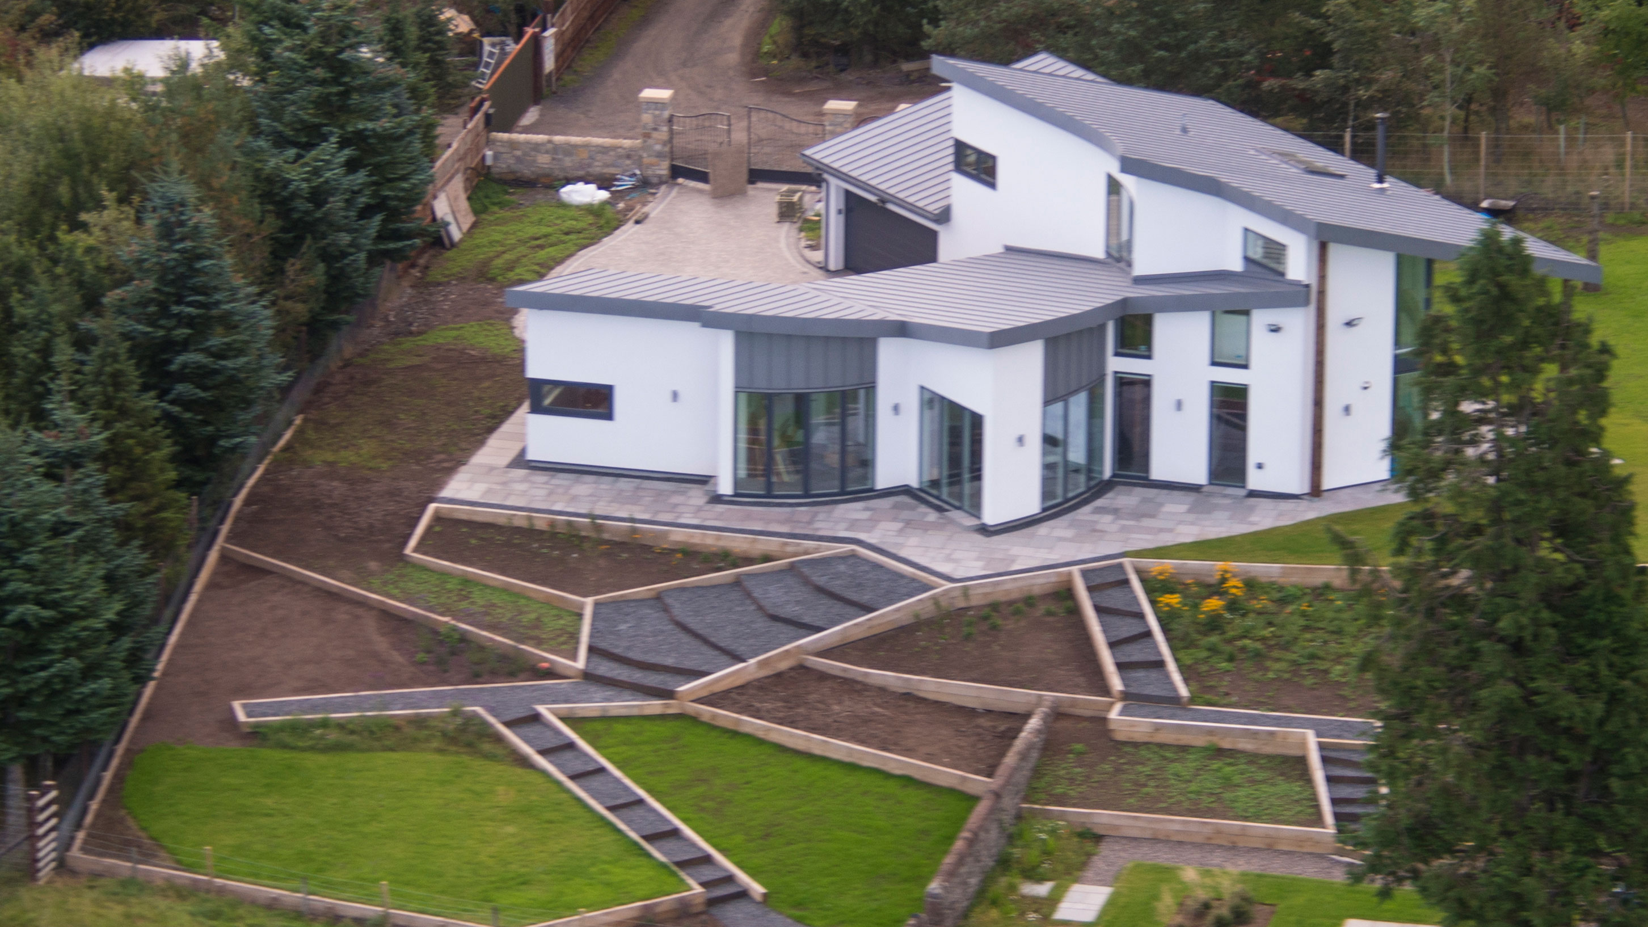
“Put simply a green or low energy home that from design, technologies and construction method uses less energy, from any source, than a traditional or average new house.”
What do we mean by a Green Home

Slide 6
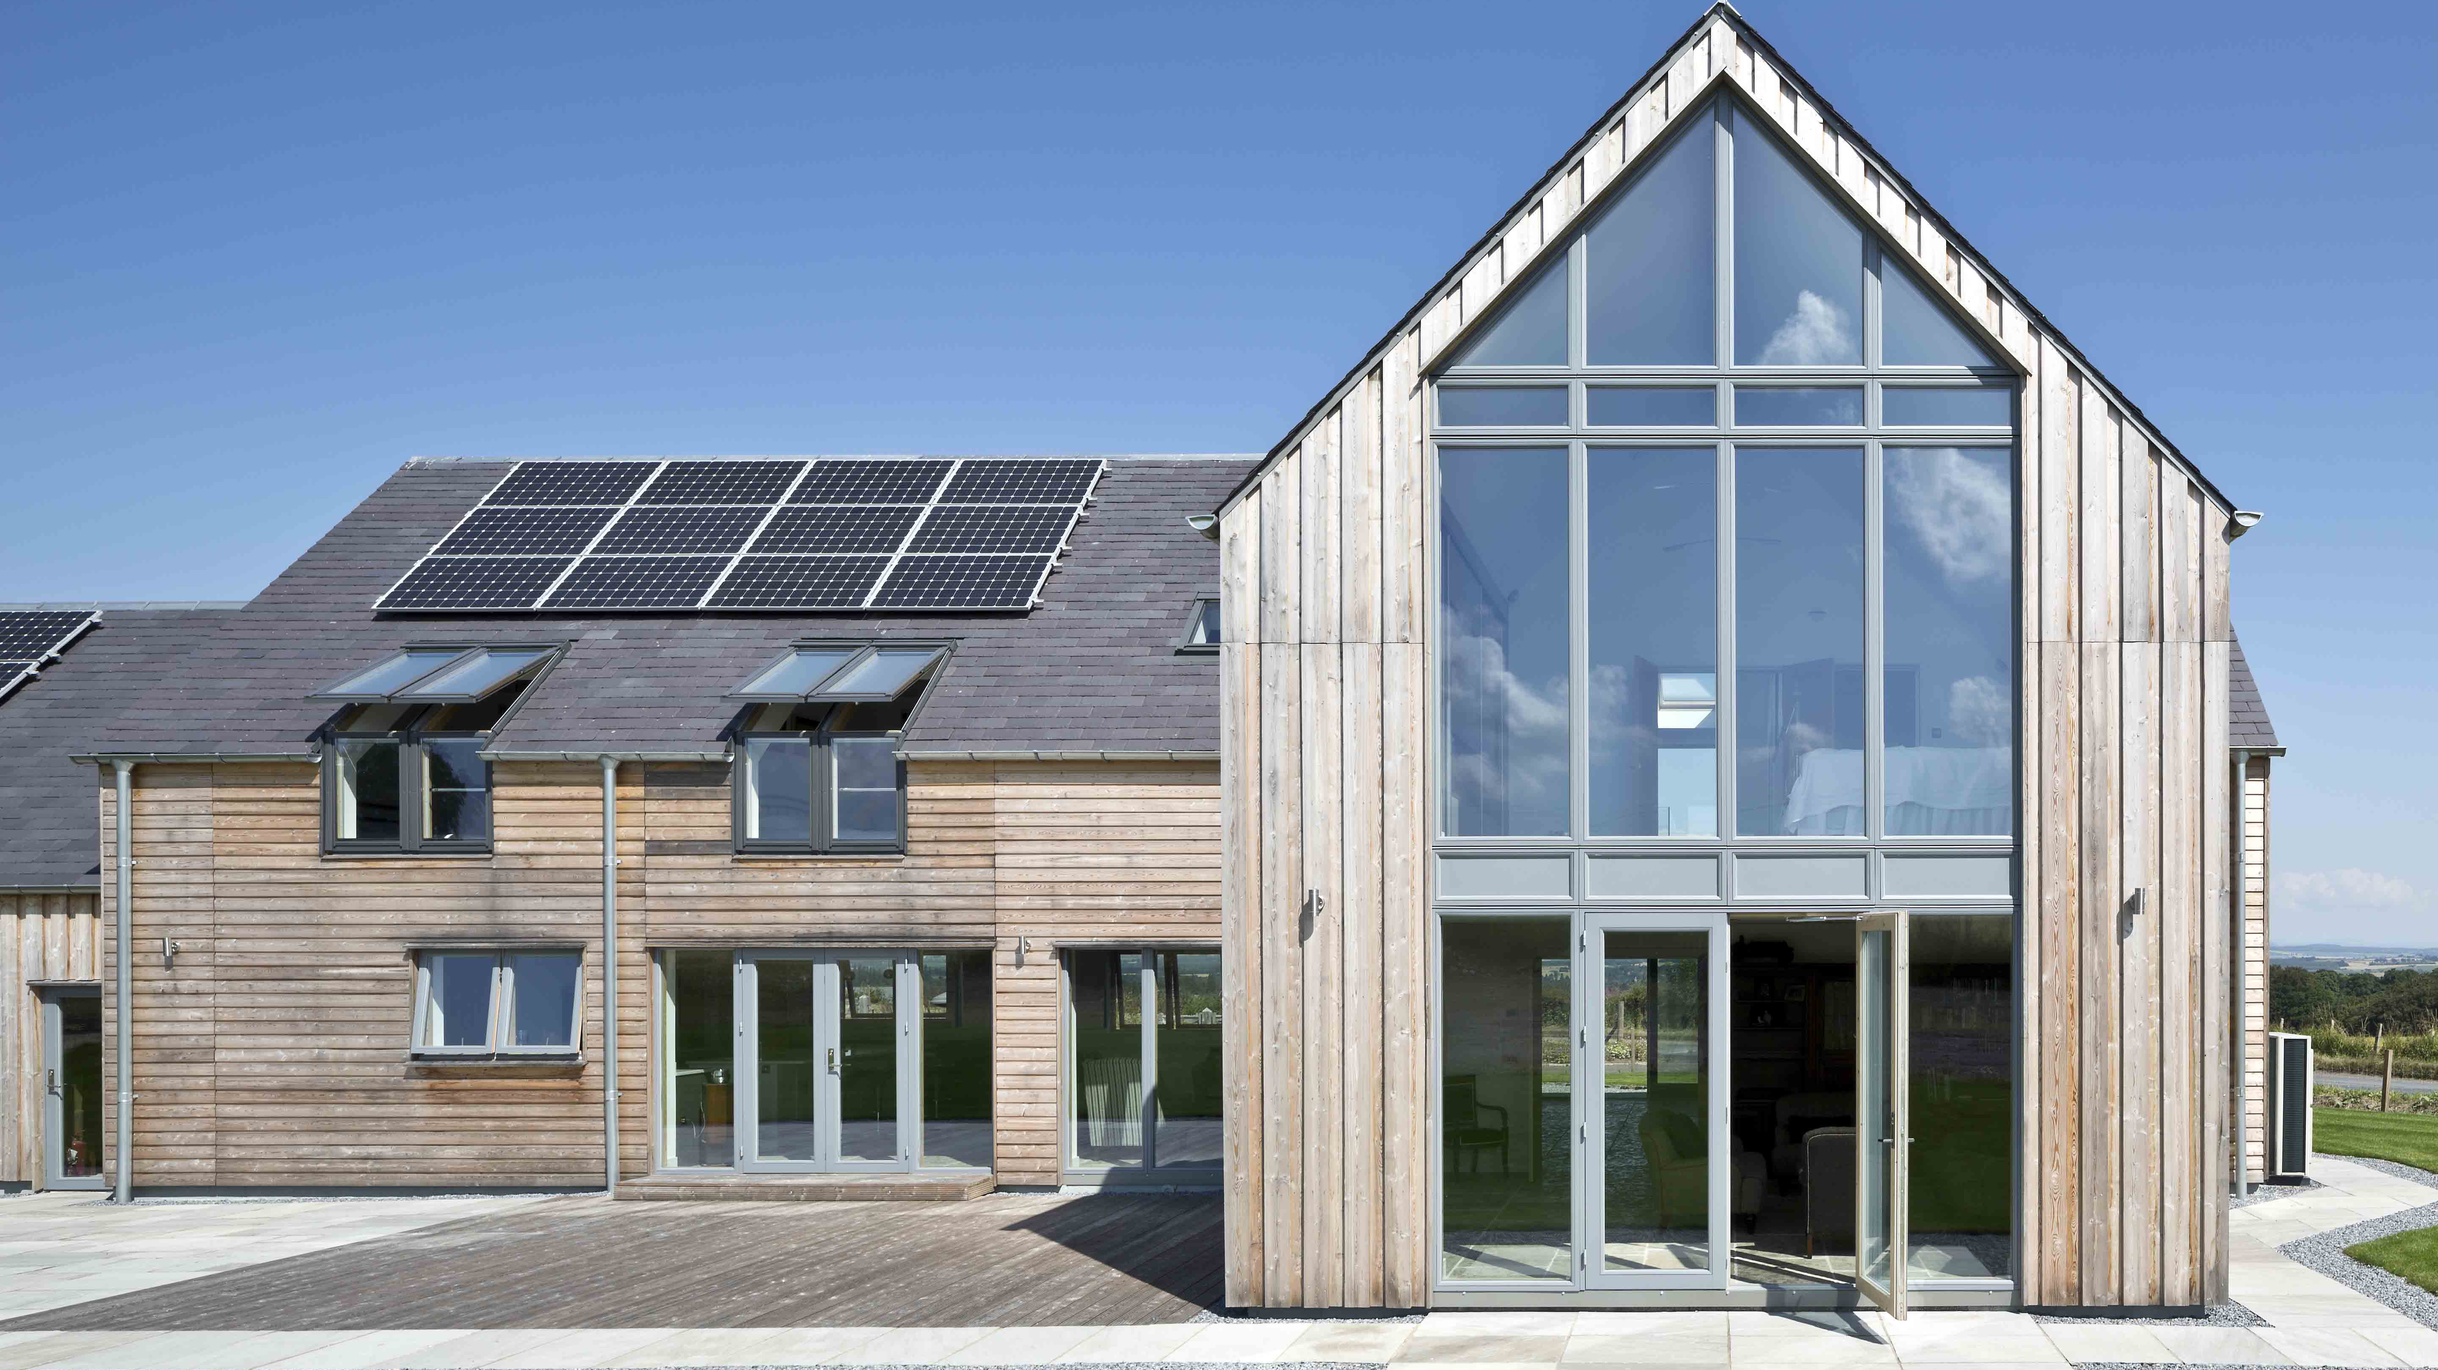
These are examples of low energy homes-

Slide 7
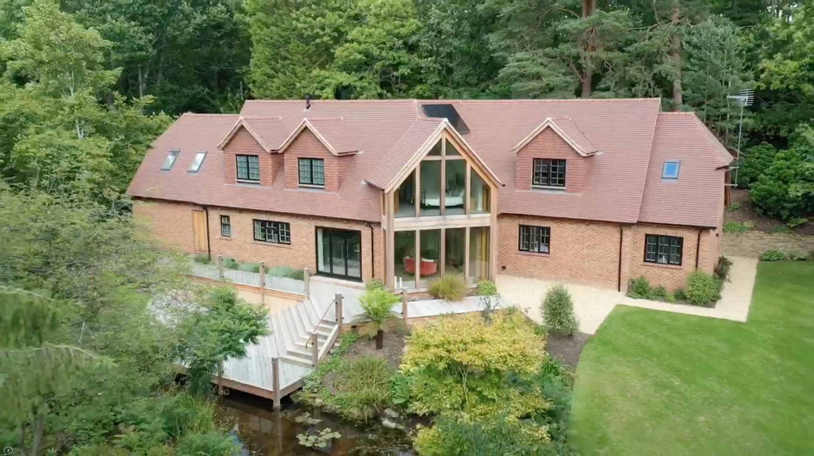
These are examples of low energy homes-

Slide 8
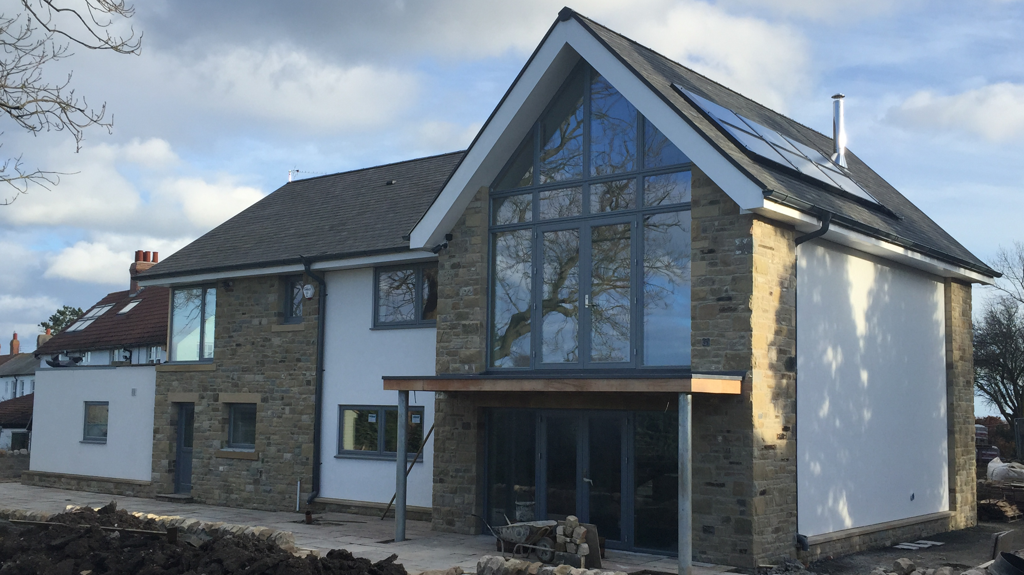
These are examples of low energy homes-

Slide 9
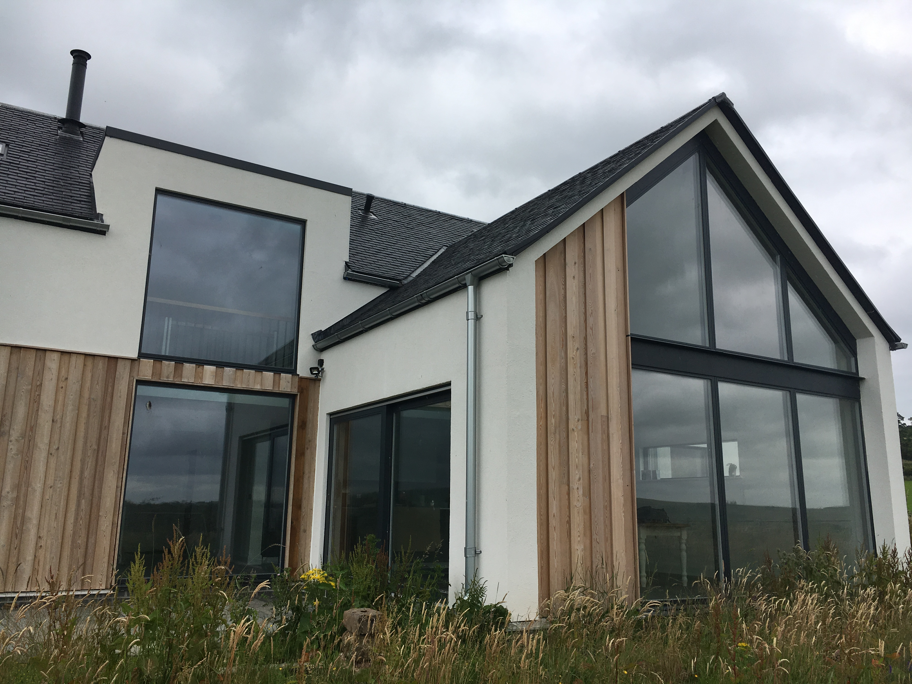
These are examples of low energy homes-

Slide 10
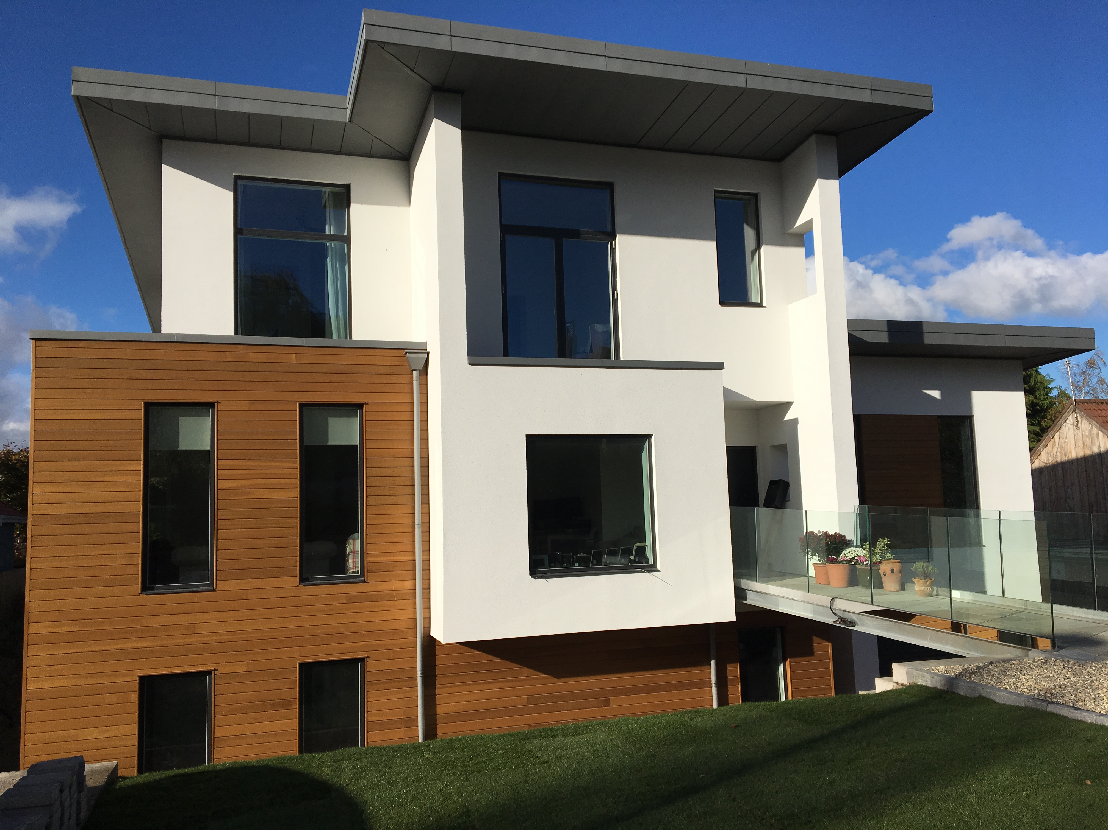
These are examples of low energy homes-

Slide 11
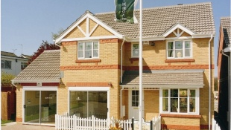
This is not -
THIS IS NOT GOOD ENOUGH…….

Slide 12
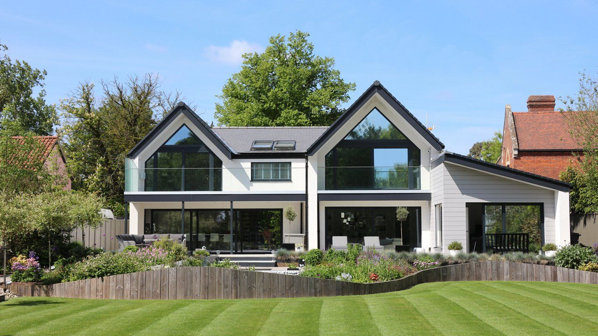
The Future Homes Standard

Slide 13
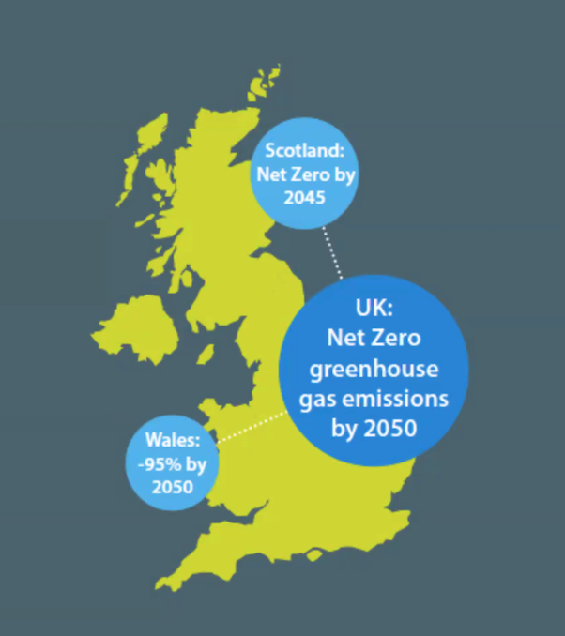
The Future Homes Standard -
We need 250,000 new homes per year
Custom & Self build’s lead the way in design and energy performance
Future Homes Standard 2025 –
- A major review of the Building Regs
(Part L - cconservation of fuel and power, Part F – ventilation)
- Drive towards Net Zero Carbon dwellings
- Remove fossil fuel boilers
- Improvement in U values
RIBA Climate Challenge 2030 –
- 50% Reduction in Operational Energy & Carbon Emissions
- 40% Reduction in Embodied Energy & Carbon Emissions
- 40% Reduction in potable water usage
- Low Carbon Heating, no fossil fuel boilers

Slide 14
The Future Homes Standard -
Its better for the environment, by reduced carbon emissions during construction
Its better for the environment, during operation due to the reduced energy demand
Typically 40-80% betterment in building standards than current housing stock
Reduced running costs over the life of the house
Potential for zero or positive energy bills
A more comfortable, healthy built environment

Slide 15
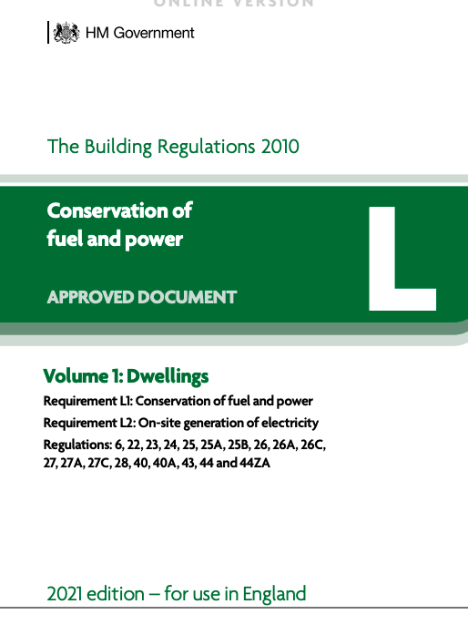
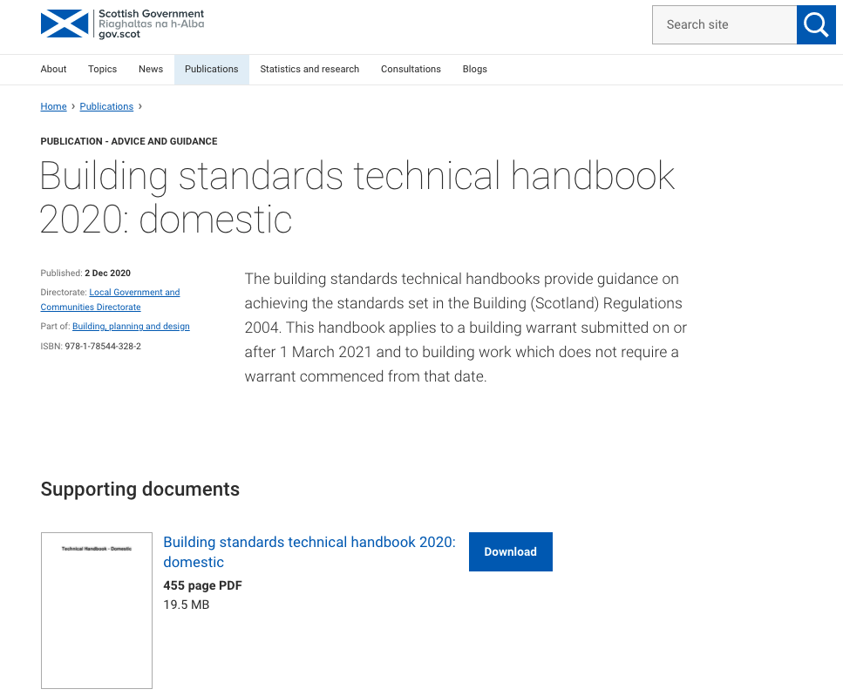
The Future Homes Standard - timeframe
The new Future Homes Standard is aimed to ensure that all new homes built from 2025 will produce 75-80% less carbon emissions than homes delivered under current regulations.
New homes built from 2022 produce 31% less carbon emissions compared to current standards. Building Regulations are planned to be updated later this year.
From 2025 no new homes should be connected to the gas grid, they should instead be heated through low carbon sources, have ultra-high levels of energy efficiency alongside appropriate ventilations.
(Committee on climate change)

Slide 16
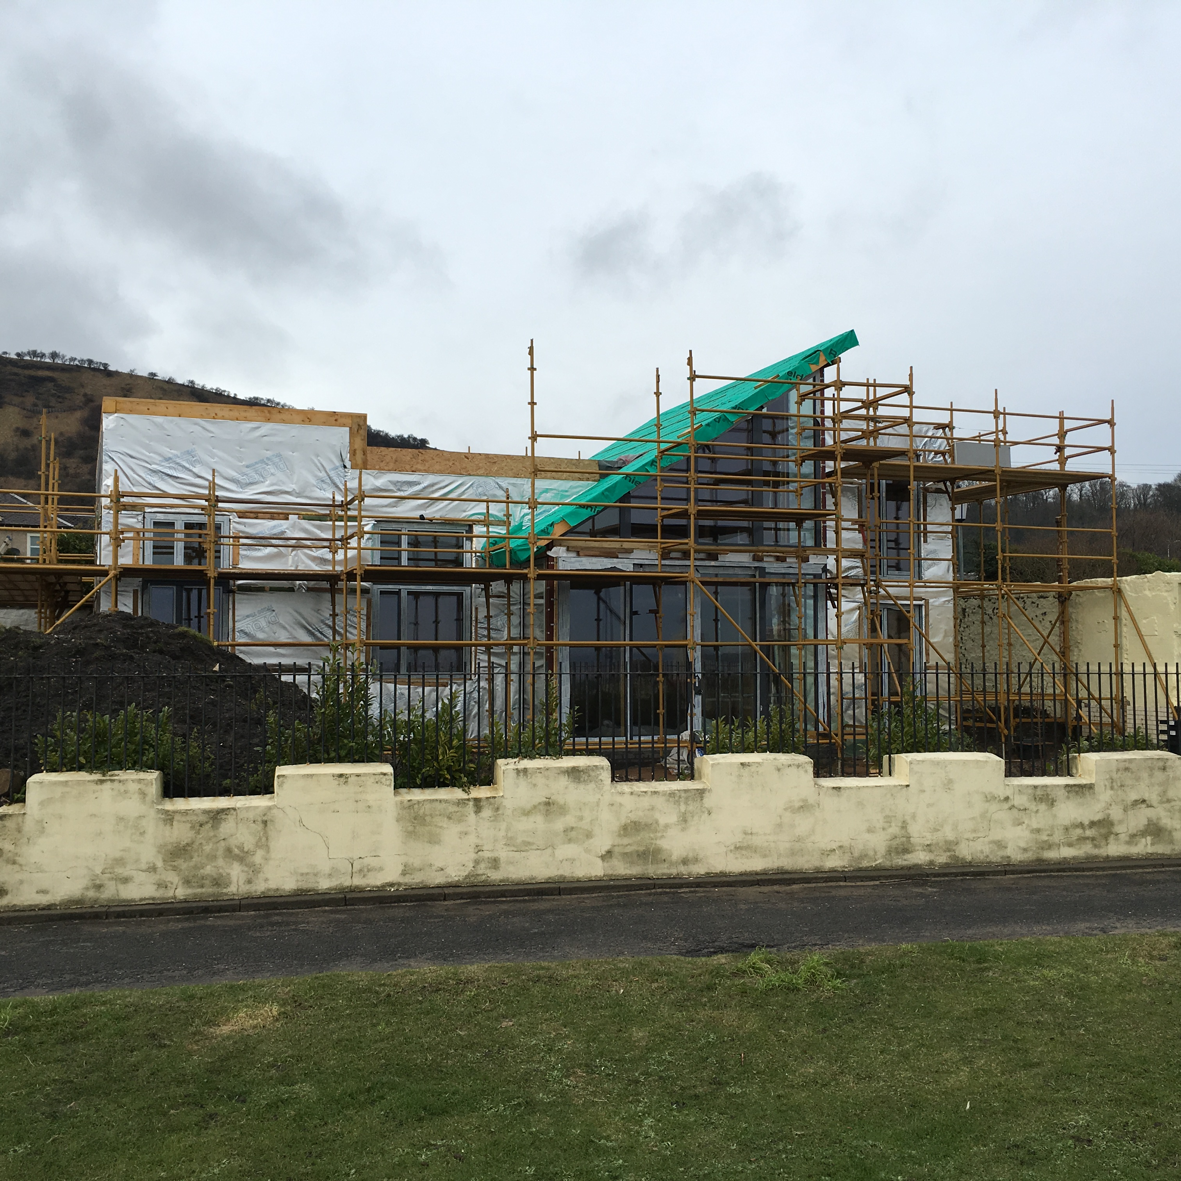
”Is a back to basics approach where you concentrate on the fabric of the building before throwing eco bling, in order to make it work.”
The Fabric First Approach

Slide 17
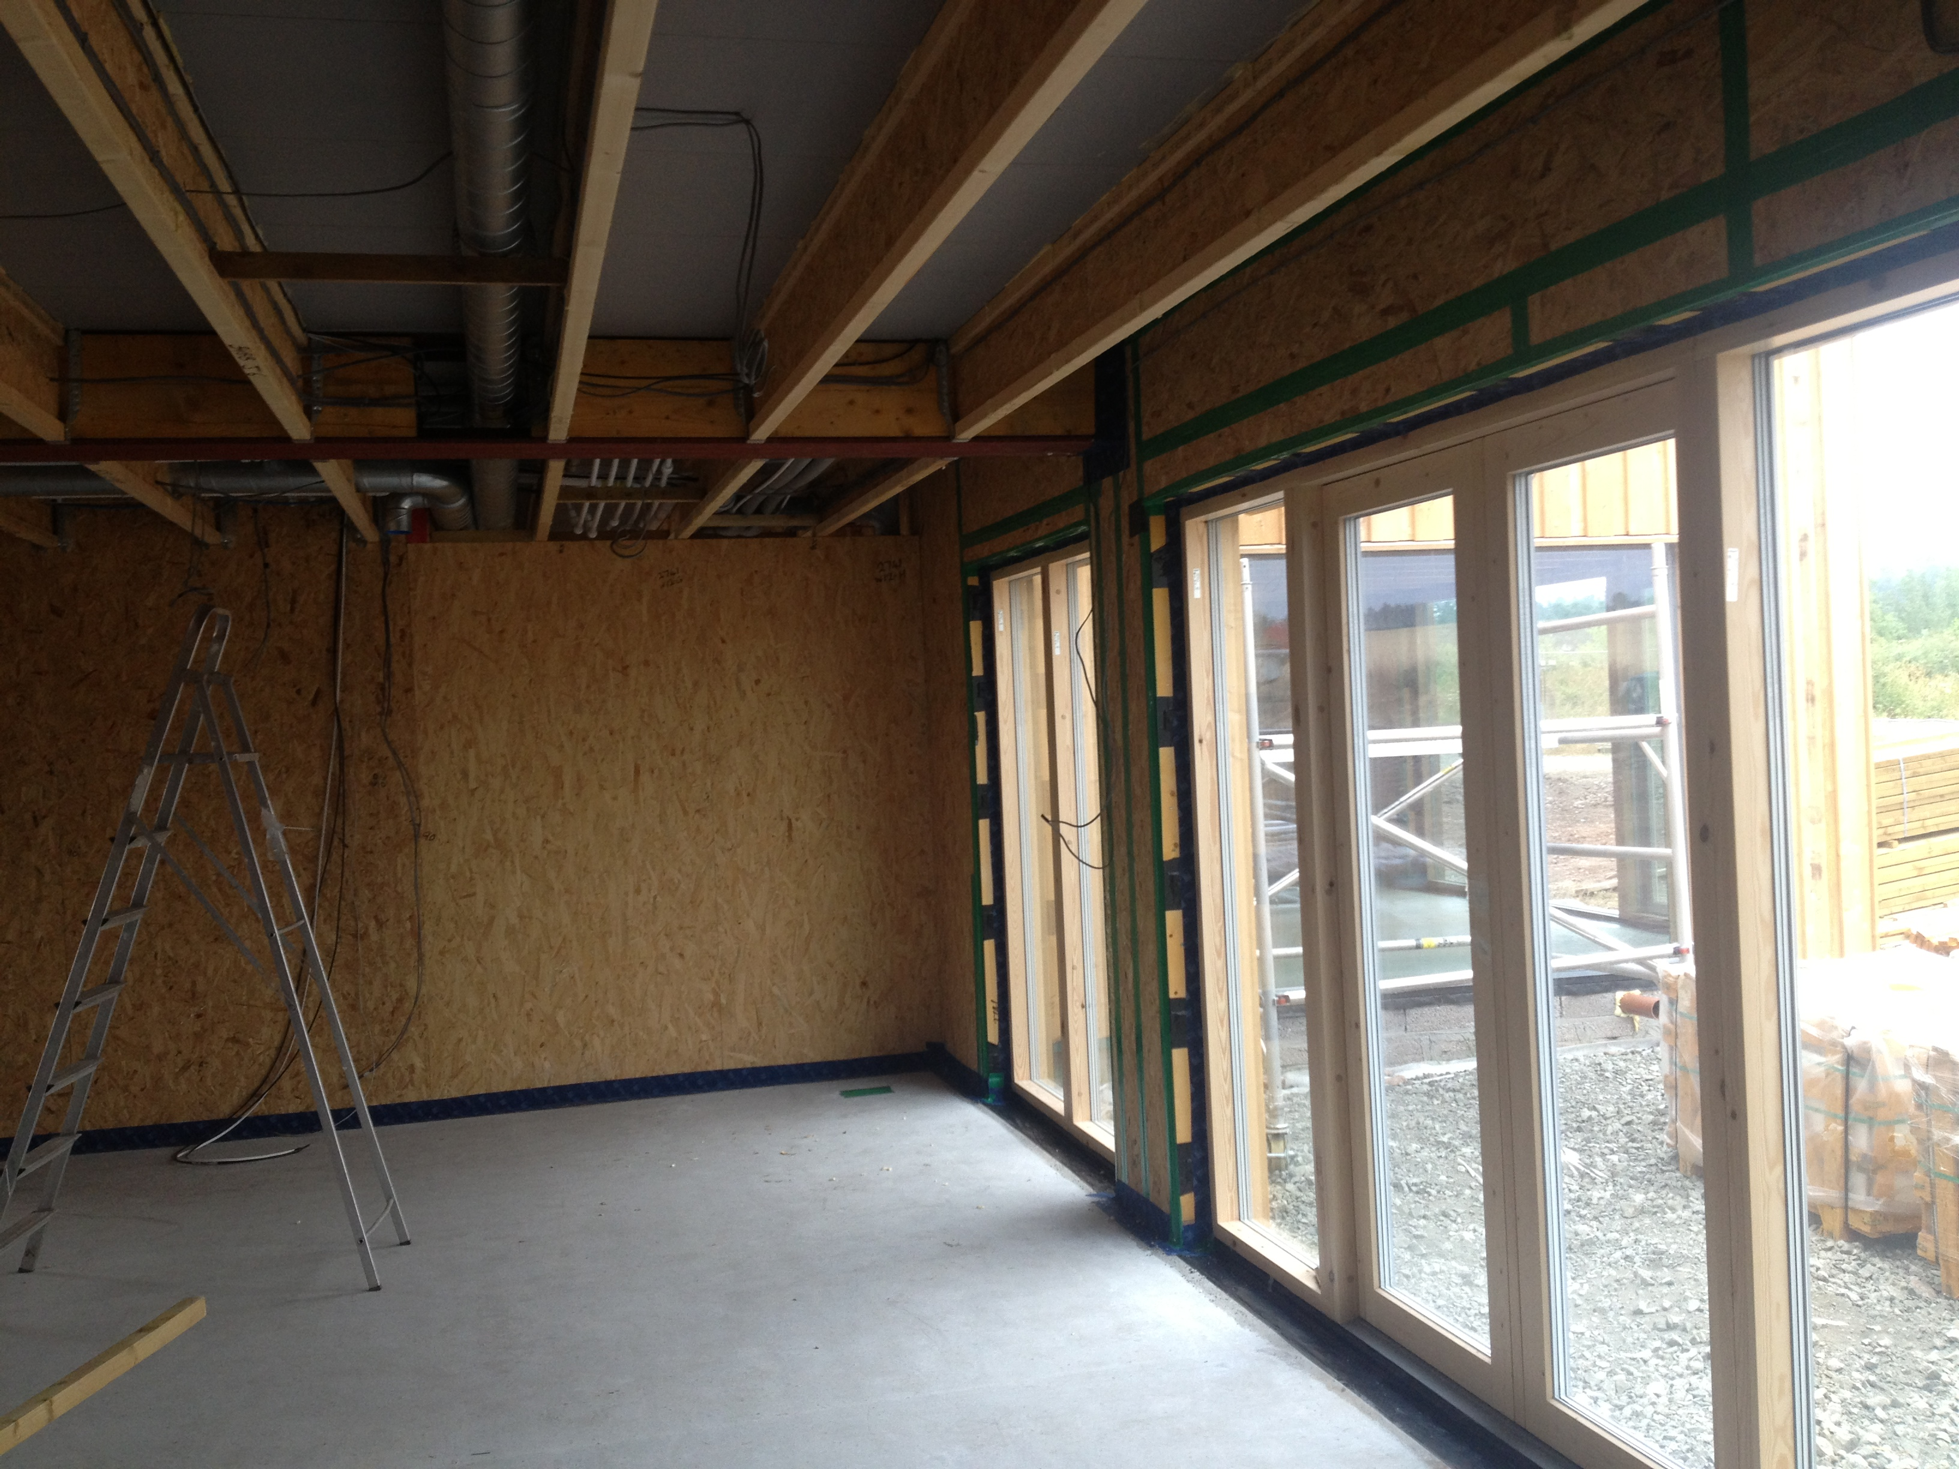
Fabric First Design Principles -
Highly insulated building envelope with limited cold bridges
High specification windows & doors
Air tight membranes and tapes used to seal all external walls and penetrations
MVHR system providing fresh heated air throughout the home, potentially with a heating element
Maximise the natural solar gain through building orientation
Utilise a small renewable led heating system

Slide 18
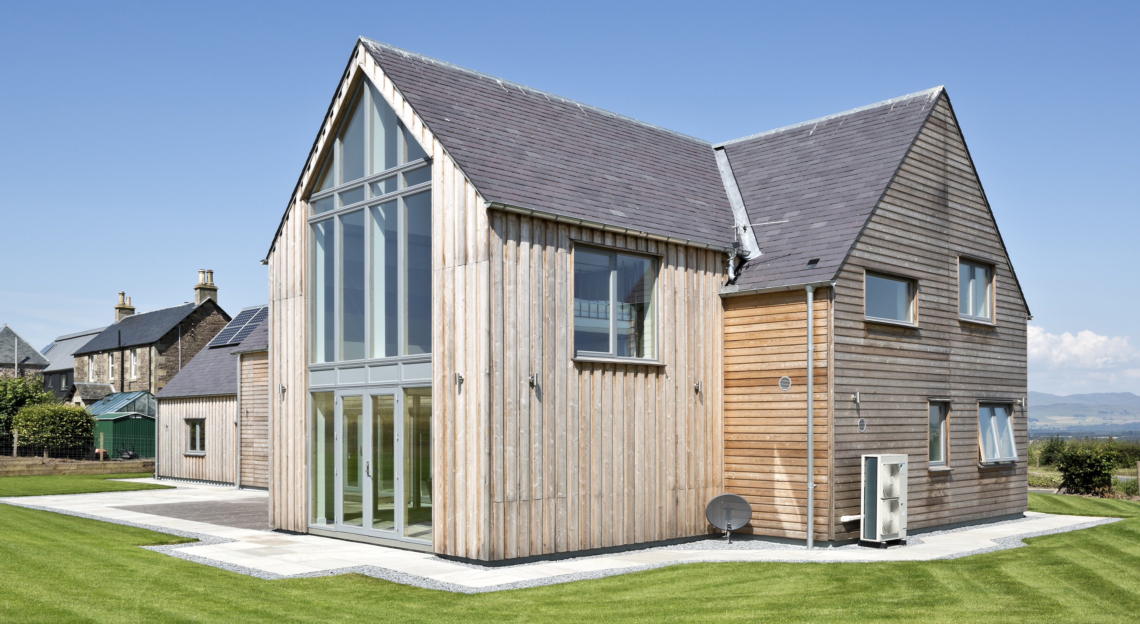
THE KEY ELEMENTS
Solar Gain
Construction Type
Air Tightness
Limit Cold Bridging
Ventilation Strategy
Heating Systems

Slide 19
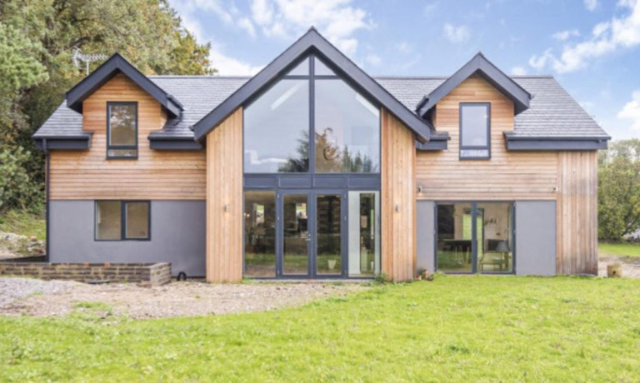
Construction Systems

Slide 20
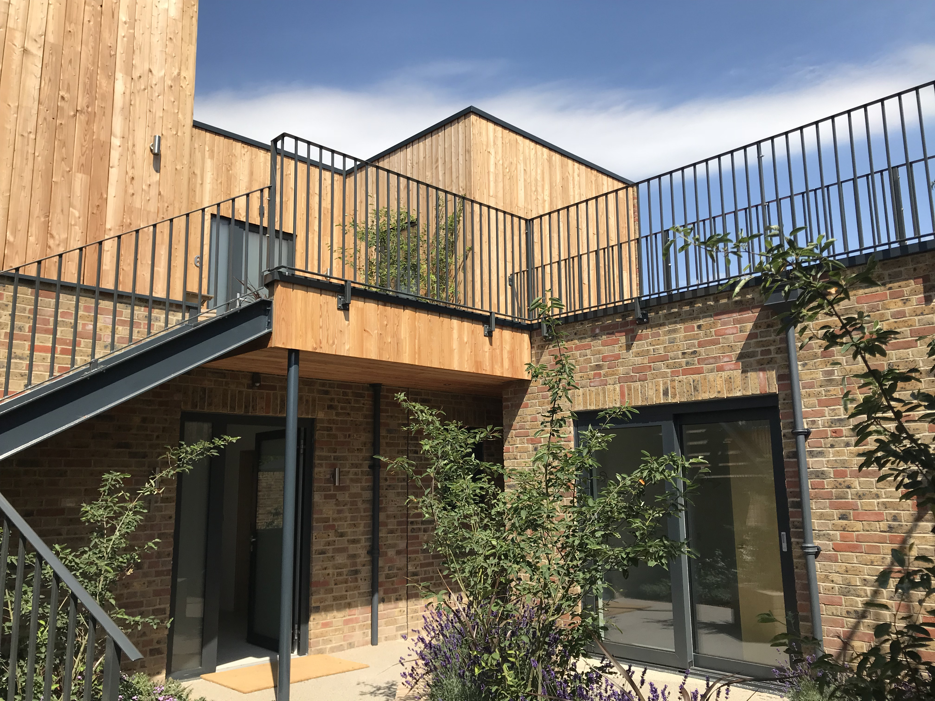
The main considerations
Questions you have to ask yourself –
How much involvement are you having in the project?
What is your budget?
Is energy performance important to you?
Is speed of build a factor?

Slide 21
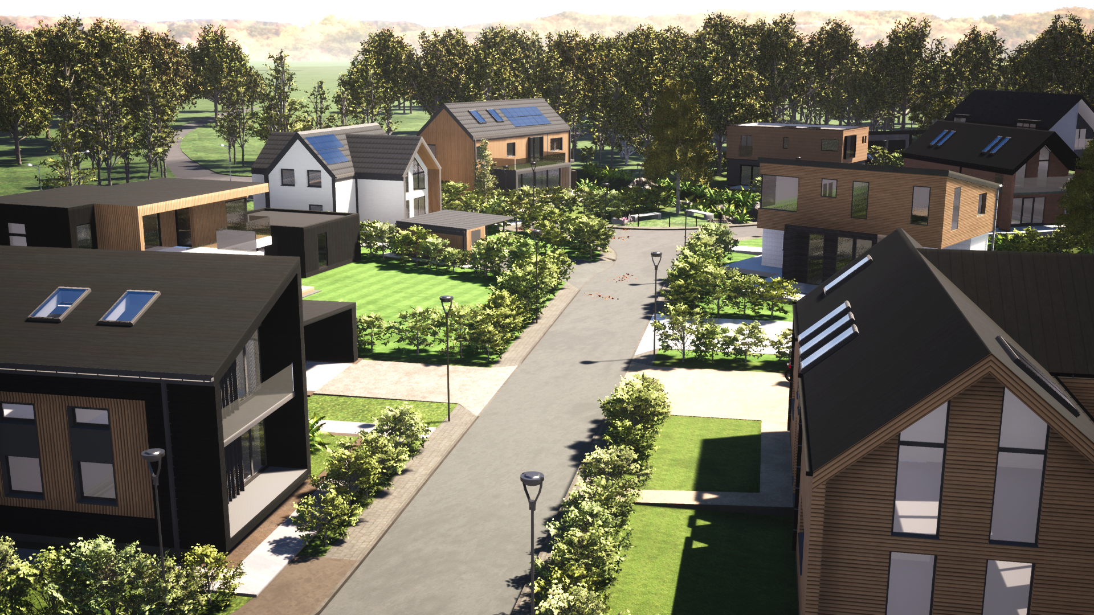
SAP – Standard Assessment Procedure
Basic Energy Performance Criteria
U – value – Measure the ease which a material or building assembly allows the heat to pass through. The lower the U-value the better the insulation properties.
 | England /Wales Section L | Scotland Section 6 | Fabric First Targets | Passive House
Wall U-value (W/m²K) | 0.18 | 0.17 | 0.15 | below 0.15
Floor U-value (W/m²K) | 0.13 | 0.15 | 0.15 | below 0.15
Roof U-value (W/m²K) | 0.13 | 0.11 | 0.15 | below 0.15
Windows/openings | 1.4 | 1.4 | 1.2 | 1.0
Air permeability | 5 (m³/hr/m² at 50 Pa) | 7 (m³/hr/m² at 50 Pa) | 1.5 - 3 (m³/hr/m² at 50 Pa) MVHR required | 0.6 air change rate @50 Pa pressure difference MVHR required

Slide 22
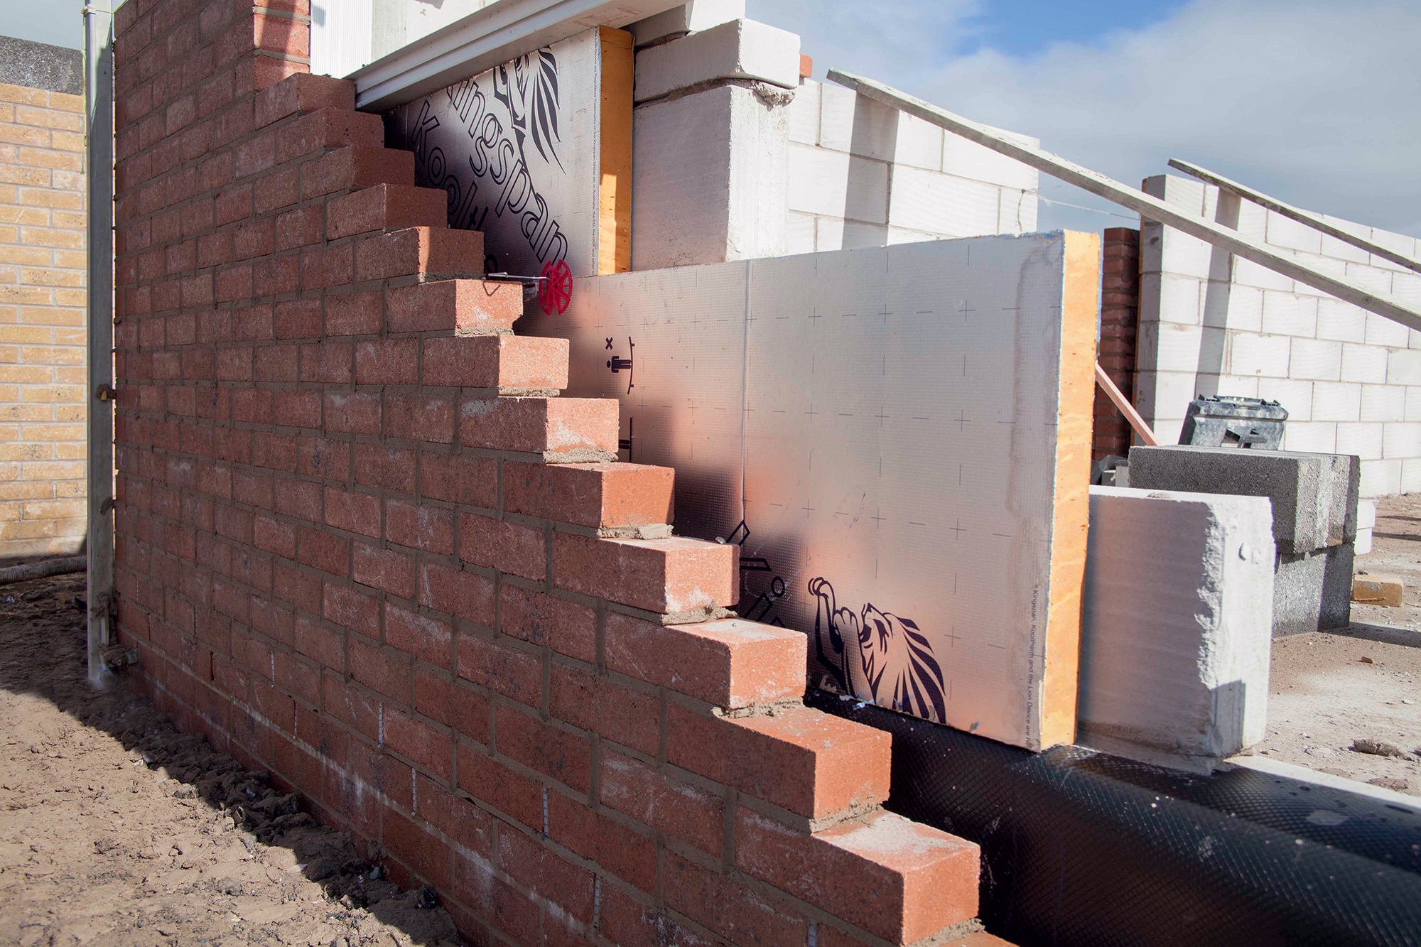
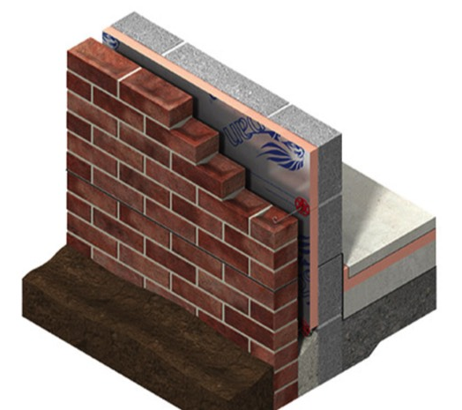
1. Masonry
Details – brick outer skin, with cavity either full or partial fill insulation, aircrete block inner skin. Timber truss roof
Market share - 46% (down from around 70%)
Time to wind & water tight – 20 weeks approx. [current market pushing to 27-30 weeks]
Cost – cheaper than off site alternatives
Pros – traditional solid and safe. No issues with building fire. Cost effective and its what most architects know. Excellent thermal mass.
Cons – Very slow compared to off site Not the preferred option for low energy homes. Thick build up
Notes:
.

Slide 23
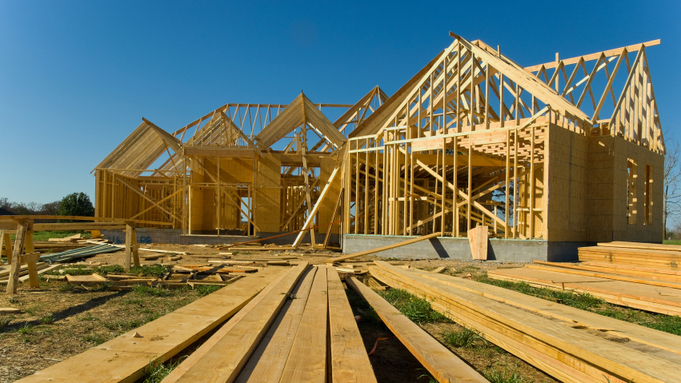
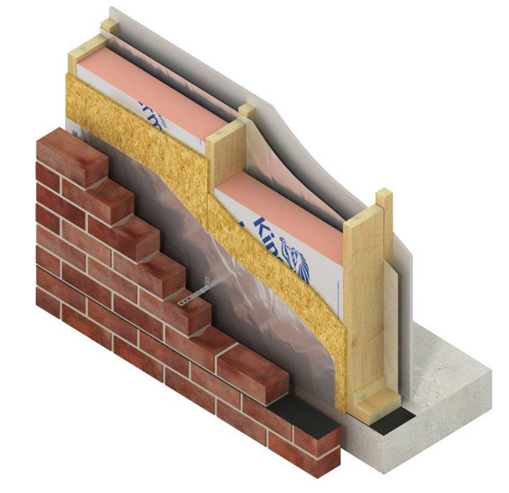
2. Timber frame
Details – timber studwork with an external OSB or plywood board nailed to it. Insulation friction fitted between the studs. OSB lined externally with a breather paper & internally with a vapour barrier.
Market share - 36%
Time to wind & water tight – 10 weeks approx
Cost – open panel system cheapest, comparable to masonry
Pros – fast and cost effective way of building, good insulation levels. Lots of suppliers and choice.
Has been the standard choice in Scotland for many years. No issues with insurance or mortgageability.
Cons – Perceived fire issues, can seem lightweight. Settlement of timber can cause cracking

Slide 24
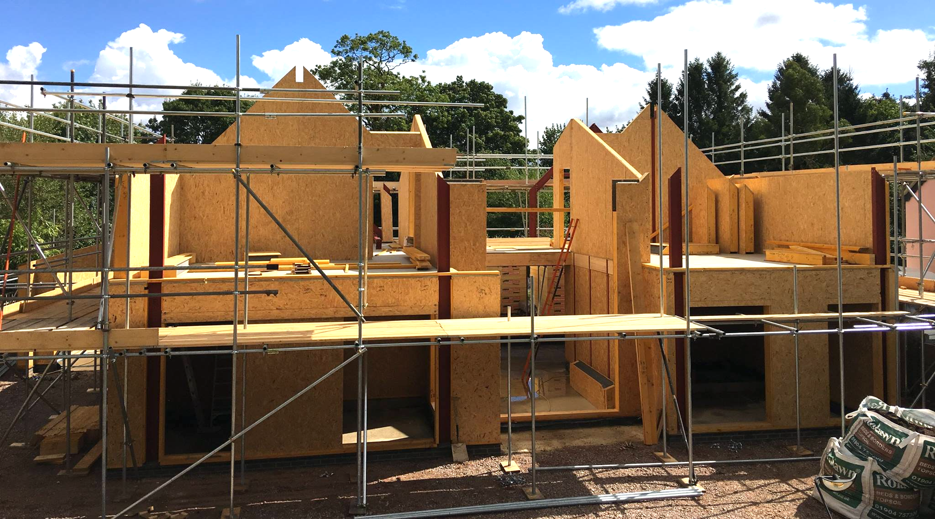
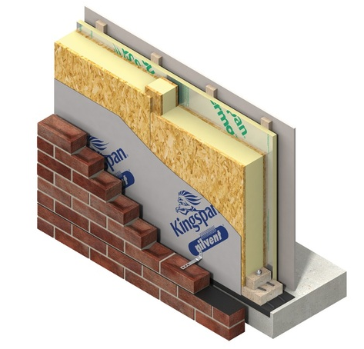
3. SIPs (Structural Insulated Panel)
Details – 2 skins of OSB are filled with either polyurethane (mix) or rigid polystyrene, infilled with timber to create closed panel. External breather membrane internal vapour barrier. Timber or mini SIPS structural splins. Wall & roof panels are the same.
Market share - 8%
Time to wind & water tight – 6 weeks approx
Cost – 10 - 15 % more expensive than timber frame
Pros – fast and cost effective if designed to panel sizes, excellent insulation levels. Airtight, ideal for fabric first or Passive House.
Huge spans, no roof trusses – vaulted ceilings. No issues with insurance or mortgageability.
Cons – Perceived fire issues, requires crane for roof. More expensive than alternatives

Slide 25
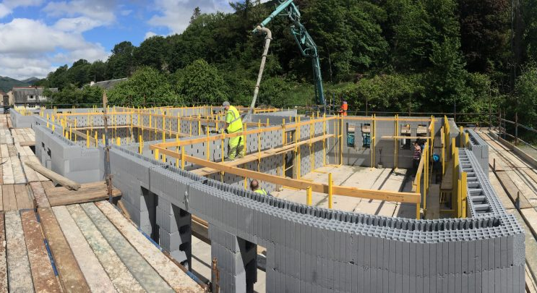
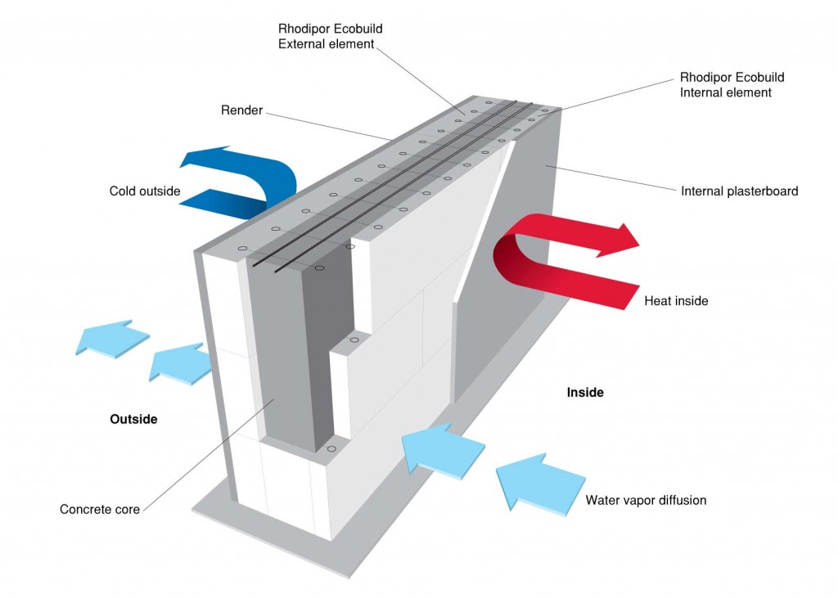
4. ICF (Insulated Concrete Form)
Details – Lightweight hollow interlocking blocks, usually made from polystyrene or PU insulation. Dry stacked, reinforced with steel rebar and filled with concrete (floor by floor). Lego blocks for grown-ups
Market share - 5%
Time to wind & water tight – 10 weeks approx
Cost – 10 - 15 % more expensive than masonry.
Pros – fast and cost effective especially if you stack the blocks yourself. Excellent insulation levels. Airtight, ideal for fabric first and Passive House.
Ideal for basements. Rigid and solid. No issues with insurance or mortgageability.
Cons – The pour is critical (burst blocks), more expensive than block. Alterations, extensions can be difficult. No full house solution.

Slide 26
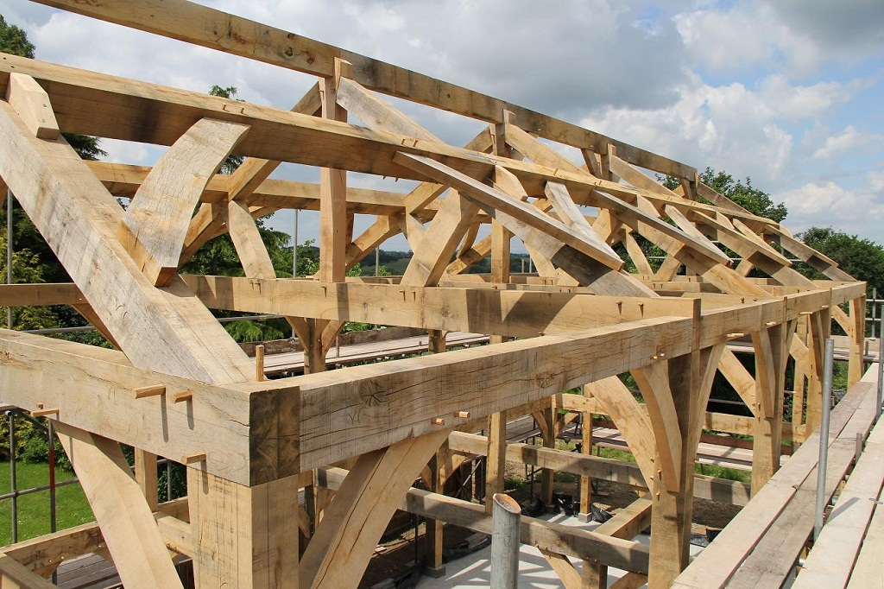
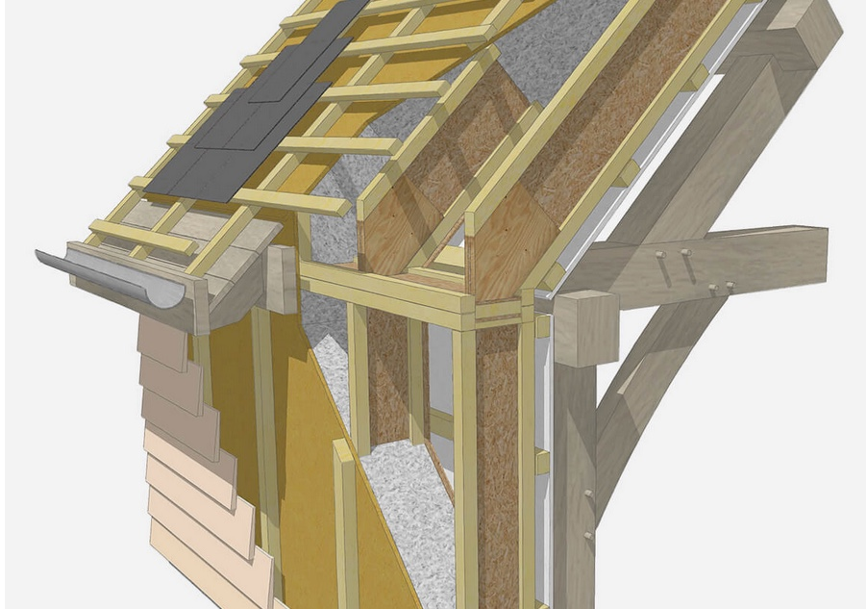
5. Oak Frame
Details – Green Oak frames are cut and shaped off site, & erected by experienced team on site. Structural frame is then encapsulated with an insulated envelope, often SIPS.
Market share - 3%
Time to wind & water tight – 10 weeks approx
Cost – The most expensive method.
Pros – can be relatively quick to erect kit & encapsulated. Perfect for more traditional designs. Can expose timber internally & externally. High performance given the right encapsulation.
Can use part frame in exposed areas.
Cons – expensive and you are doubling up on structural frame. Frame will move and shrink due to high water content, requires cleaning with Oxalic acid once erected. Specialist designers.

Slide 27
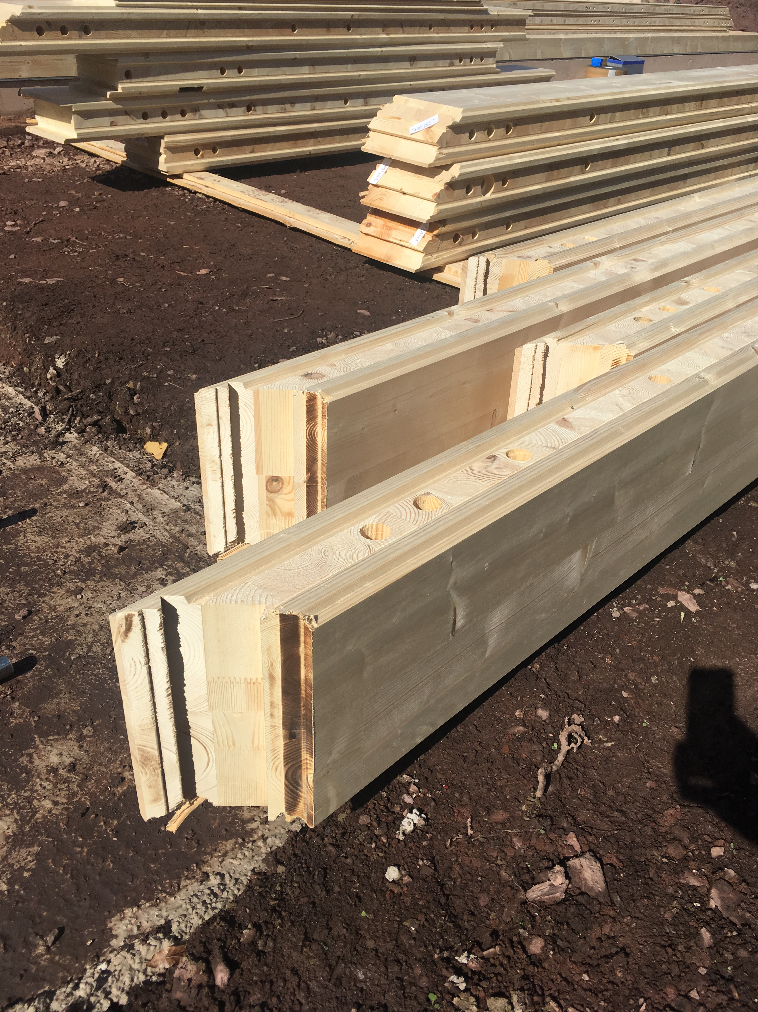
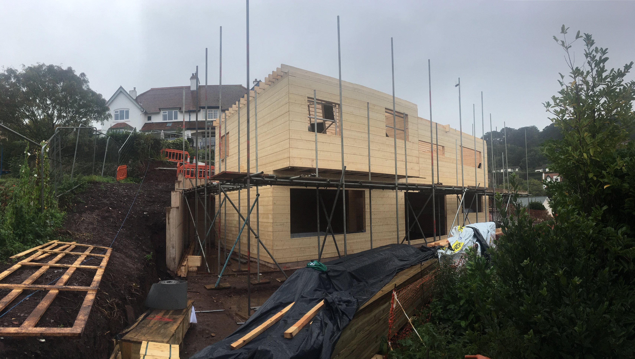
6. Solid Wood Construction
Details – Ecological Construction option. Solid wood modular construction method. Kit detailed offsite and arrives in small packages to site.
Time to wind & water tight – 12 weeks approx
Cost – 10 - 15% more expensive than timber frame
Pros – Low Carbon Footprint. Renewable raw material sustainable development. Carbon sink. Efficiency of production (processing). Natural ideal humidity.
Cons – Specialist design, limited providers.

Slide 28
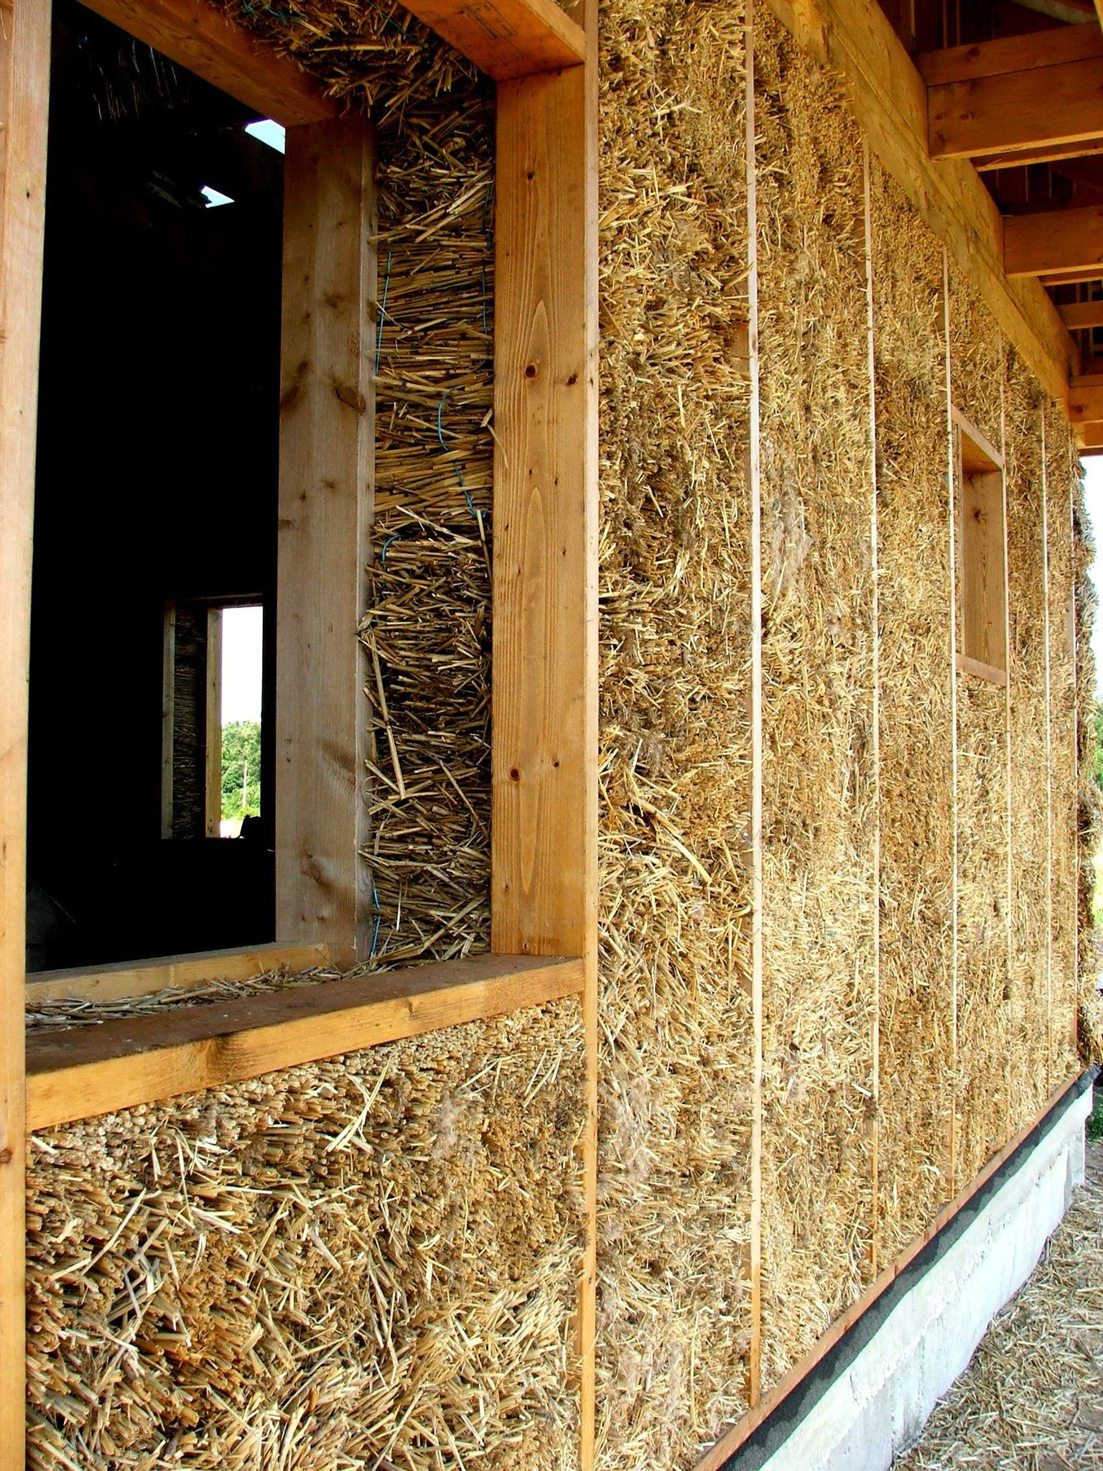
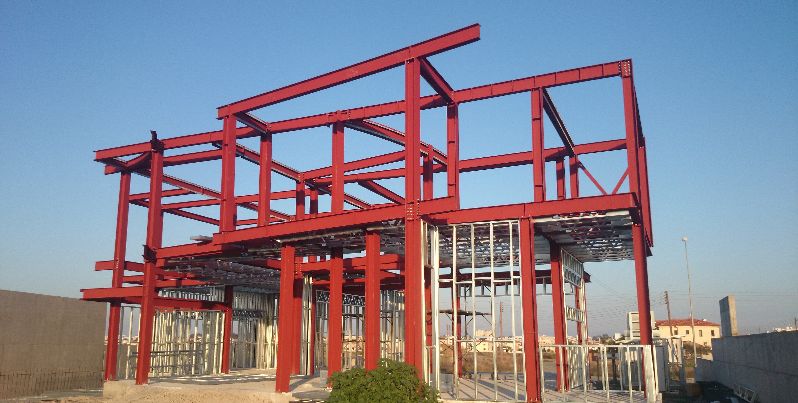
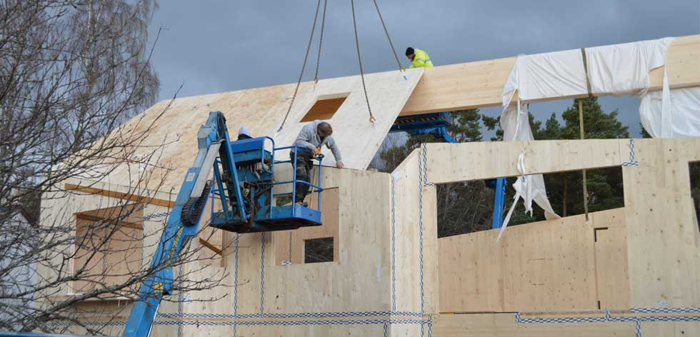
7. Alternatives
Steel frame
Straw bale
CLT

Slide 29
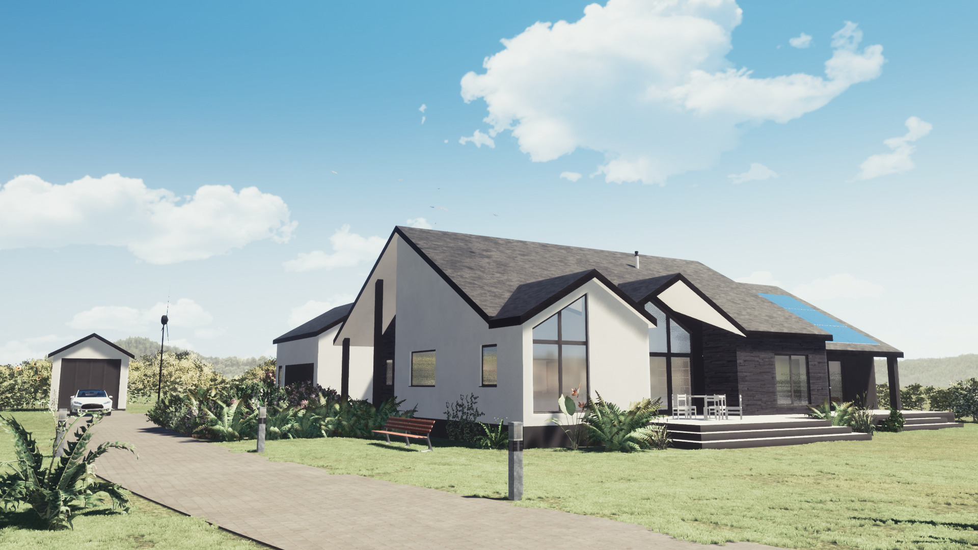
How to Choose
Do your research & decide which construction method best suits your requirements – budget, speed, thermal performance etc
Then select and get at least 3 quotes from manufacturers of that construction method (builder or factory). Look around their factory, visit ongoing sites, speak to clients. Also check Companies House.
If you are using off site manufacturing, try and find a company that has everything in-house. i.e. drawings, manufacturing and site teams (not all outsourced).
Negotiate a fair price and agree on a fixed cost and timeframe. Make sure you go over the quote to understand all the details.
At the end of the day choose a company you feel comfortable with!

Slide 30
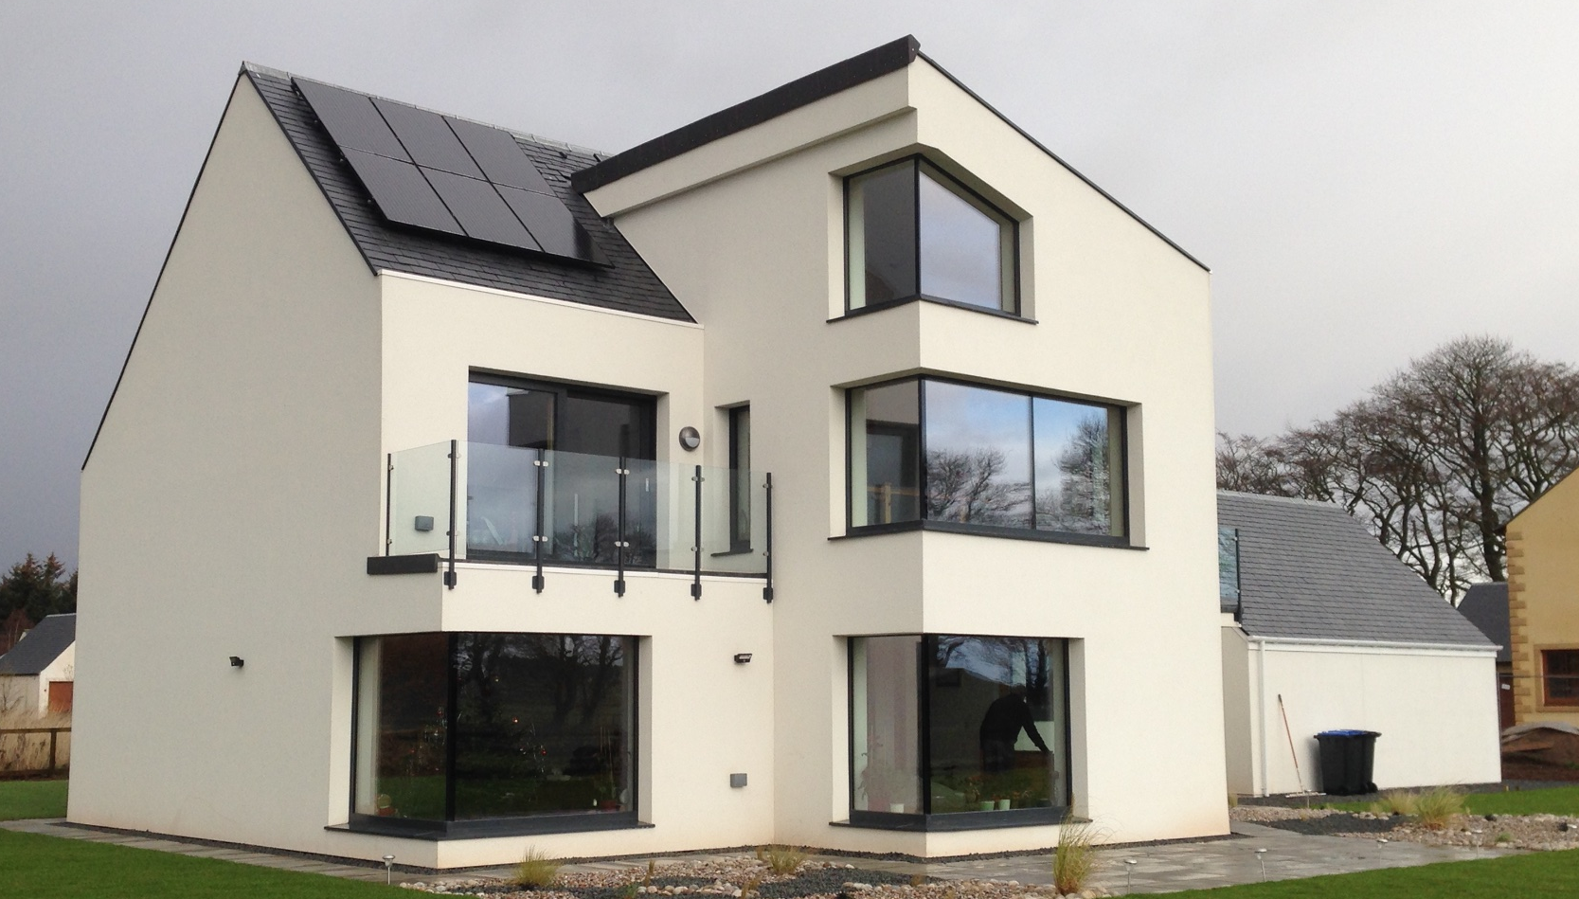
Passive House Principle
“A Passive house is a building in which a comfortable interior climate can be maintained without active heating and cooling systems. The house heats and cools itself, hence the term passive”. – Wolfgang Feist.
Passive House

Slide 31
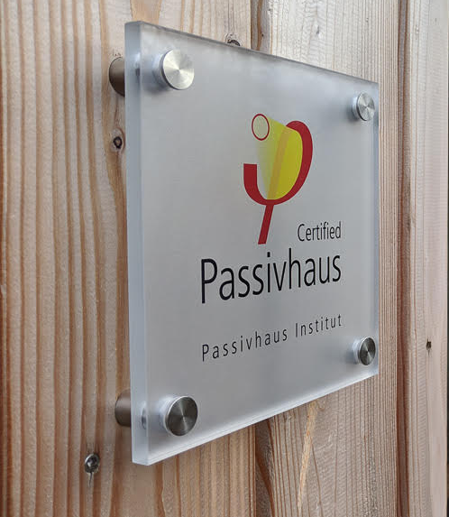
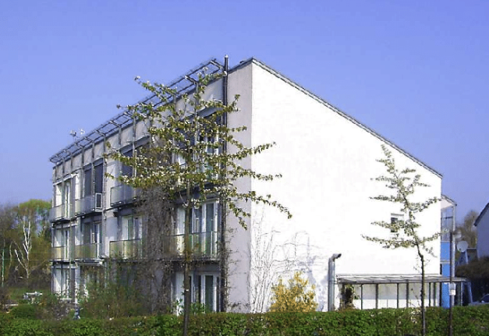
The background to Passive House Design -
The Passive House standard was developed in Germany in the early 1990s by Professors Bo Adamson of Sweden and Wolfgang Feist of Germany and the first dwellings to be completed to the Passivhaus Standard were constructed in Darmstadt in 1991.
Passive House is the fastest growing energy performance standard in the world with 65,000 buildings built to date.
The Passive House standards strengths lie in the simplicity of its approach; build a house that has an excellent thermal performance and high airtightness with mechanical ventilation.

Slide 32
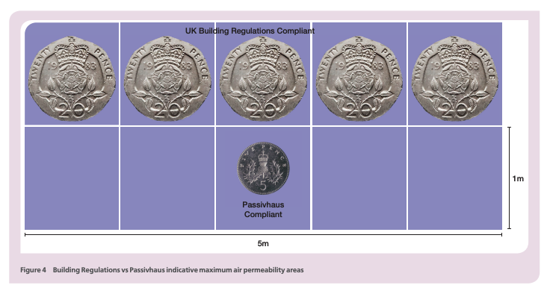
Passive House Energy Standard -
A robust energy performance specification – mandatory technical requirements
1. Airtight Construction <0.6 air change rate @50 Pa pressure difference
2. Maximum Heating (or Cooling) demand <15kW/m2yr or alternatively the heating load must be smaller than 10W/m^{2.}
3. Maximum Energy demand <120 kW/m2yr or the primary energy renewable demand is limited to 60 kWh/m²yr
Understanding Passive House is about a lot more than these numbers.
PH standard – not only an energy standard but intended to be a holistic design process.
1. Airtightness
bre Airtightness guide – Passivehaus Institute
2. Passive House standards vs building to current Building Regulations & Fabric First Approach
 | England /Wales | Scotland | Fabric First Targets | Passive House
Space Heating Demand | 140kWH/m2 per year No energy standard defined in Building Regulations | 140kWH/m2 per year No energy standard defined in Technical Handbooks if Gas/Oil/LPG used renewable energy is required (PV’s) | Around 40 kWh/m2 per year PV’s & ASHP recommended | 15 kWh/m2 per year PV’s & ASHP recommended

Slide 33
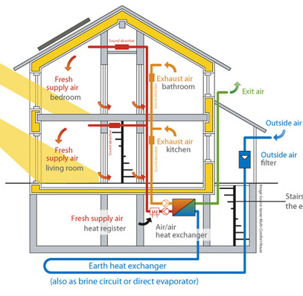
The Passive House Key Design Principles –
1. High levels of insulation (fabric)
  - Walls, roof & floor <0.15 W/m2k
  Openings <1.0 W/m2k
No thermal bridges
Passive House Windows (Solar Gains/Shading)
Design Form & Form Factor
- avoid complex forms
5. Thermal Comfort- Constant internal temperature
not feeling too cold or too hot. Ambient temperature = 20⁰
Airtightness & good indoor air quality
30m3 per person per hour achieved
by highly efficient MVHR system
Overheating Limit
Ambient temperature of above 25*C<10% per year
Except for the airtightness, which is measured on site, all these figures are obtained by calculation with the PHPP design tool.

Slide 34
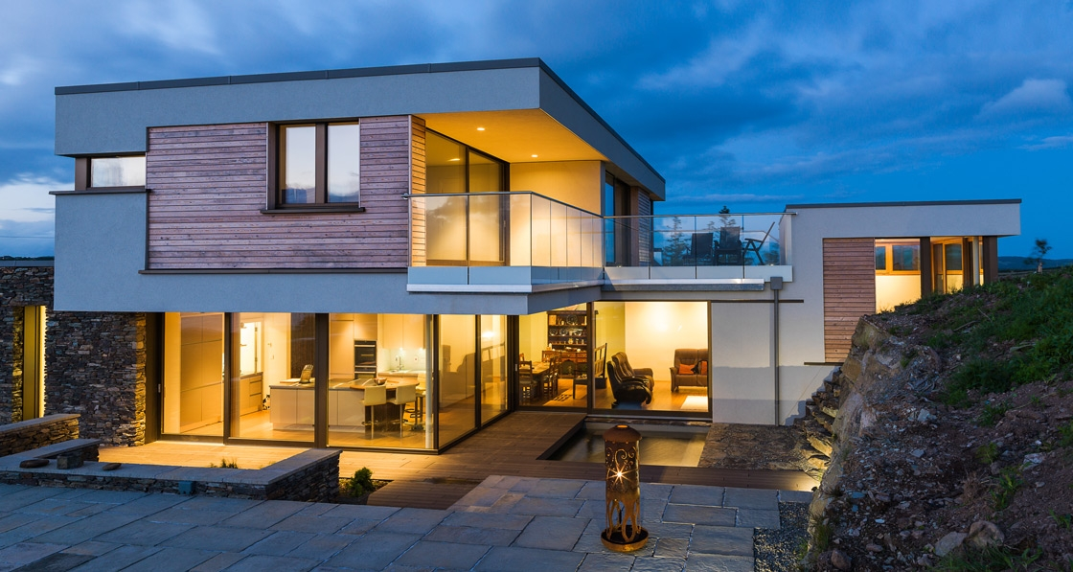
Economics , life cycle costs -
Professional Design fees from specialists & certification route (approx. £5,000)
Construction costs difference to traditional build (between 4 -8%)
Passive House with renewables is a cost-effective option for Nearly Zero Energy Buildings. This means that the benefits of a Passive House are higher than its costs in the long term.
Achieving around 75-85% reduction in running costs

Slide 35
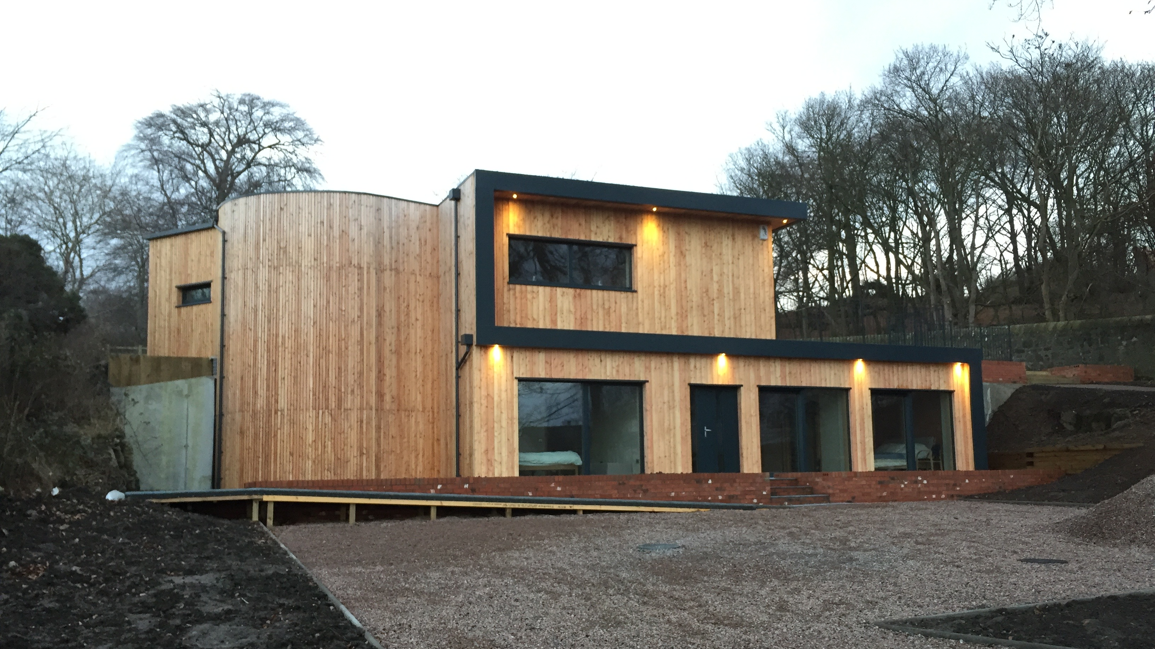
Economics , life cycle costs - Summary
Invest more in:
insulation, Passive House windows, a better airtightness level and an energy-efficient ventilation system
planning work hours, thermal bridge calculations and quality assurance
The cost benefits on the other hands will be:
smaller heating or cooling unit and distribution system
Although the MVHR ventilation filters will require regularly change, maintenance and little expenditure on electricity for the fans - This is nothing compared to the money you will save thanks to lower heating, cooling and water-heating bills.
The maintenance costs of the heating and cooling system will also be lower.

Slide 36
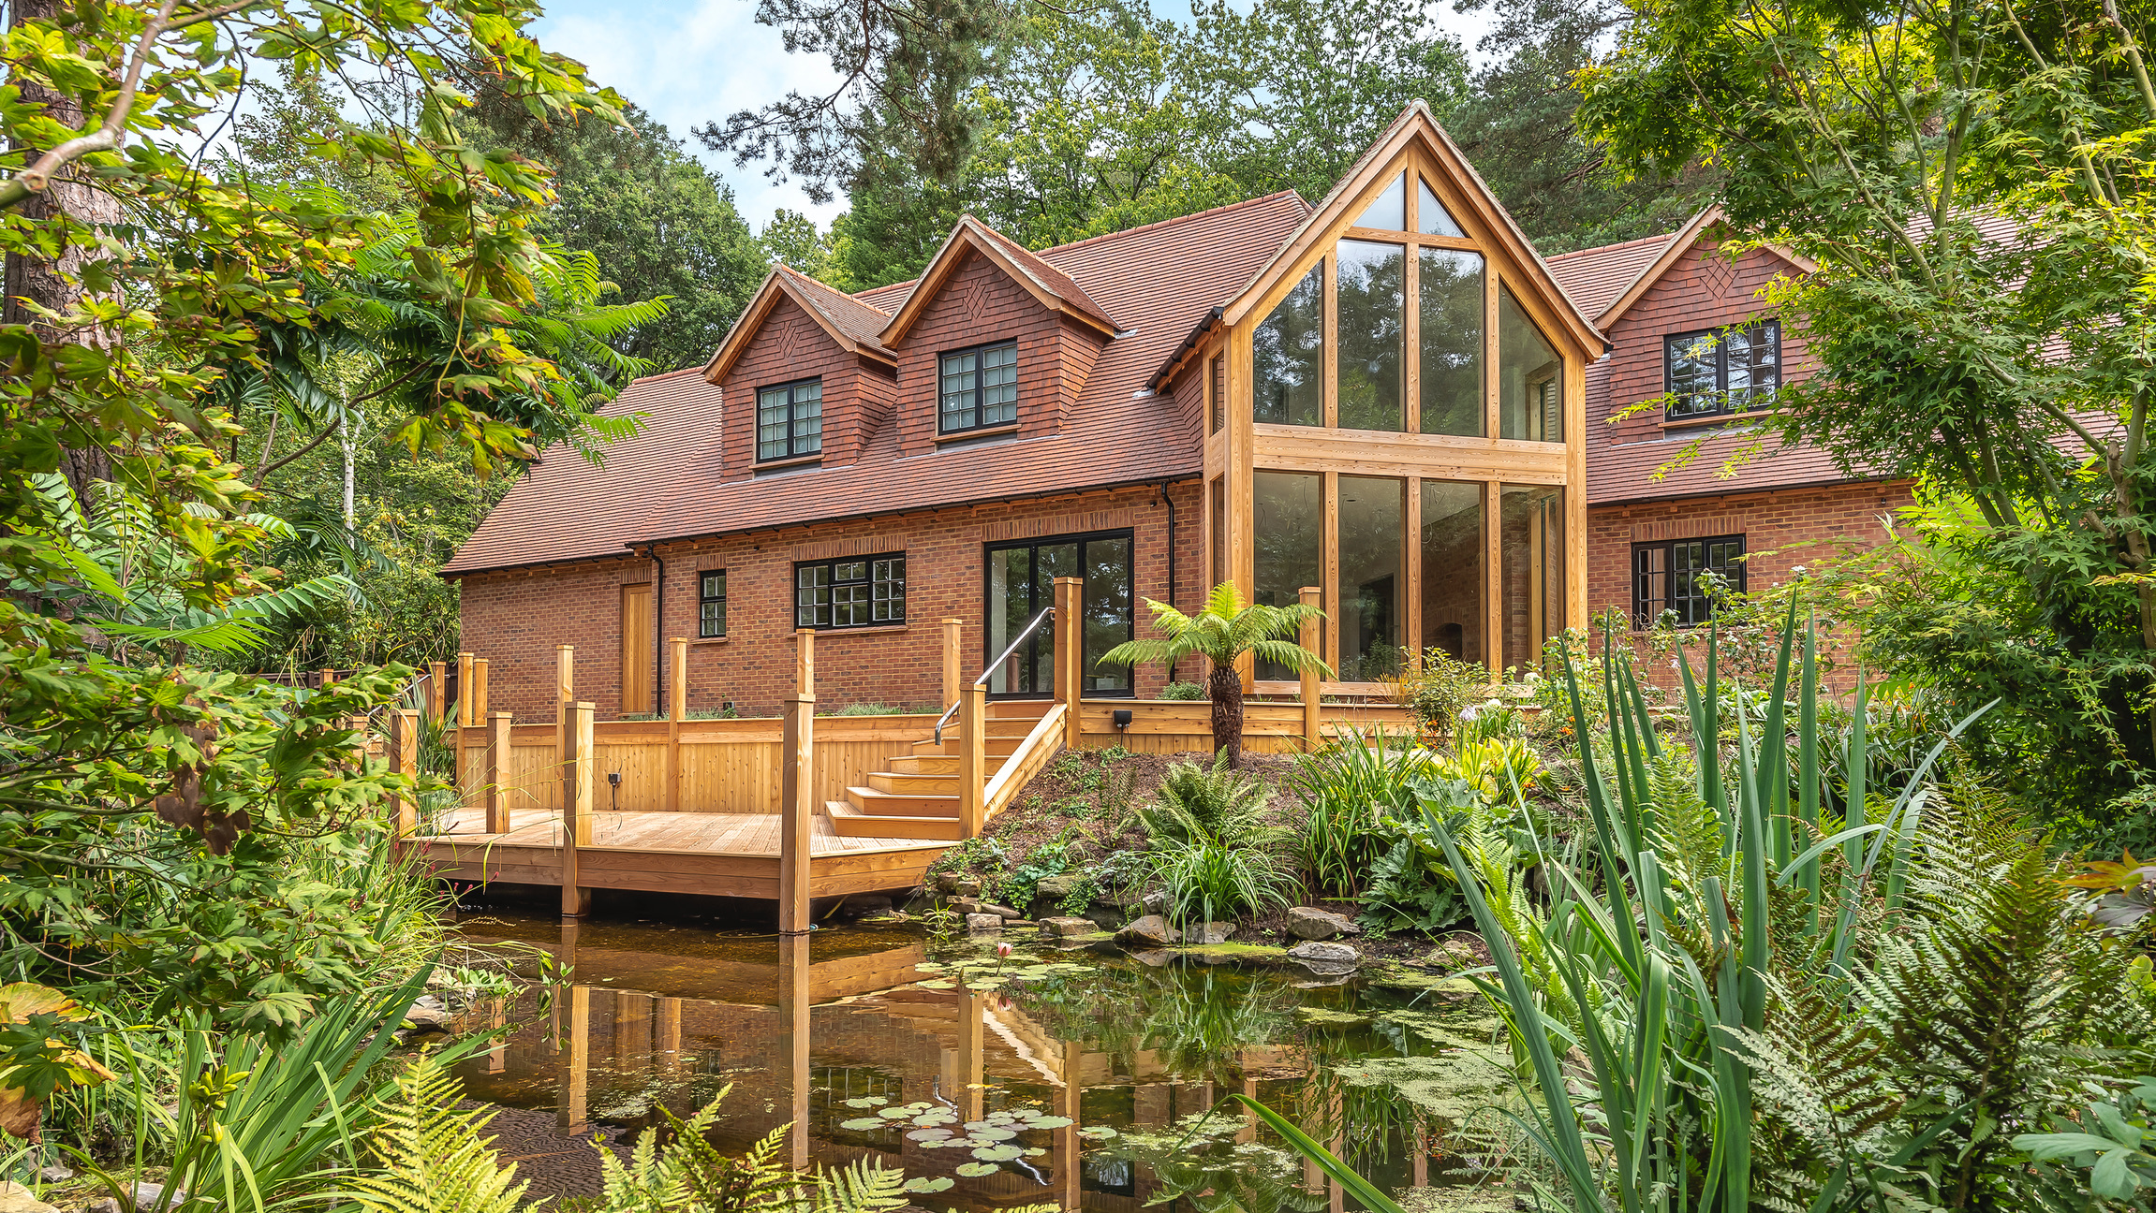
The Design Process

Slide 37
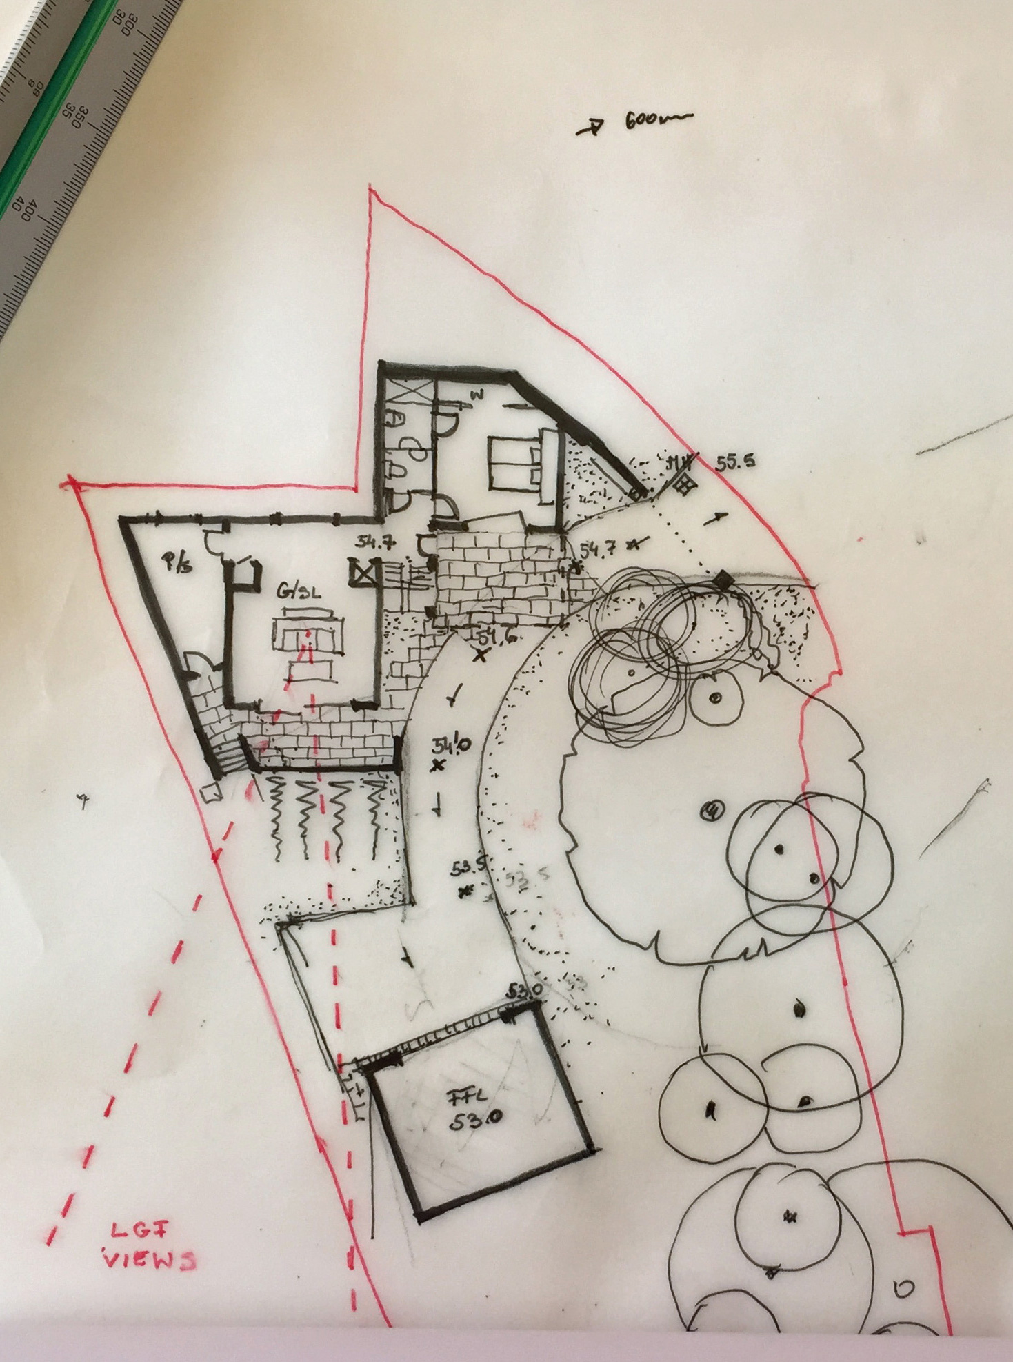
Initial design & planning stage -
Initial design ideas should be a response to the site and your brief (function before form)
Orientate habitable rooms due South to maximise solar gain, with utility/plant/service zones to the North
If going for Passive then large windows to South none on the North, also compact simple form
Larger more complex forms will cost more and have more junctions which will impact thermal bridging factor
Design with a construction method in mind
Limit overheating at design stage, ideally outwith building envelope
Once design is frozen complete initial PHPP and SAP calculations

Slide 38
Technical design (regs & production) -
You should be working with an efficient design, suitable for construction
Appoint a suitable kit company for the fabric of the building
Finalise specification of all major products and materials
Detail all individual construction connections, clearly showing insulation and airtightness (openings & penetrations)
Thermally model any bespoke details
Review and update PHPP and SAP calculations
Appoint specialist design items – MVHR, renewable heating etc
Make sure design & specification is both buildable & economic

Slide 39
On site -
Before you start make sure you discharge any planning or regs conditions. Also put in place any warranty or insurance policies
What procedures do you have agreed for managing quality on site
Every trade that comes on site needs to know about airtightness
If you are using inexperienced trades then consider Pasive House Toolbox talks, at key stages –
  Kit sign off
  Window fitting
  Airtightness layer (VCL)
  Pre airtest
Tape everything
Any onsite changes to be run passed the design team

Slide 40
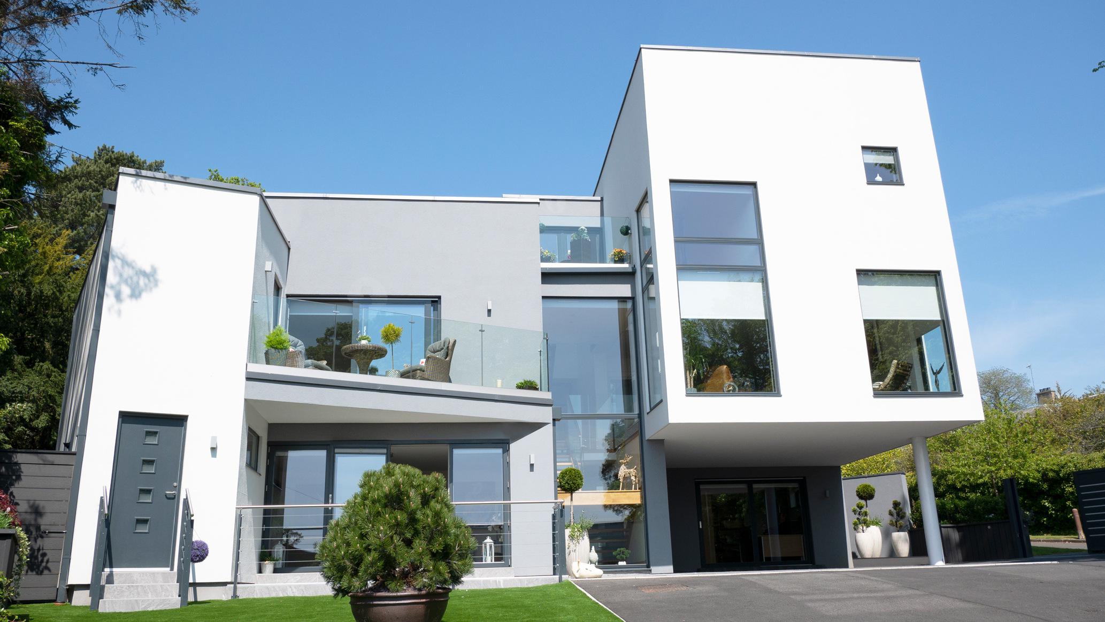
IN SUMMARY
The biggest impact on your Low Energy Home is during the initial design stages
Review & research all options, principles and construction methods for Low Energy Homes.
Define your low energy goals.
Detail out all of the poor traditional construction details, ie limit areas of cold bridging
Remember none of this matters if your designers/builders don’t follow these principles!

