Slide 1
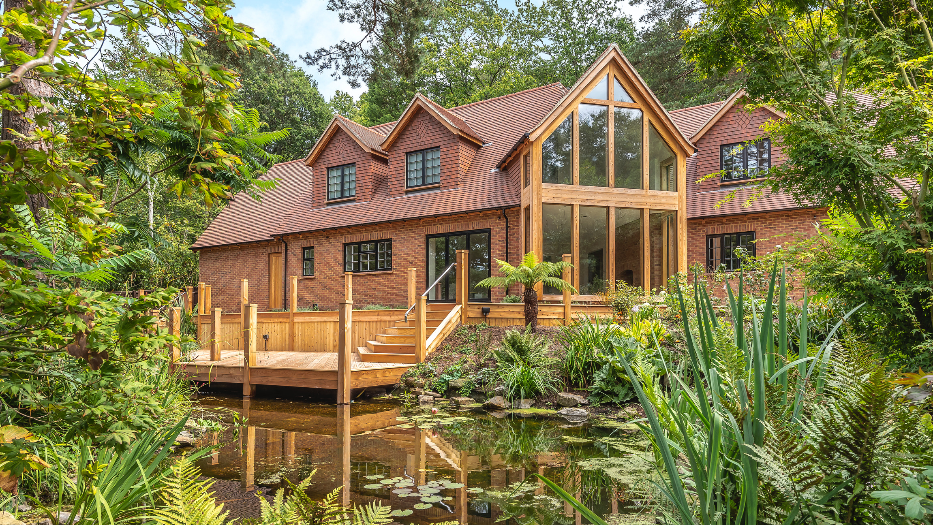

Beginning your Project and the Design process – WITH JENNY CHANDELA
Notes:
Hello and welcome to today’s talk on getting started with your project and the design process. As you know, I am Jenny Chandela, an architect with AC Architects. I am based at our office here in Swindon, working directly out of the NSBRC.

Slide 2
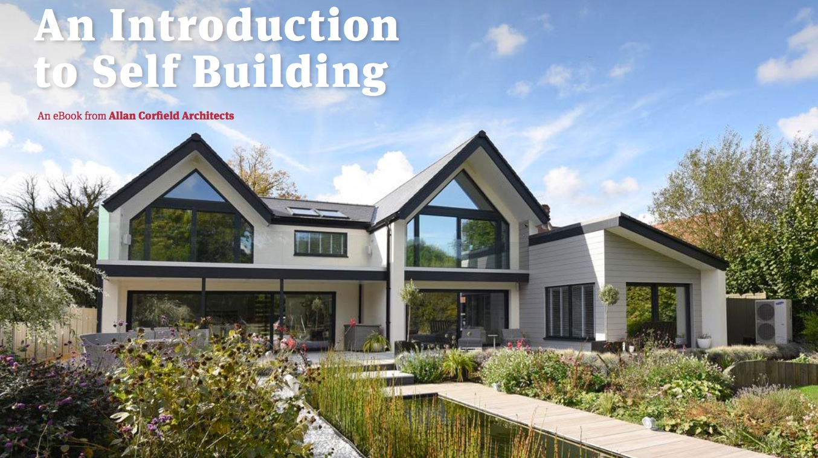
Based in Swindon & Dunfermline
Covering the whole of the UK
Completed 430+ projects
Specialists in Low energy residential projects
RIBA Chartered Architects
Energy Performance & Passive House Design
Cost Consultancy
CDM Principle Designer
Structural Engineering
VR & 3D design
Notes:
Since 2009 AC Architects have been helping self-builders design their dream homes. We have worked on over 450 projects across the UK, including small extensions, one-off homes and large housing developments. All of our low energy eco homes are built around the Fabric first approach, utilising modern methods of construction such as Structural Insulated Panels (SIPs), Timber Frame and Insulating Concrete Formwork (ICF).

Slide 3
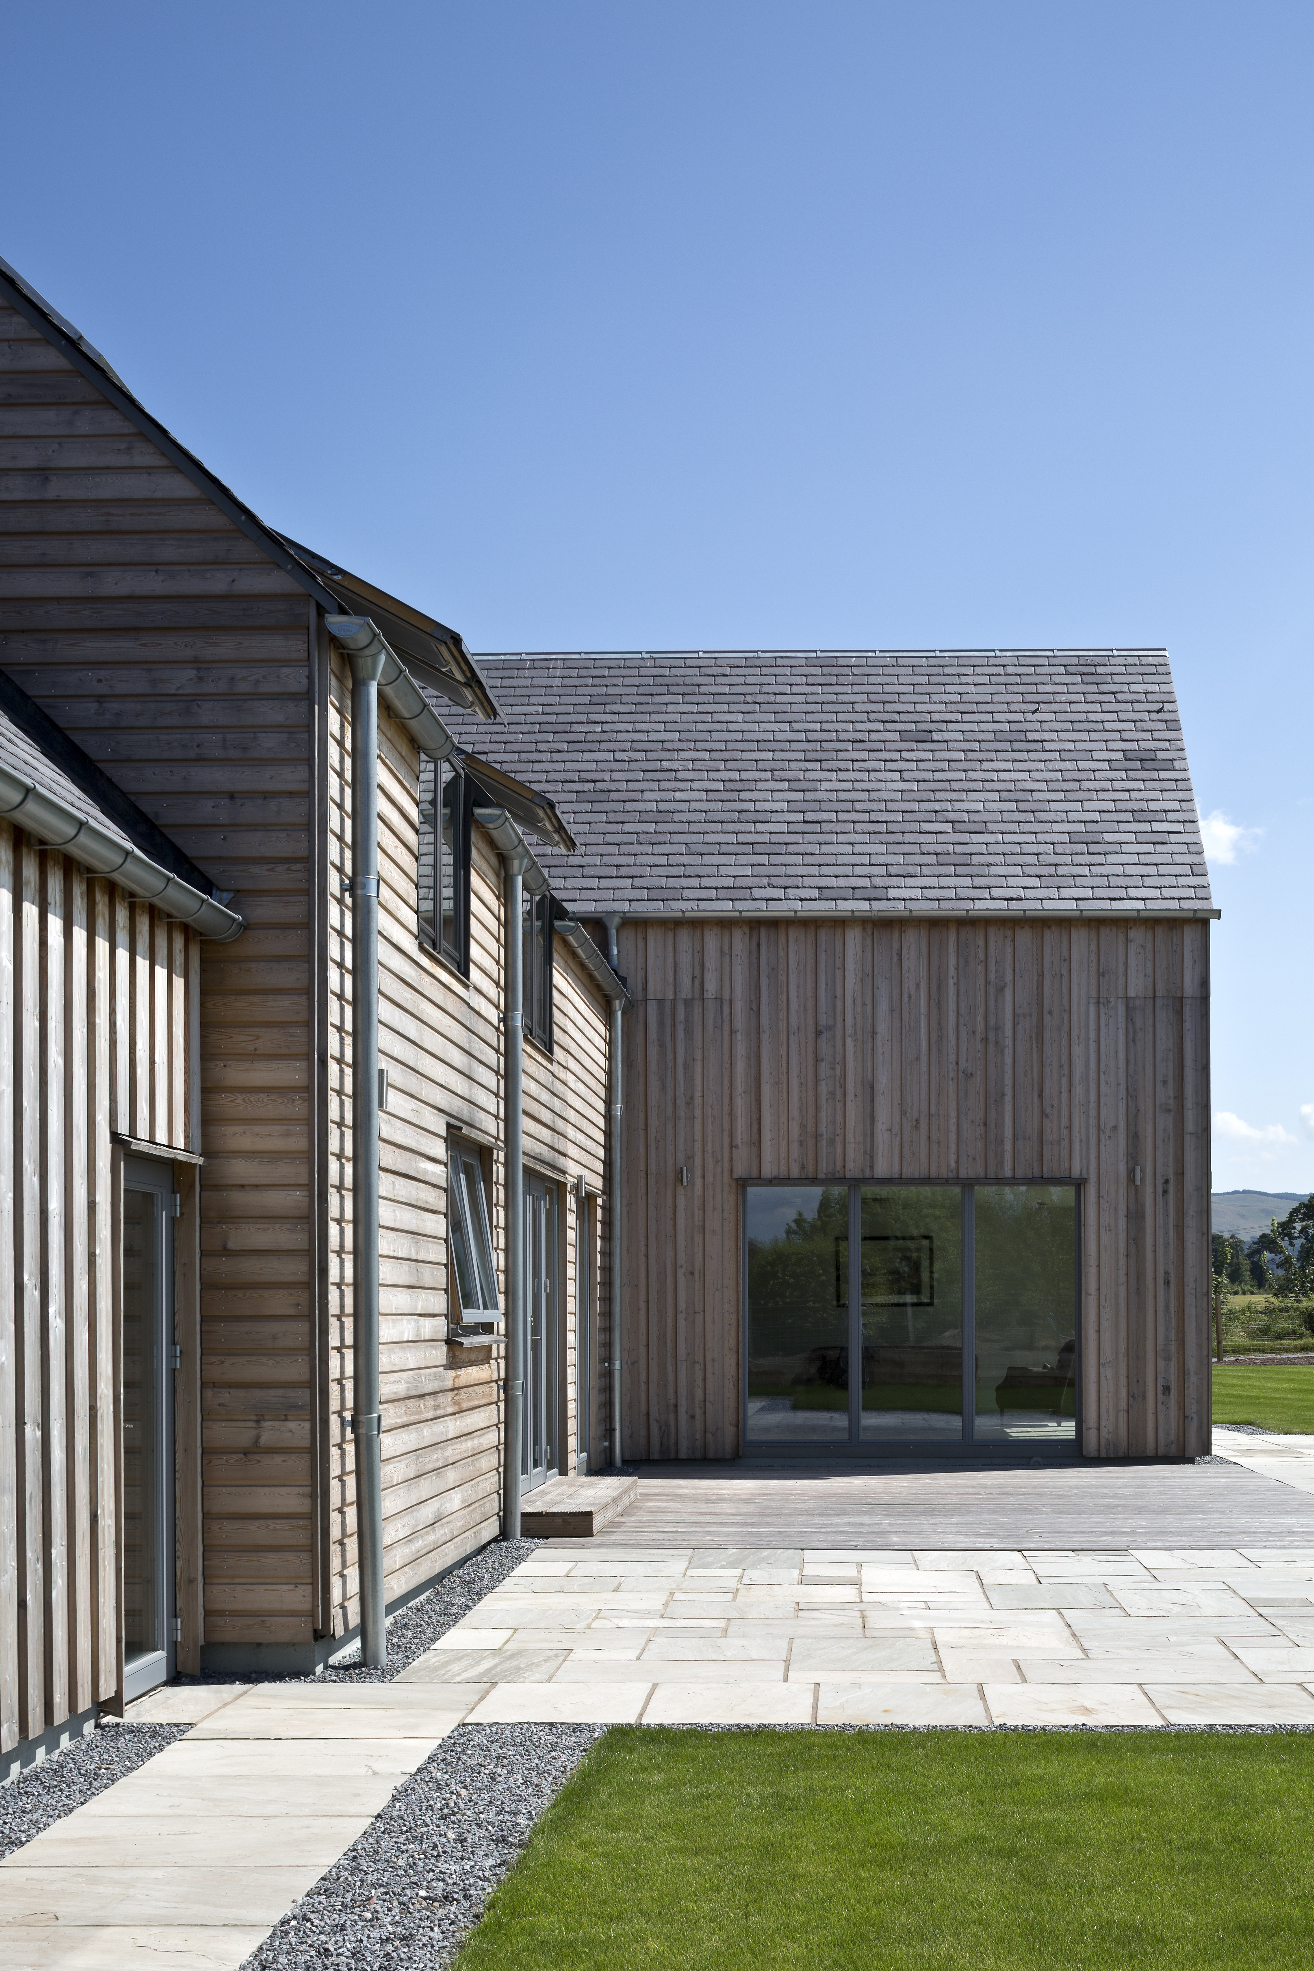
Getting started
Finding a plot
The design process
Getting the right help
Building your dream
Top tips

Slide 4
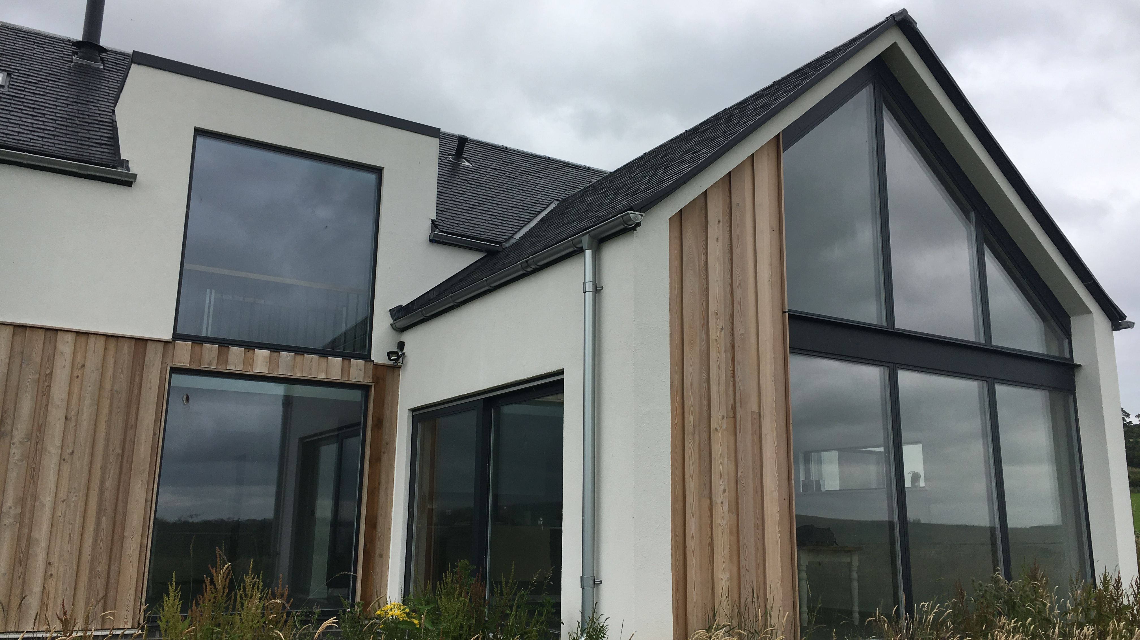
GETTING STARTED

Slide 5
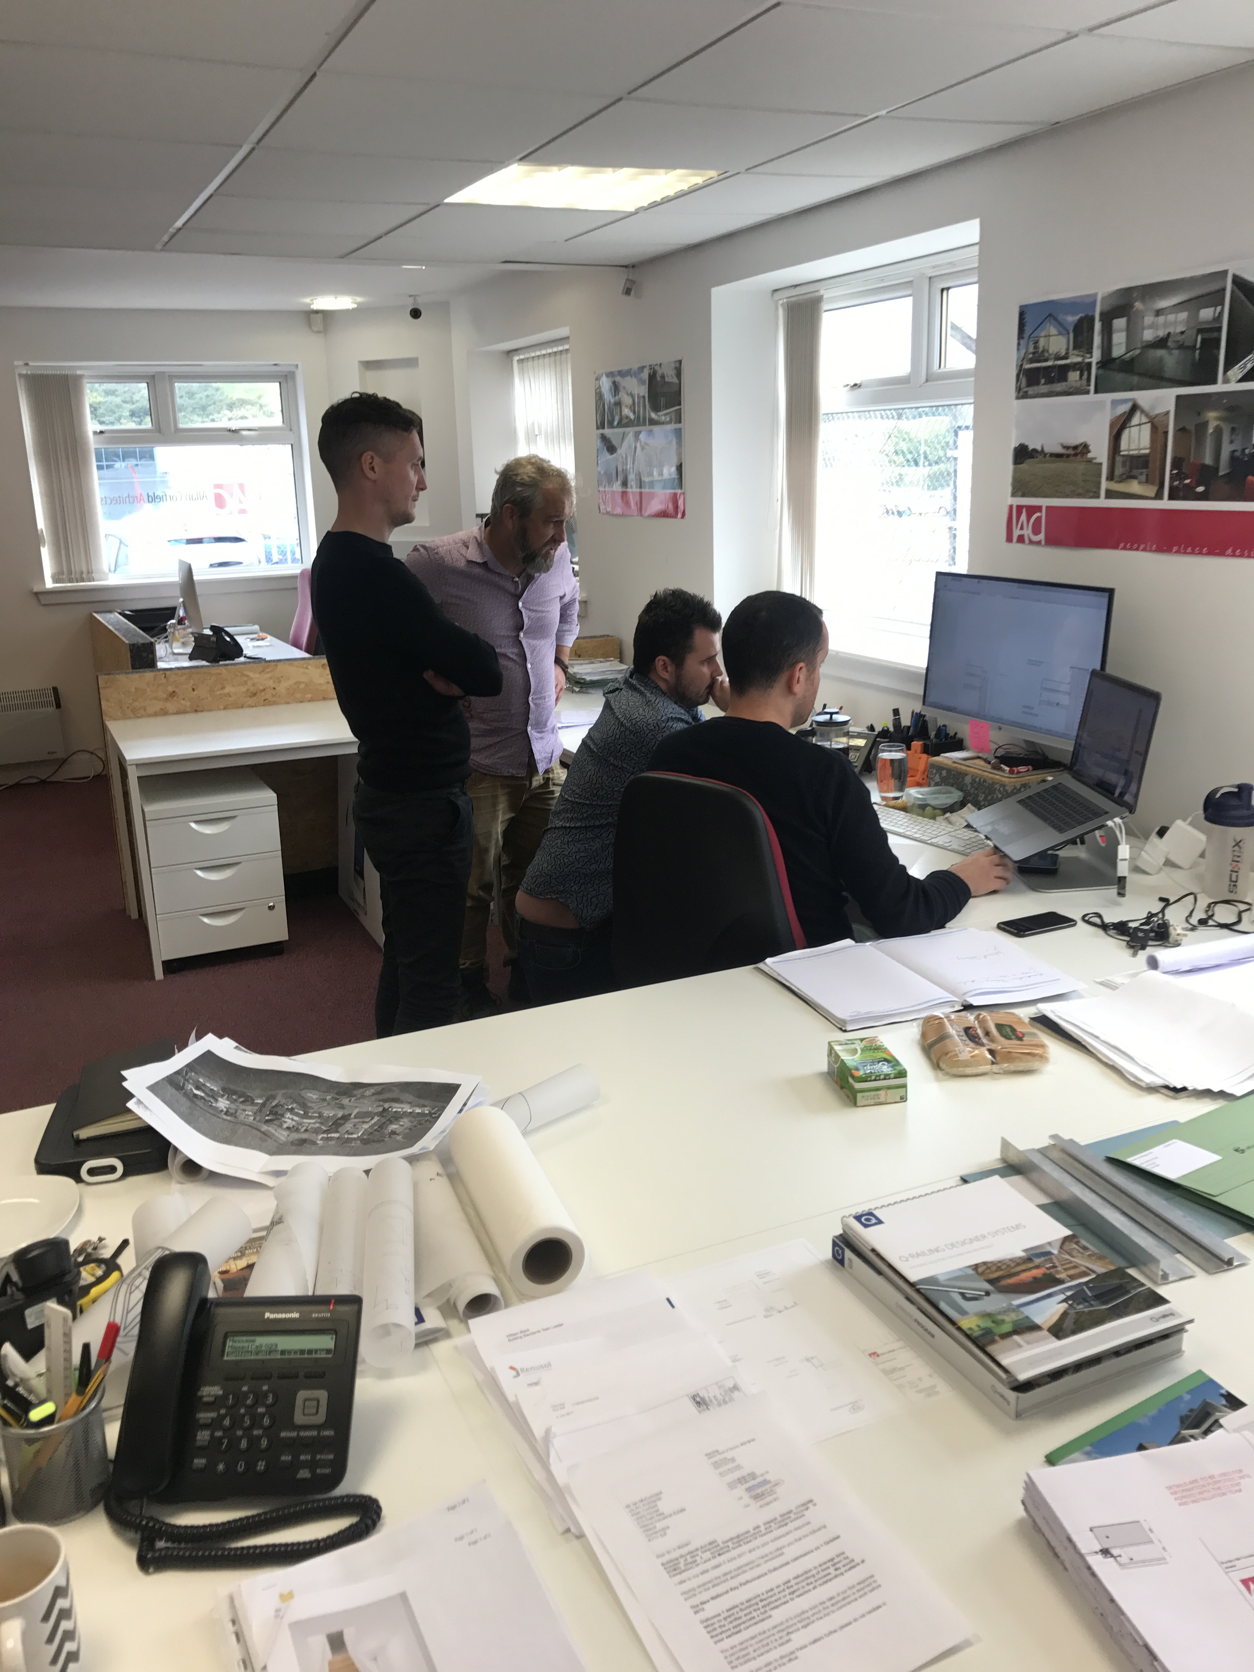
Who do I need to work with?
Basic –
Architect or Architectural Designer
Structural Engineer
Might need –
Planning Consultant
QS
Heating Engineer
Project Manager
Landscape, lighting or interior designers
Principle Designer

Slide 6
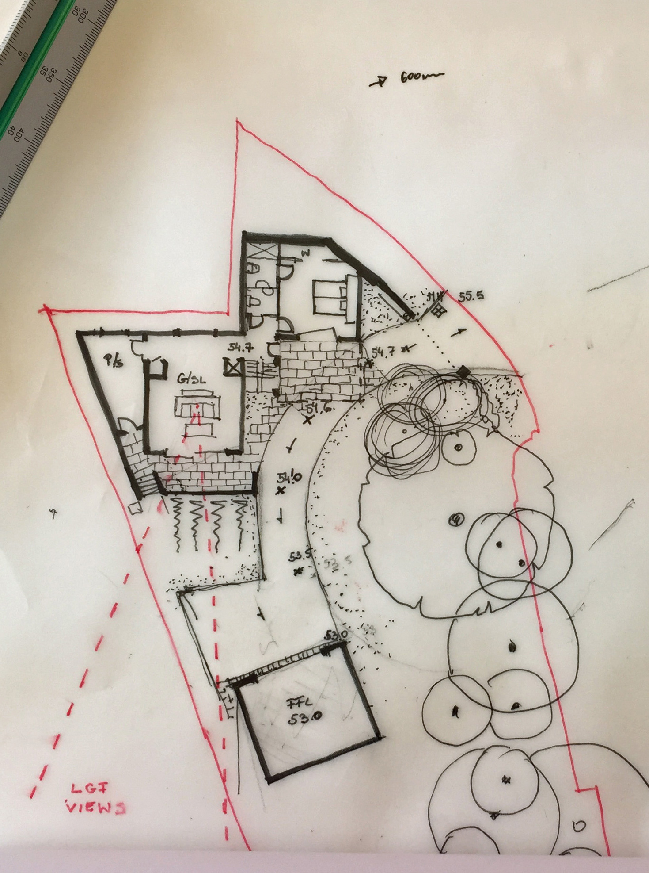
Design process overview -
Stages
Initial Design
Planning Application
Building Regulations or Warrant
Production Drawings
On site
CDM

Slide 7
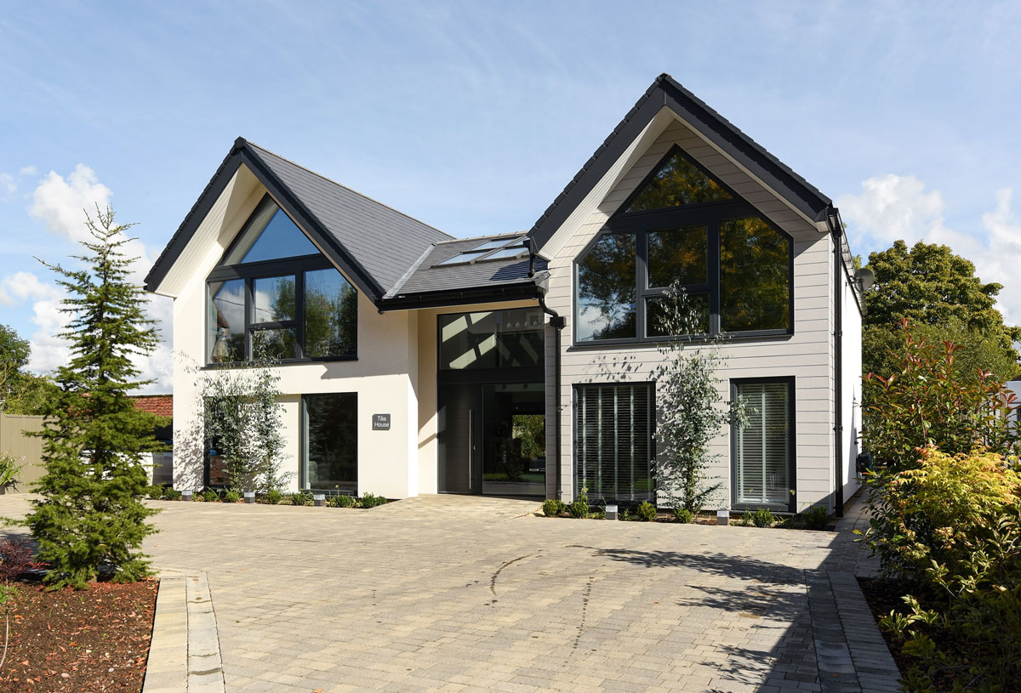
What is critical throughout these stages?
Your involvement, its your home not your design teams
Checking that you can afford it!
You must love the design before you proceed through the stages
Engage with your neighbors and the planners as soon as you can
Communication with your consultants

Slide 8
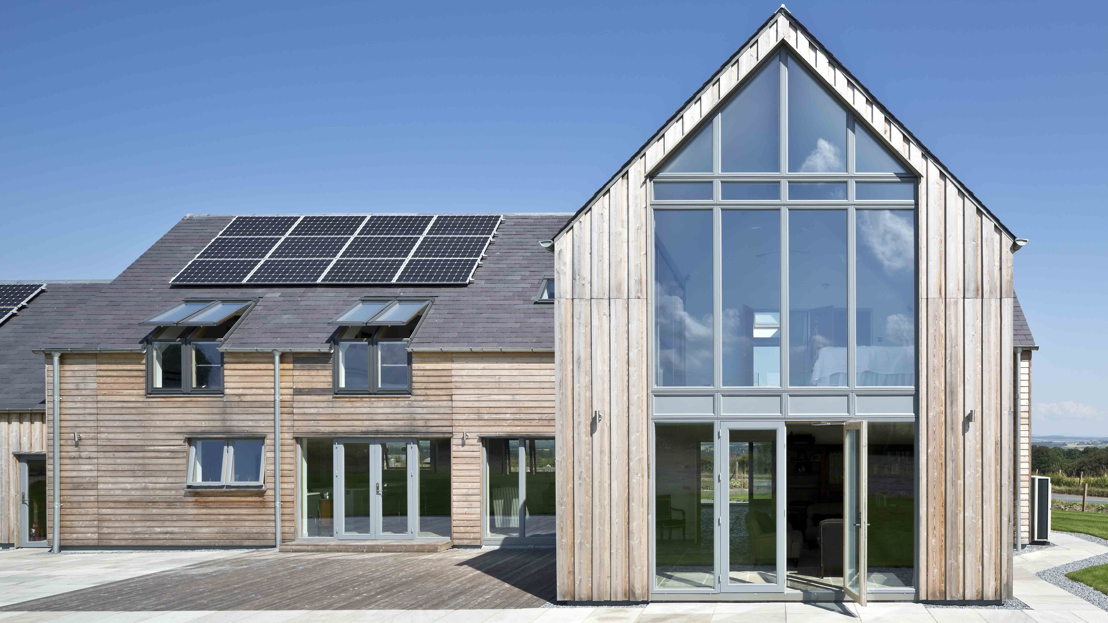
Benefits of early engagement -
Site suitability
Building orientation/ siting
Refinement of brief
Consideration of building envelope
Integration of systems
Developing a relationship

Slide 9
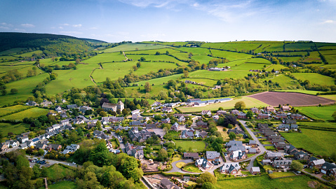
FINDING A PLOT

Slide 10
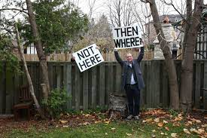
Limited supply of developable land
Nimbyism
Planning complications
Potential land controlled by developers = Limited availability!
The perfect plot doesn’t exist!
Very rigid requirements
Unrealistic expectations
Not prepared to compromise

Slide 11

You could be the problem!
Work out your land finding strategy
Make sure your plan is deliverable
Know what you’re looking for
Don’t ‘hunt with the pack’
Learn how to ‘beat’ the market
Know your competitors
Focus your search

Slide 12
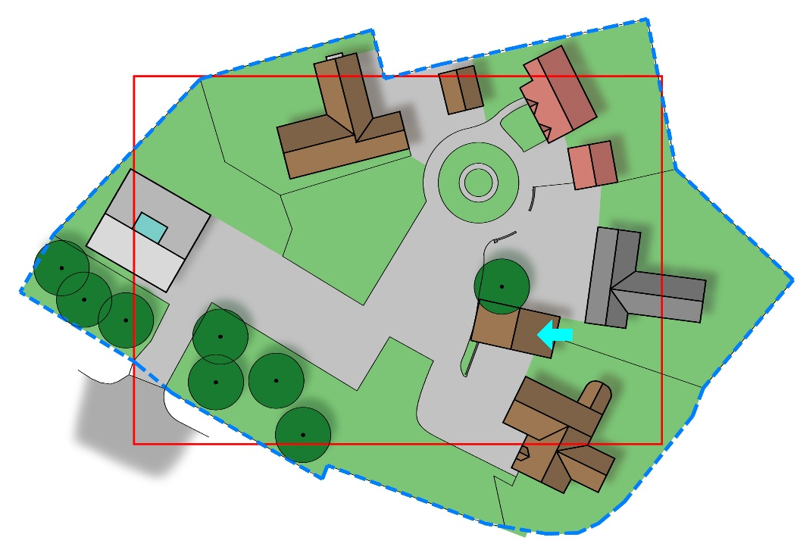

St Neots, Show Centre
5260m2
(Approx 1.3 Acres)
How the same 154m² (1800ft²) house fits on different sized plots
How much land?

Slide 13
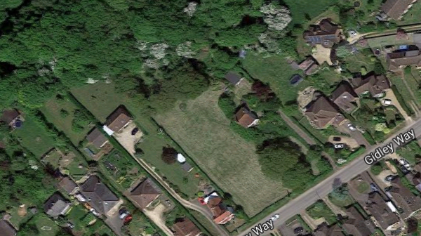
Identifying potential plots-
Knock down and rebuild
Garden plots
Infill plots
Plots with challenges
Forgotten land
Stalled developments
Brownfield land
Class Q permissions

Slide 14
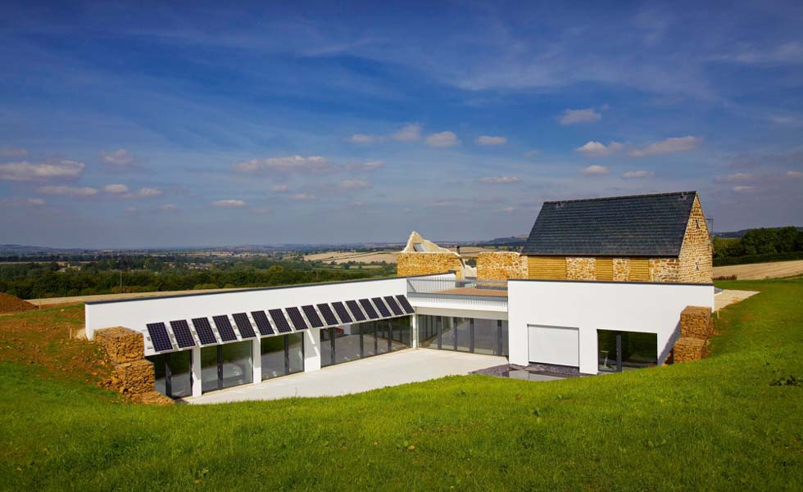
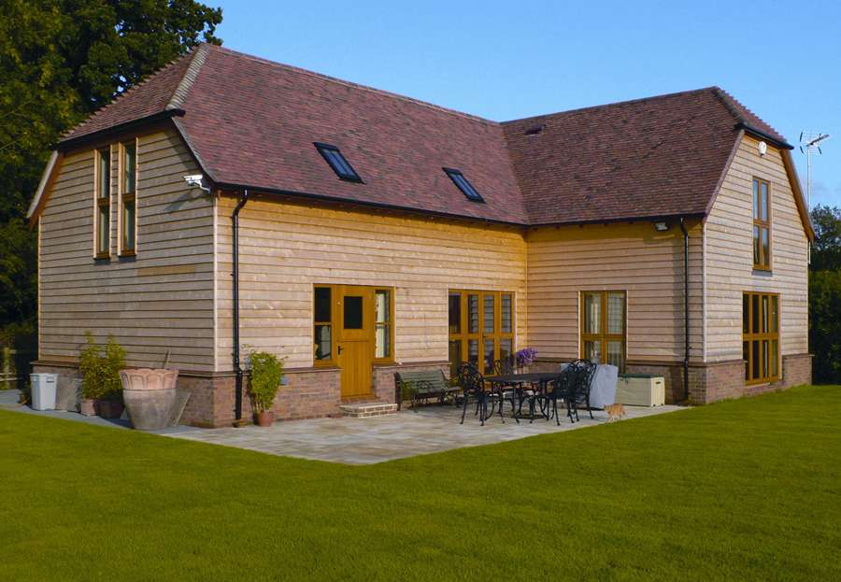
A paragraph 80 planning permission
Architecturally ‘outstanding’
Design & planning very expensive
Very risky and expensive to build
Very few are built!
Apply for an agricultural workers dwelling
Must satisfy stringent local planning conditions
Very difficult to achieve: Limited national guidance
Must demonstrate an essential need to live at place of work
FIELDS AND PADDOCKS

Slide 15
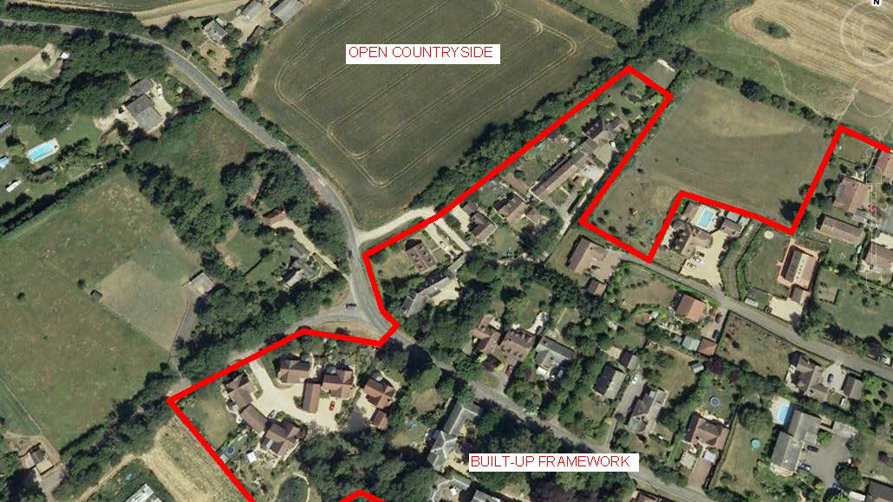
Options for finding the plot-
Planning Portal
Settlement boundary
Specialist search engines
Get out and look!
Spread the word
Search the brownfield register
Approach estate departments
Builders/ Custom Build sites/ Self Build companies
Auctions

Slide 16
Personal needs and objectives
Potential
Sense check the plot
Planning Potential assessment
Plot construction risk assessment
Price
Check the plot against your budget
Start Here
APPRAISING THE PLOT

Slide 17
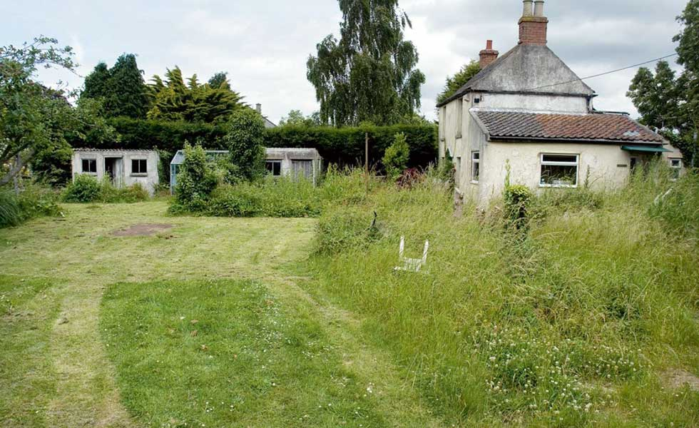
Site suitability -
Architectural
Planning potential
Legal restrictions
Site access
Services to site – major connection costs
Physical characteristics
Ground conditions - including topo, soil investigation & percolation test

Slide 18
Building siting/ orientation-
Assess external landscape features
Assess internal landscape features
Weather data and sun path analysis

Slide 19
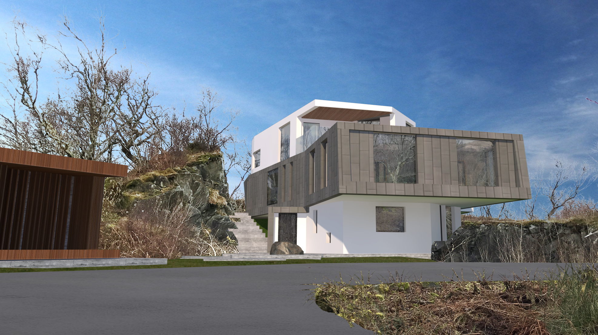
THE DESIGN PROCESS

Slide 20
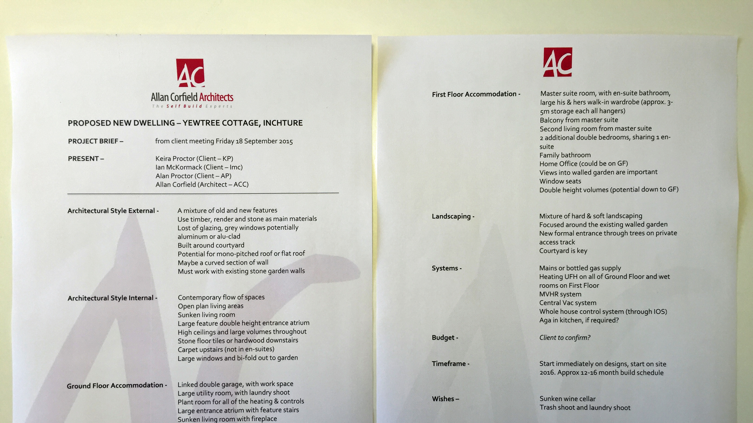
The design process starts with YOU.
What is a Brief and what is it used for?
Your brief sets out all of the important requirements for your project
It is created by you prior to engaging with your design team
You should use it to obtain accurate fee proposals from your design team
It is an evolving document, throughout the life of project

Slide 21
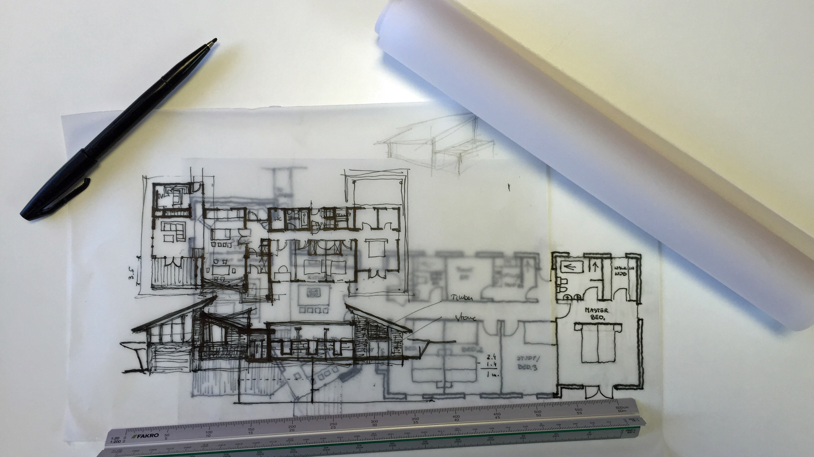
What is included in your Brief?
Basic room information & room sizes
How the building flows
Architectural Style
Is a certain view or orientation important?
Energy Performance & Heating Strategy
What is your role (be the best self builder you can)
Budget & Timescales
Why

Slide 22
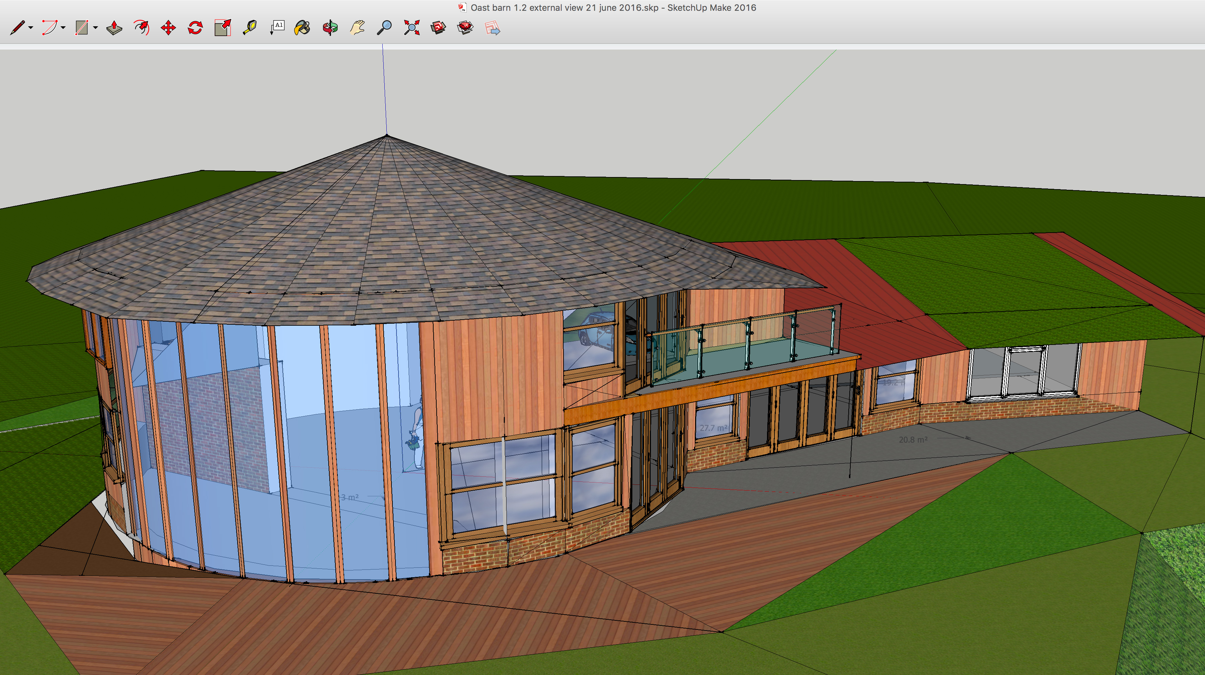
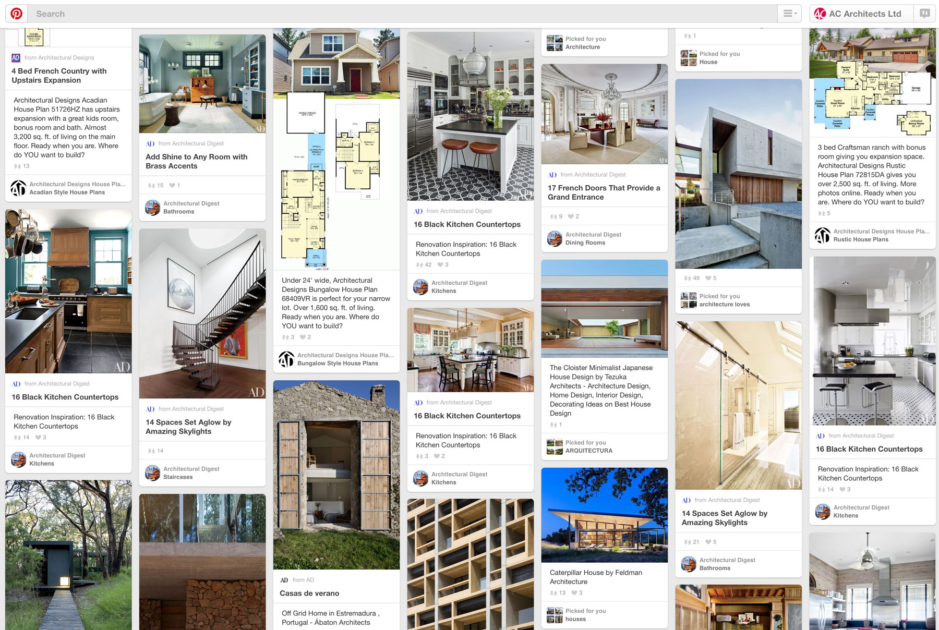
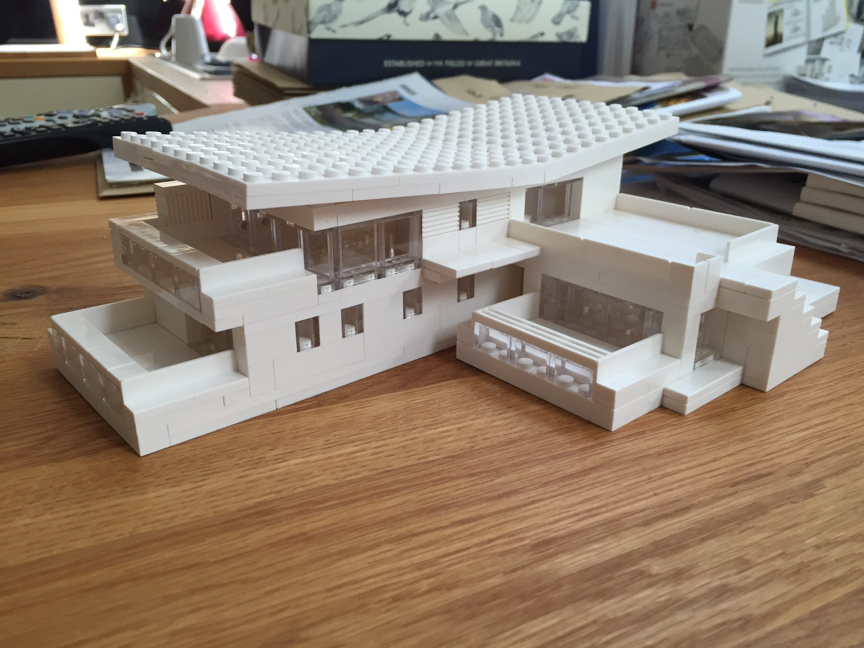
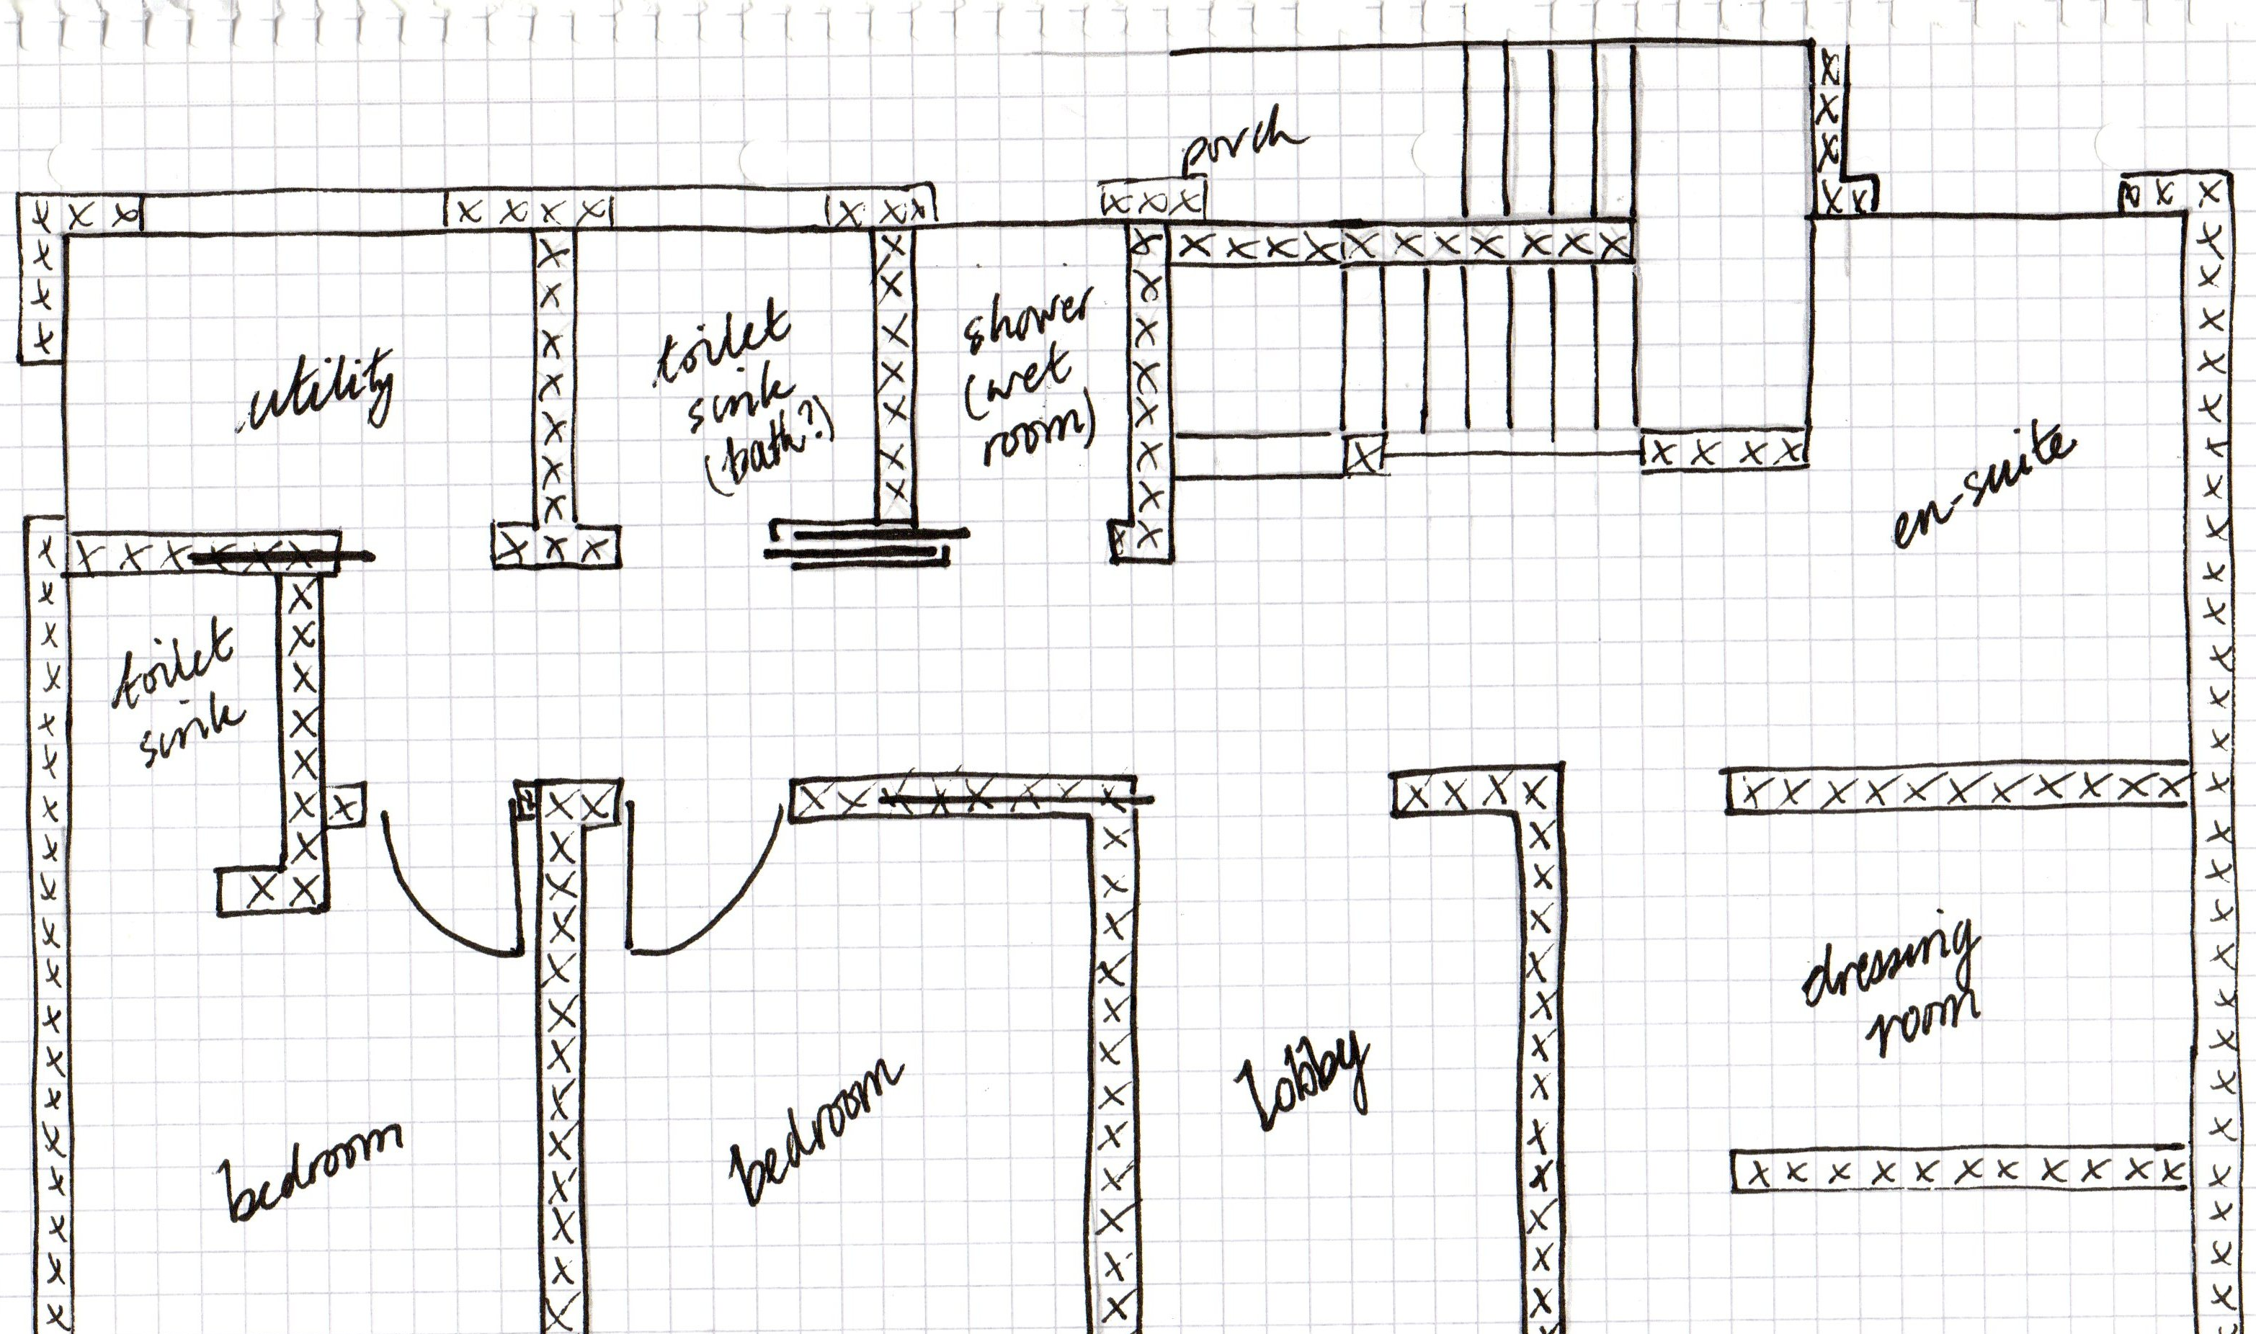
Provide additional information
Sketches
Sketch-up models
Lego or physical models
Pinterest Boards

Slide 23
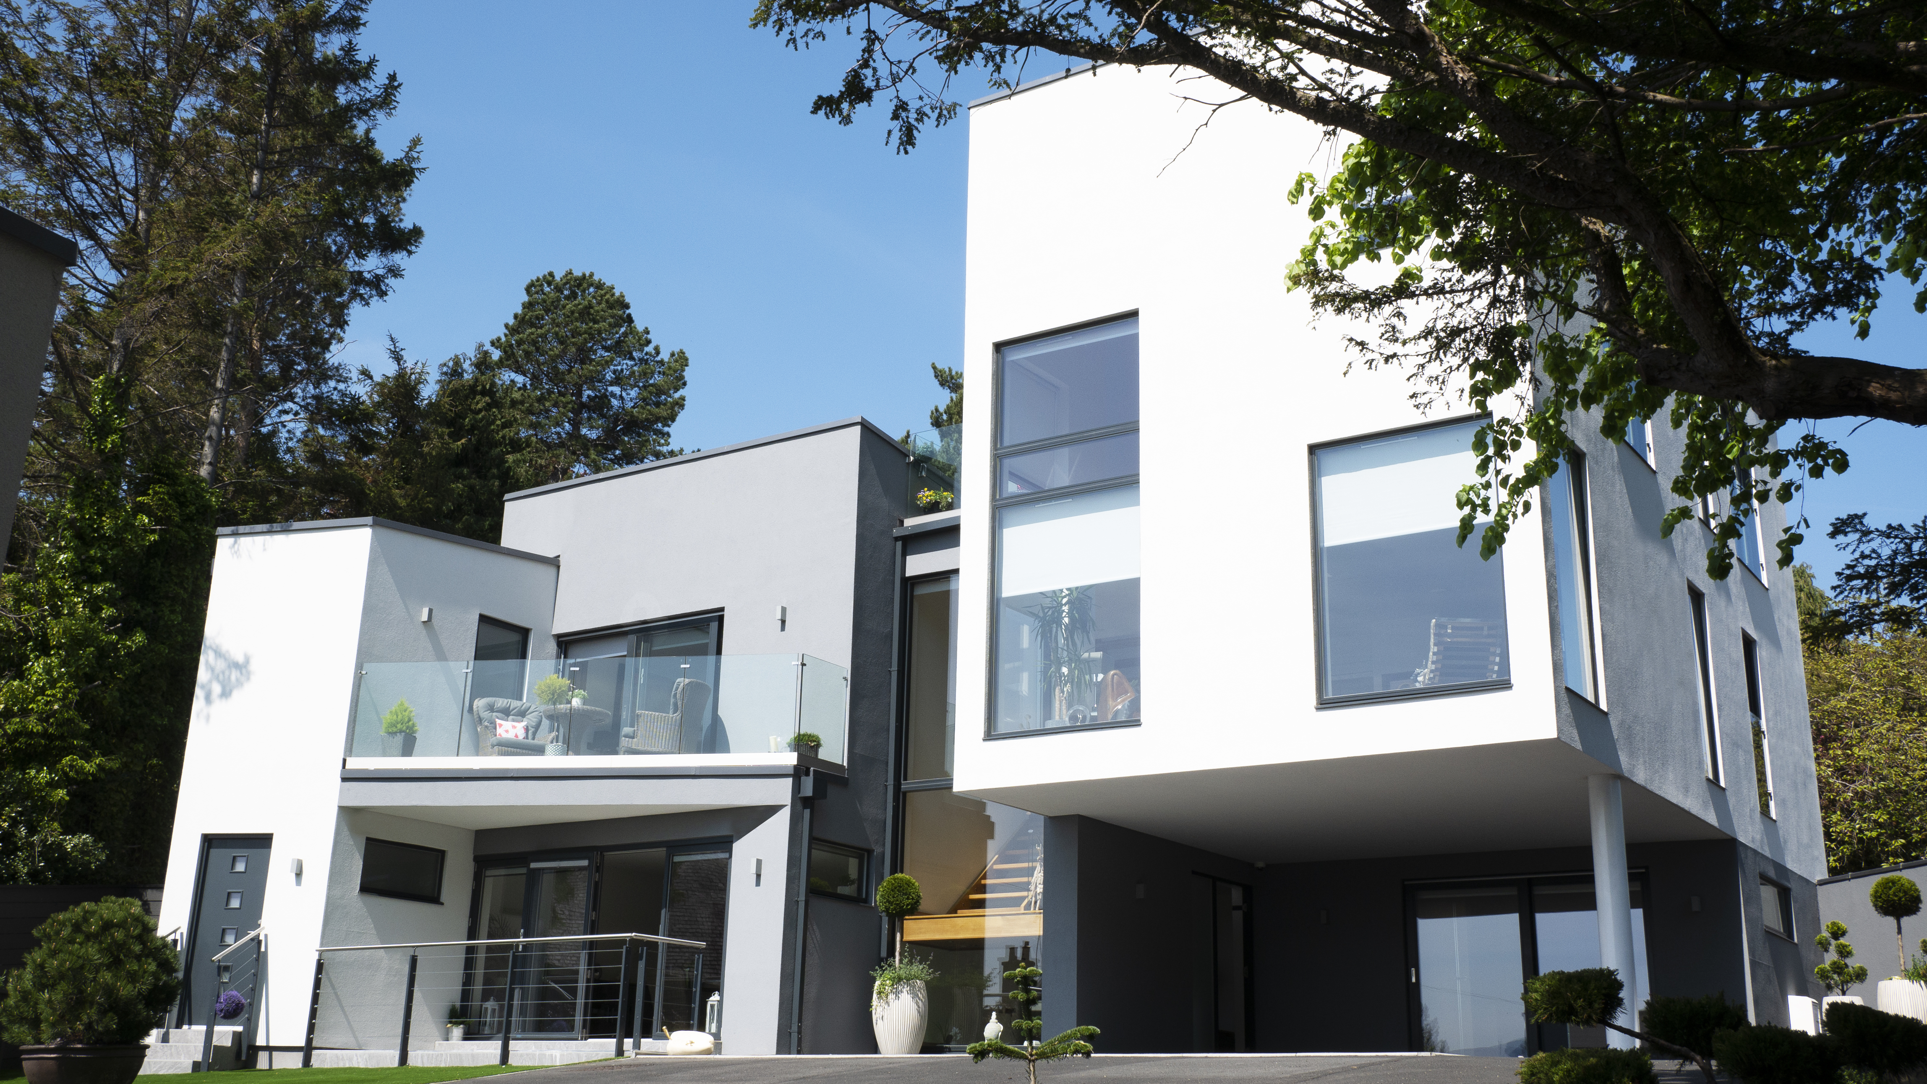
GETTING THE RIGHT HELP

Slide 24
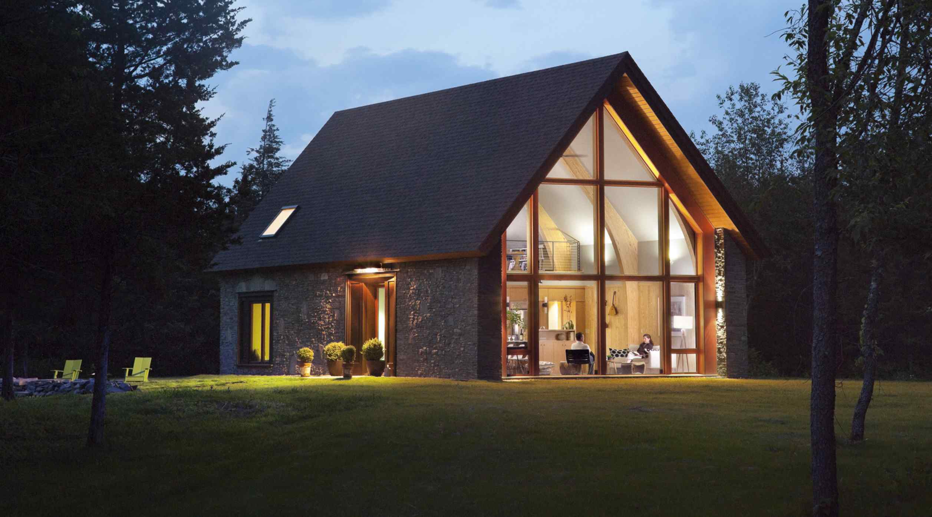
Portfolio of works
Issues -
Increased Design fees from specialists
Cost increase in construction costs (on average 2.5 to 5% increase)

Slide 25
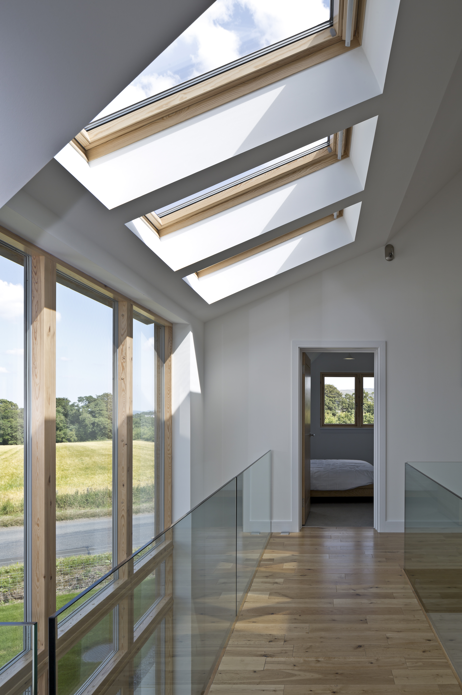
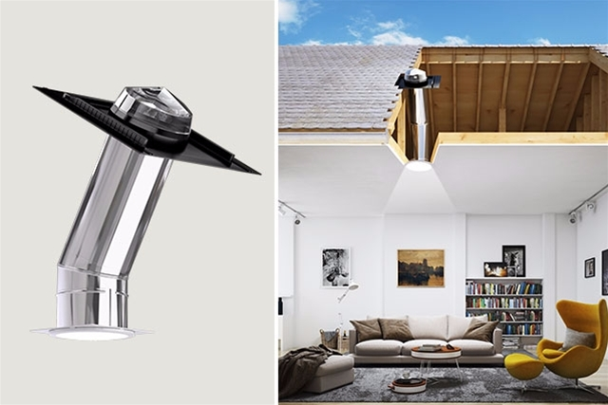
Experience

Slide 26
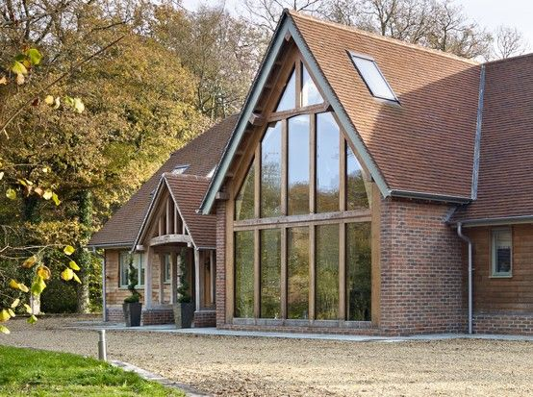
Ability to listen

Slide 27
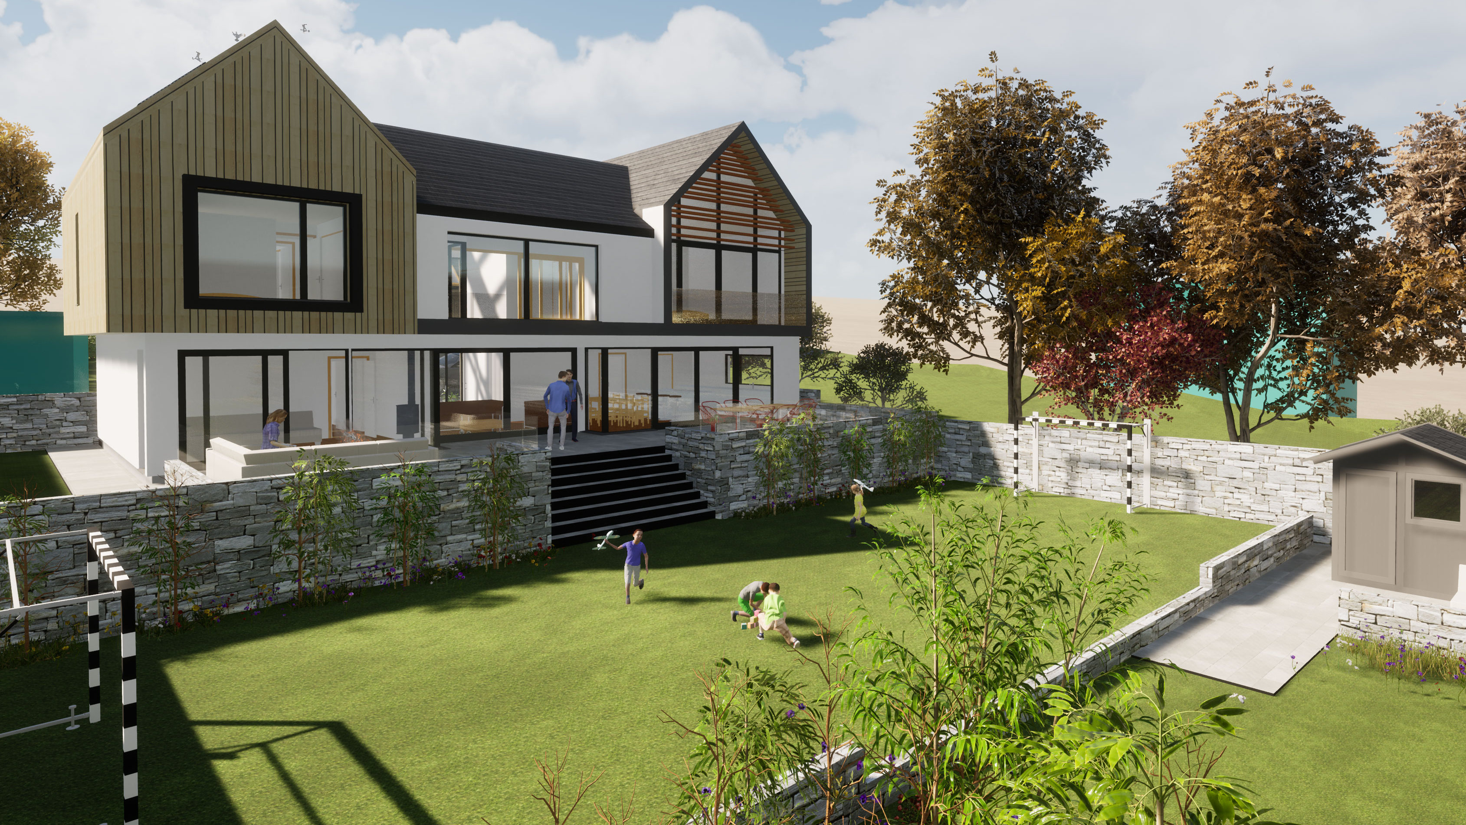
Chemistry and trust

Slide 28
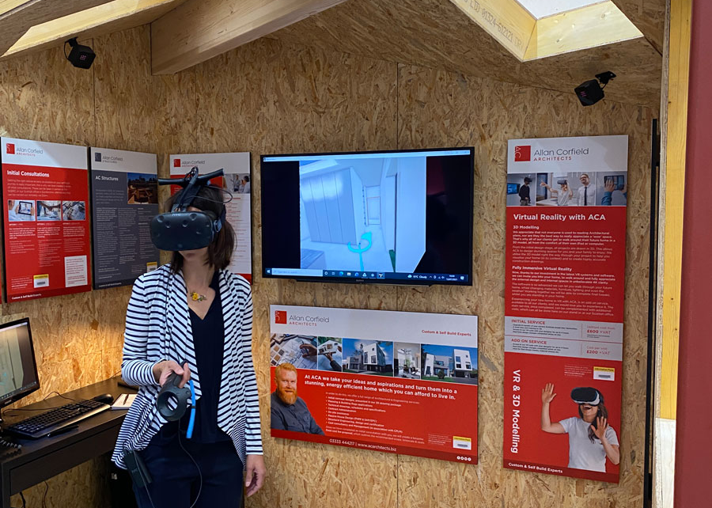
Ability to visualise

Slide 29
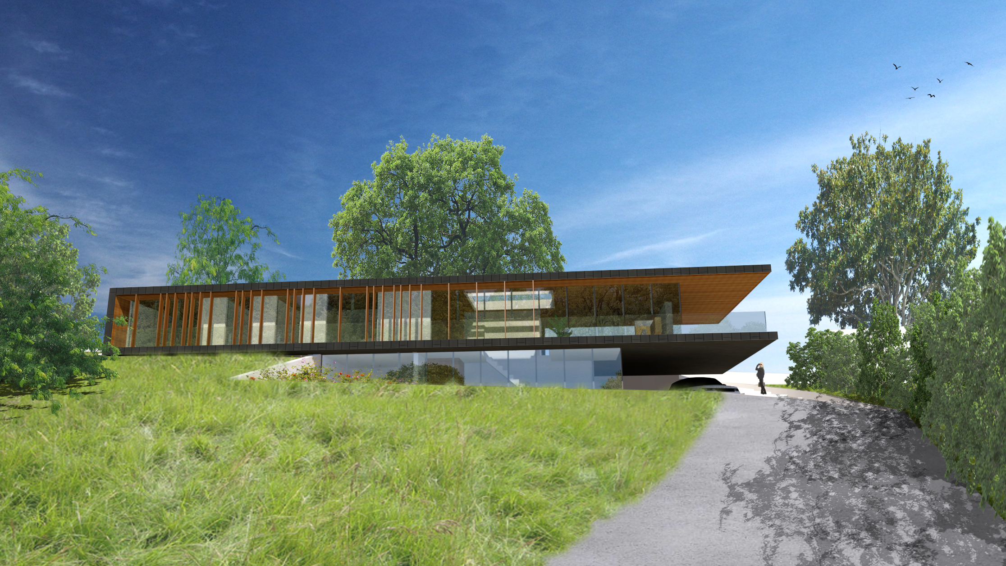
Top tips on appointing your design team
Interview each profession required, ask for references and look into previous work.
Provide your detailed brief to anyone you require a quote from.
Obtain written quotes & ensure they are fixed fees – don’t go for % of construction cost quotes!
Speak to professionals who regularly handle your type of project – Self Build specialists can give you the best advice! These professionals will be part of your life for at least 18 months, so you need a good relationship too!
Don’t fight costs down too much; you want a good service – they are a business after all!
If the relationship turns sour, be aware of your options for parting ways!

Slide 30
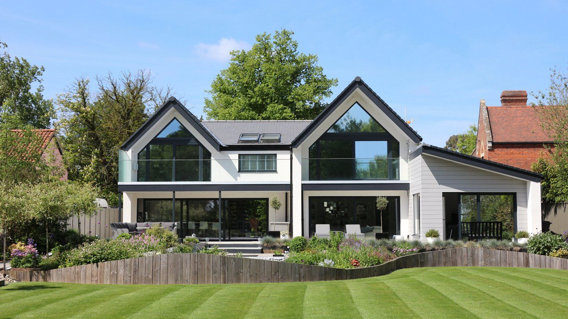
BUILDING YOUR DREAM

Slide 31
Refinement of brief -
Evolving document
Incorporate changes as knowledge increases
Top priorities

Slide 32
Initial design & planning stage -
Initial design variations - based upon brief, site conditions and programme
Review of design variations to agree a final revision – 2D and 3D visualisation
Consideration of structural design and other systems to provide economy of layout and form
Design with a construction method in mind
Work up a full set of initial design drawings to planning level
Completion of external rendered images – key to planning success
Complete all support documentation required to lodge a planning application

Slide 33
Technical design (regs & production) -
Technical review, investigation and documentation of various construction methods
Integration of Structural Engineers design information
Confirmation of heating requirements, energy performance and SAP calculation – resulting in draft EPC
Completion of building regulations drawings and submit application
Discharge relevant Planning Conditions
Guidance on the construction process and procurement routes
Development of construction drawings and integration of specialist designs
Review of building kit and windows/ doors package

Slide 34
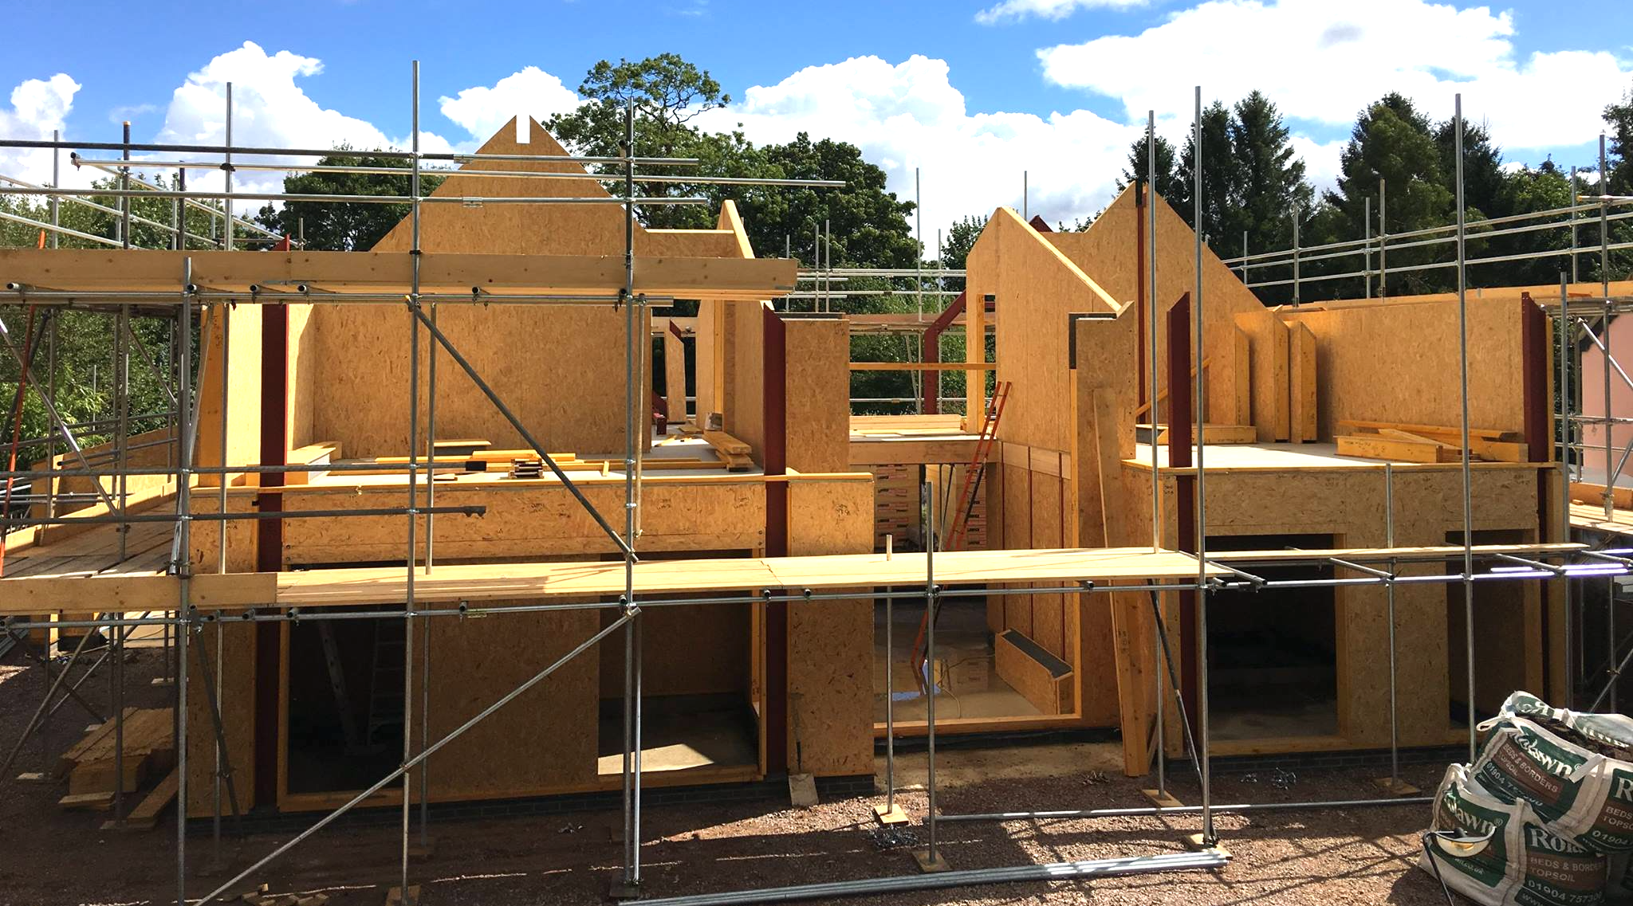
On site -
Confirmation that all planning and building control conditions have been released.
Site Inspections/ Toolbox talks
Issue of CML mortgage Certificates to release Mortgage payments
Interim through to Completion Certification
1 year inspection to confirm making good of defects.

Slide 35
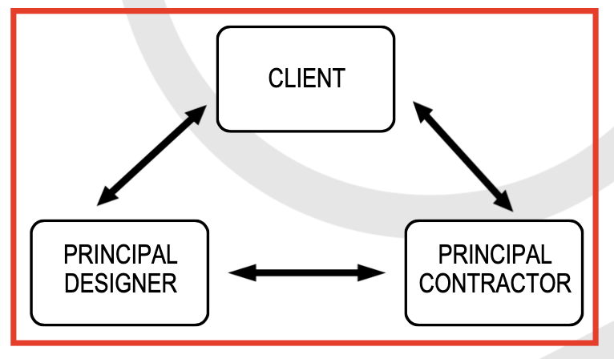
CDM 2015-
The Client has overall responsibility for the successful management of the project and is supported by the Principal Designer and Principal Contractor in different phases of the project.
The Principle Designer will:-
Provide pre-construction information to appointed designers and Principal Contractor
Assist the client in provision of pre-construction information
Gather information for the Health and Safety File
Liaise with the Principal Contractor
Update to CDM Matrix where design work is carried out after the construction phase has commenced

Slide 36
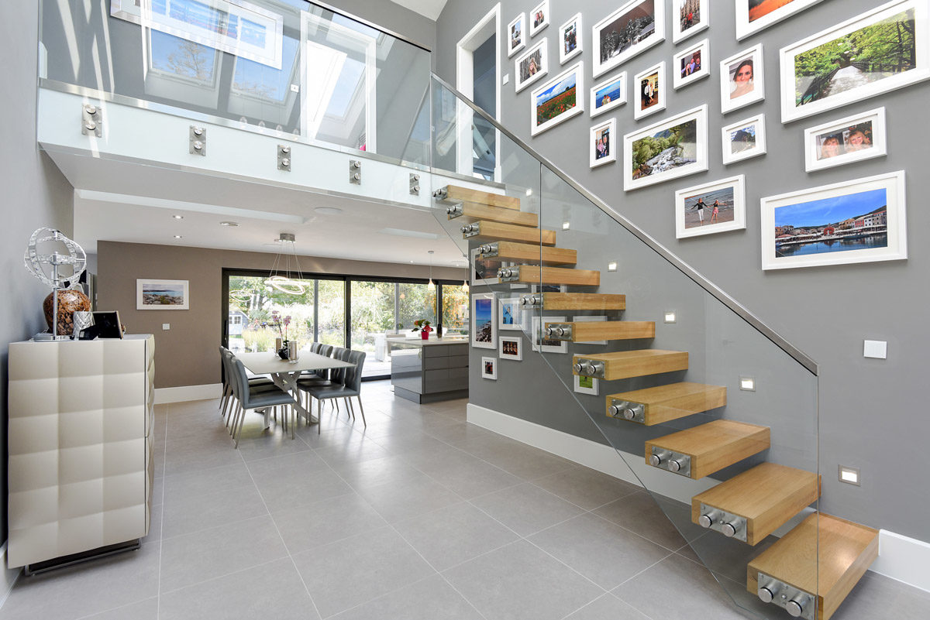
TOP TIPS
Do your research about potential sites.
Develop your brief early on and commit to it.
Be the best self-builder or client you can be!
Prioritise your goals and integrate from the outset.
Hire the right team to design in more complicated features.
Notes:
Thank you for your attention during this talk, we will next welcome Dave Gallagher of AC Structures to speak about Structural Design considerations from the initial site selection all the way through finished design and construction.

