Slide 1
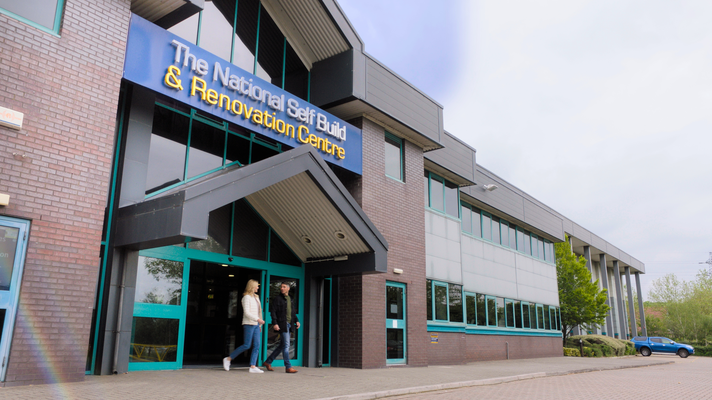
Welcome
26 April 2024
Harvey Fremlin, Managing Director

Slide 2
Number of people self-building in UK: Currently around 8-9,000 Usually about 10-13,000 each year (around 10% of the housing market) It should (and could) be more!

Slide 3
Self Build in the UK

Slide 4
Let’s start with why.

Slide 6
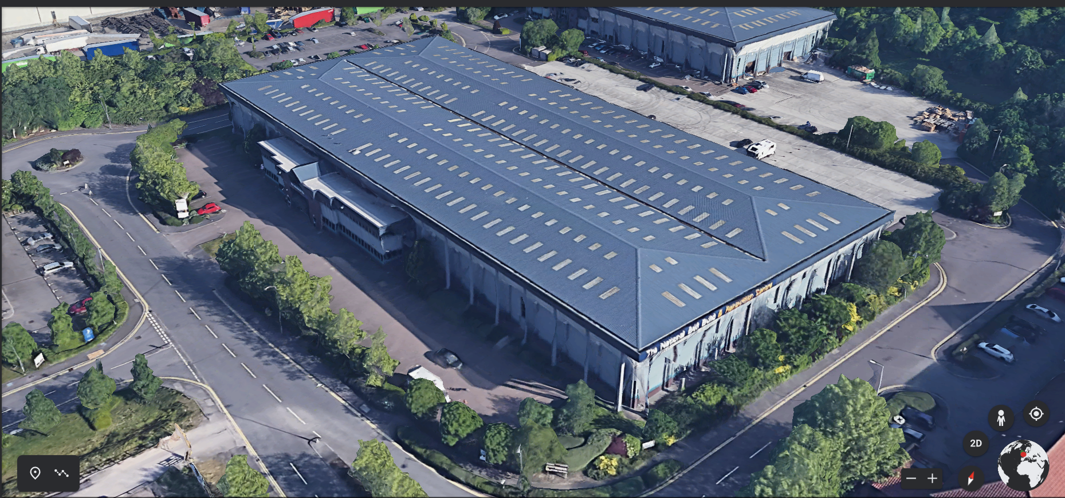

Slide 12
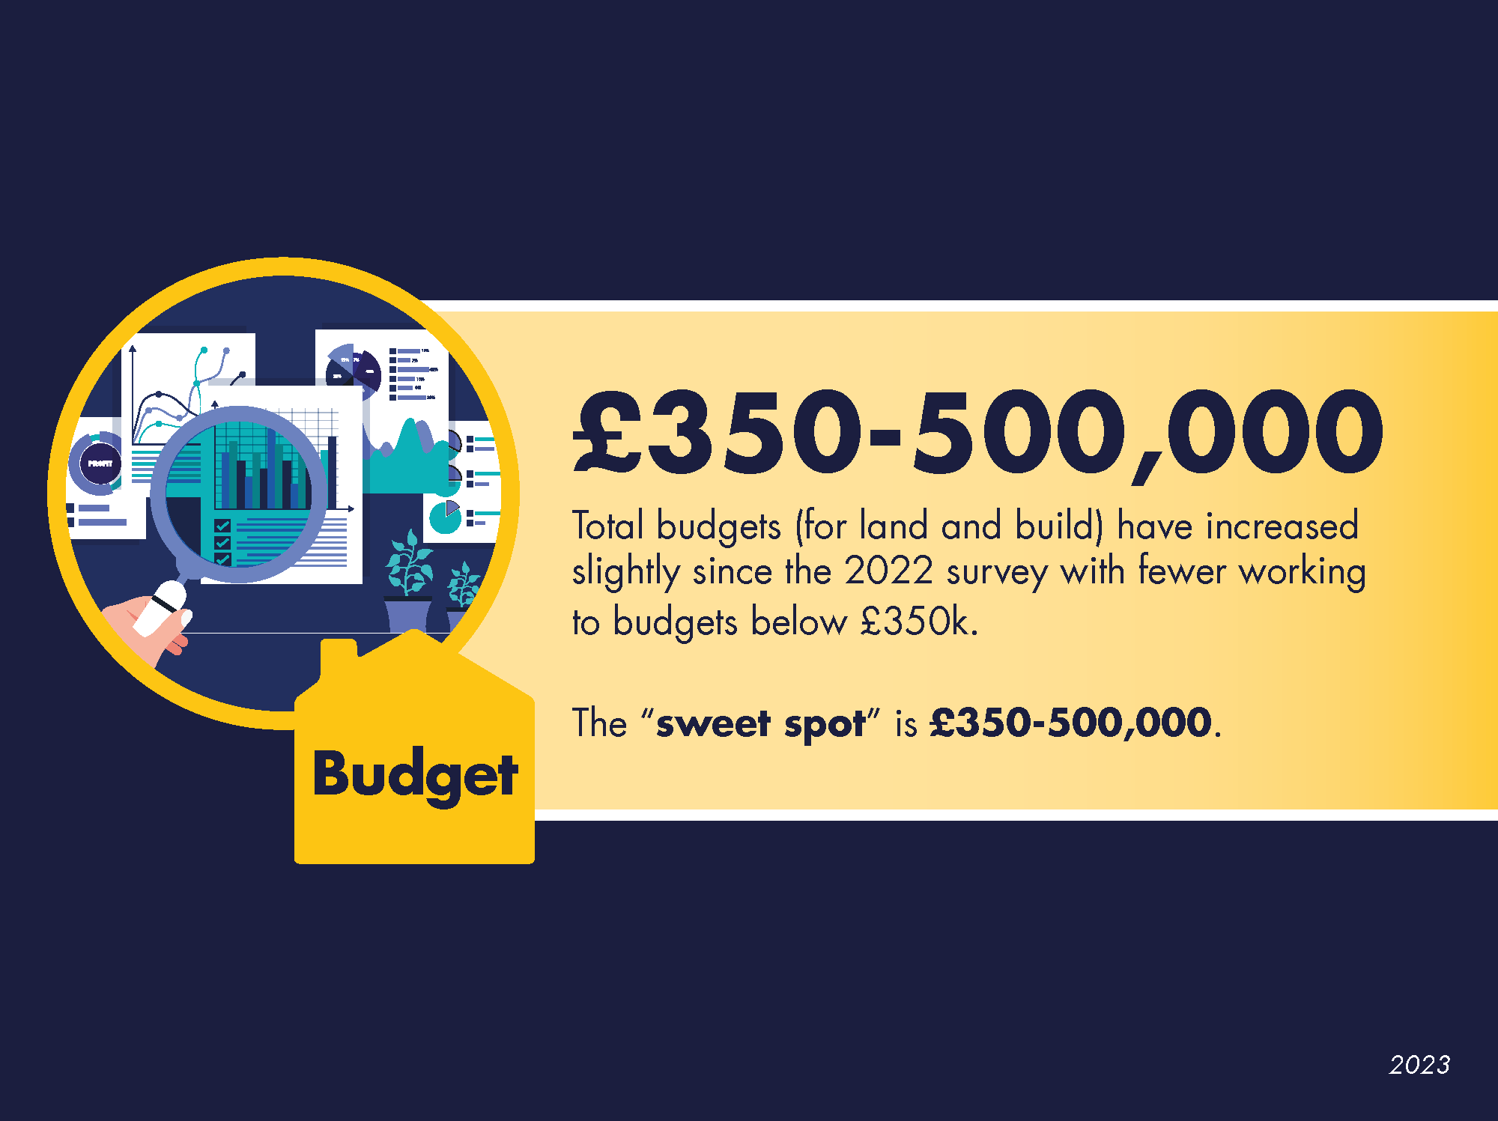

Slide 18
Research, Research, Research!
Ensure you have the right team around you.
Professionals who understand the aims for your project.
Are they interested (before being interesting)?
Are they prepared to offer constructive feedback?
Understand your budget AT THE VERY BEGINNING.
How can a designer design, without knowing the budget?

Slide 19
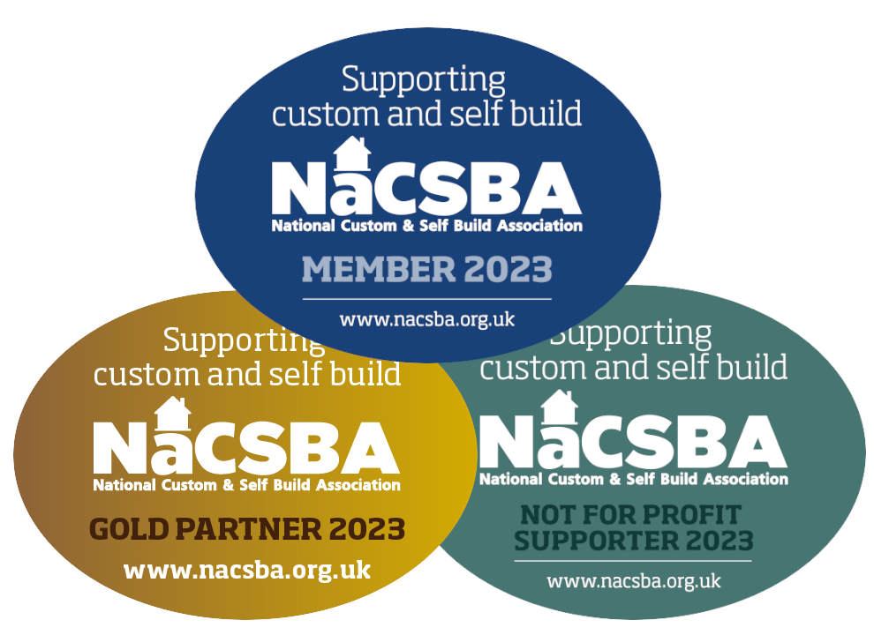
Things to look out for
Longevity in the market – Does the business understand self-builder’s requirements and are they equipped to communicate in a way you’ll understand – AND – be prepared to offer more support than a ‘trader’
Are they a member of a trade association or trusted group?

Slide 21
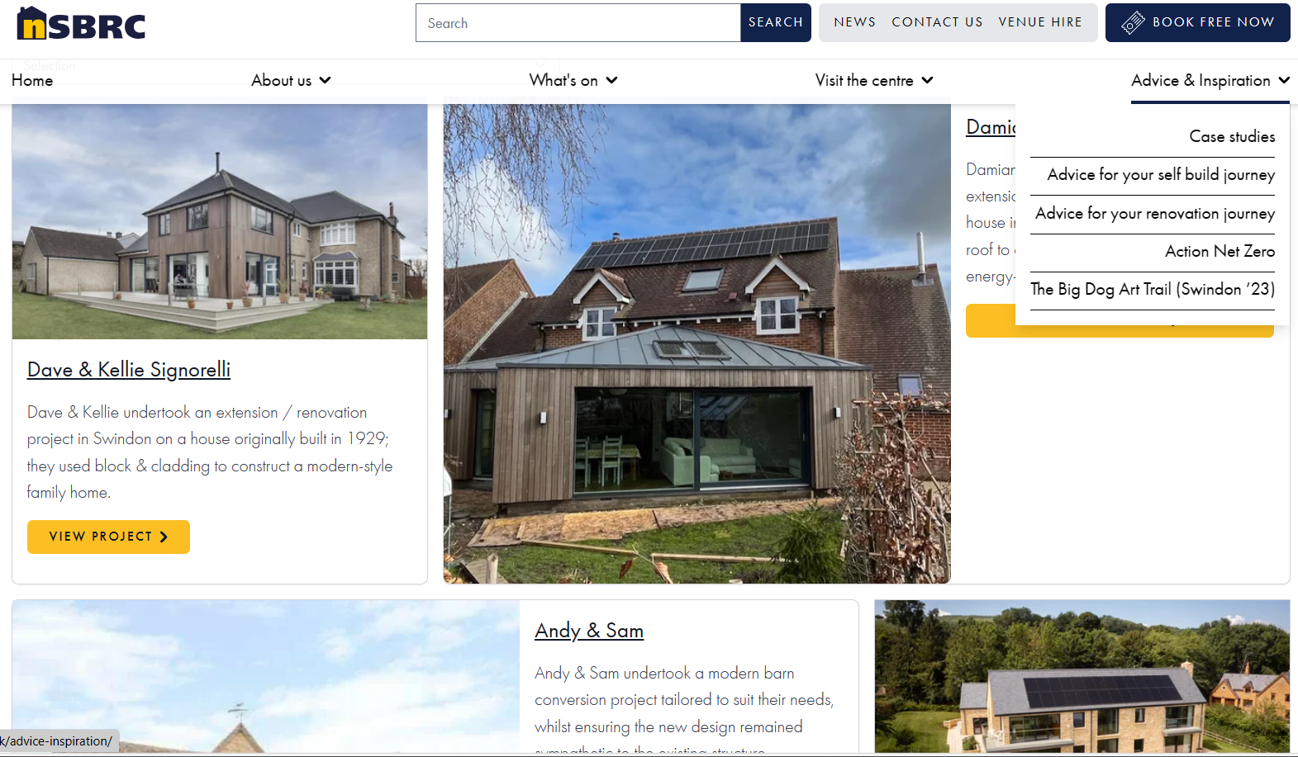

Slide 24
Thank you
Harvey Fremlin
Managing Director
harvey.fremlin@nsbrc.co.uk
nsbrc.co.uk

